Slide 1
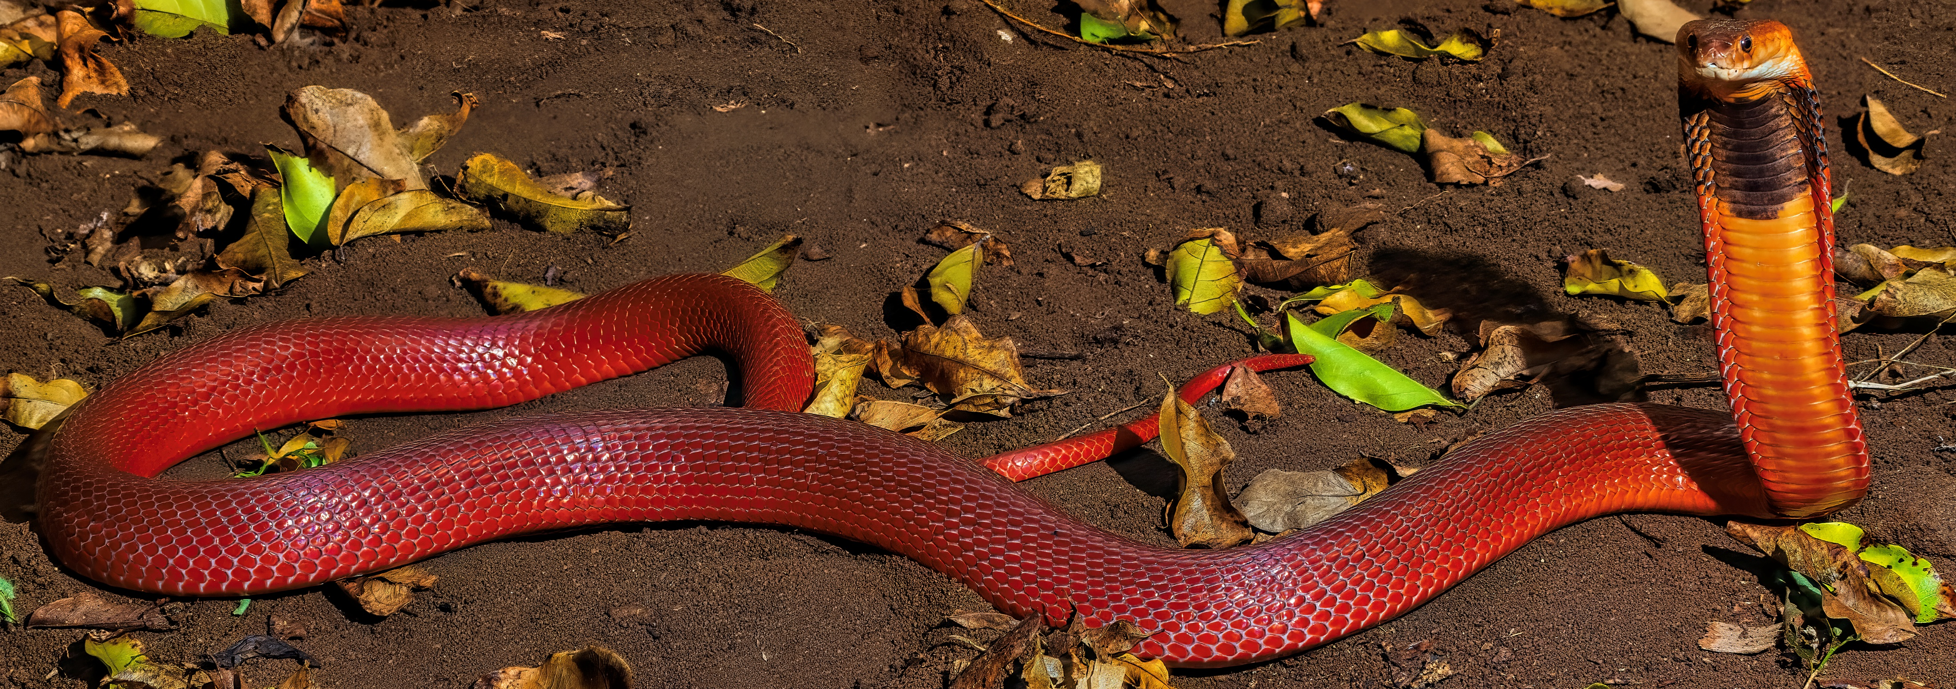
Epidemiological profiles, antivenom use and treatment outcomes at Kitui County Referral Hospital (November 2024-July 2026)
Caroline Mbangula Jeff¹, John Mungai¹, Victor Kairu¹, Jackson Munyaka¹, David J. Williams², David A. Warrell³
¹ Kitui County Referral Hospital, P.O. Box 22-90200, Kitui, Kenya. mbangulacaroline@gmail.com
² Global Snakebite Initiative USA Foundation Inc, Belmont, CA, United States of America.
³ Nuffield Centre for Tropical Medicine, Oxford University, Oxford, United Kingdom.

Slide 2
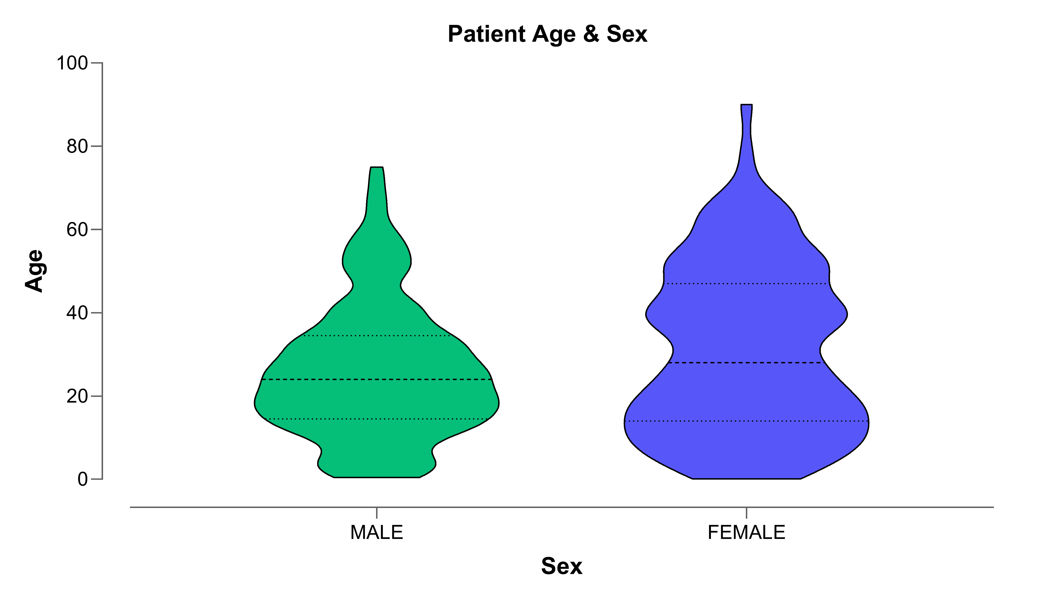
Snakebite cases admitted to KCRH (5/11/24-1/7/26)
Kitui County (population: ~1.22 million), in central-eastern Kenya, snakebite envenoming is a common medical emergency with an estimated annual incidence of 695.6 cases/100,000 (95% CI: 636.9-754.2/100,00).
Kitui County Referral Hospital (KCRH) is a 204-bed Level 5 facility that offers comprehensive medical and surgical services, including intensive care and high dependency units capable of managing snakebite cases.
Between 5 November 2024 and 1 July 2026, a total of 250 patients were admitted with real or suspected snakebites.
These included:
  141 males (median: 24.0 years, IQR: 15.0-34.0 years)
  109 females (median: 28.0 years, IQR: 14.0-46.0 years).
The youngest patient was a 1-month-old female, and the oldest was a 90-year-old woman.

Slide 3
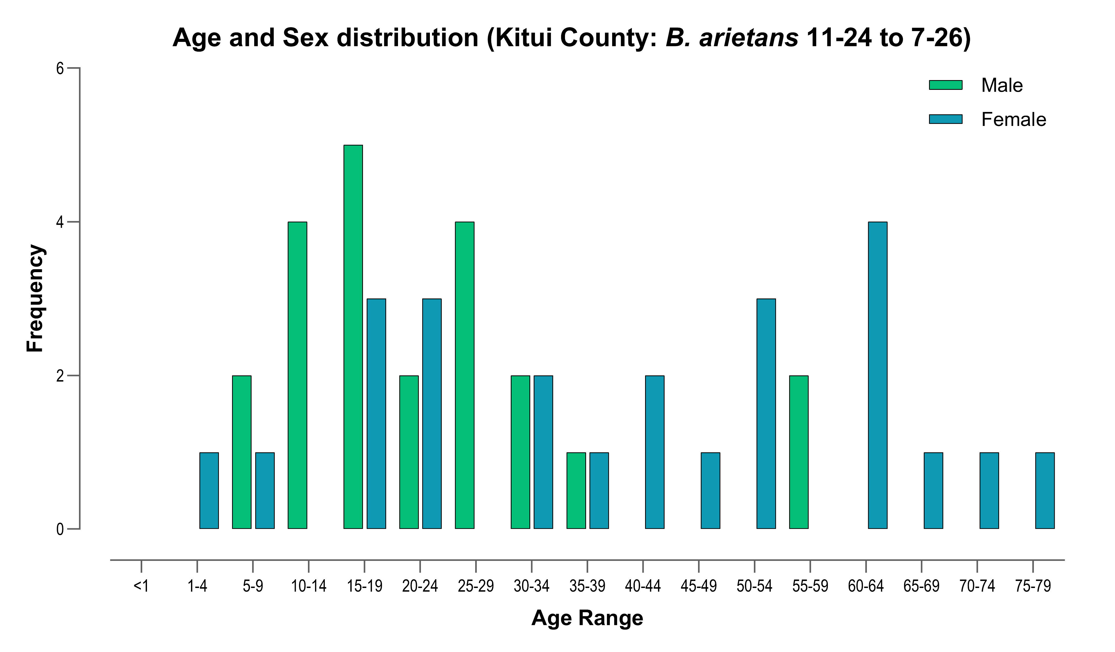
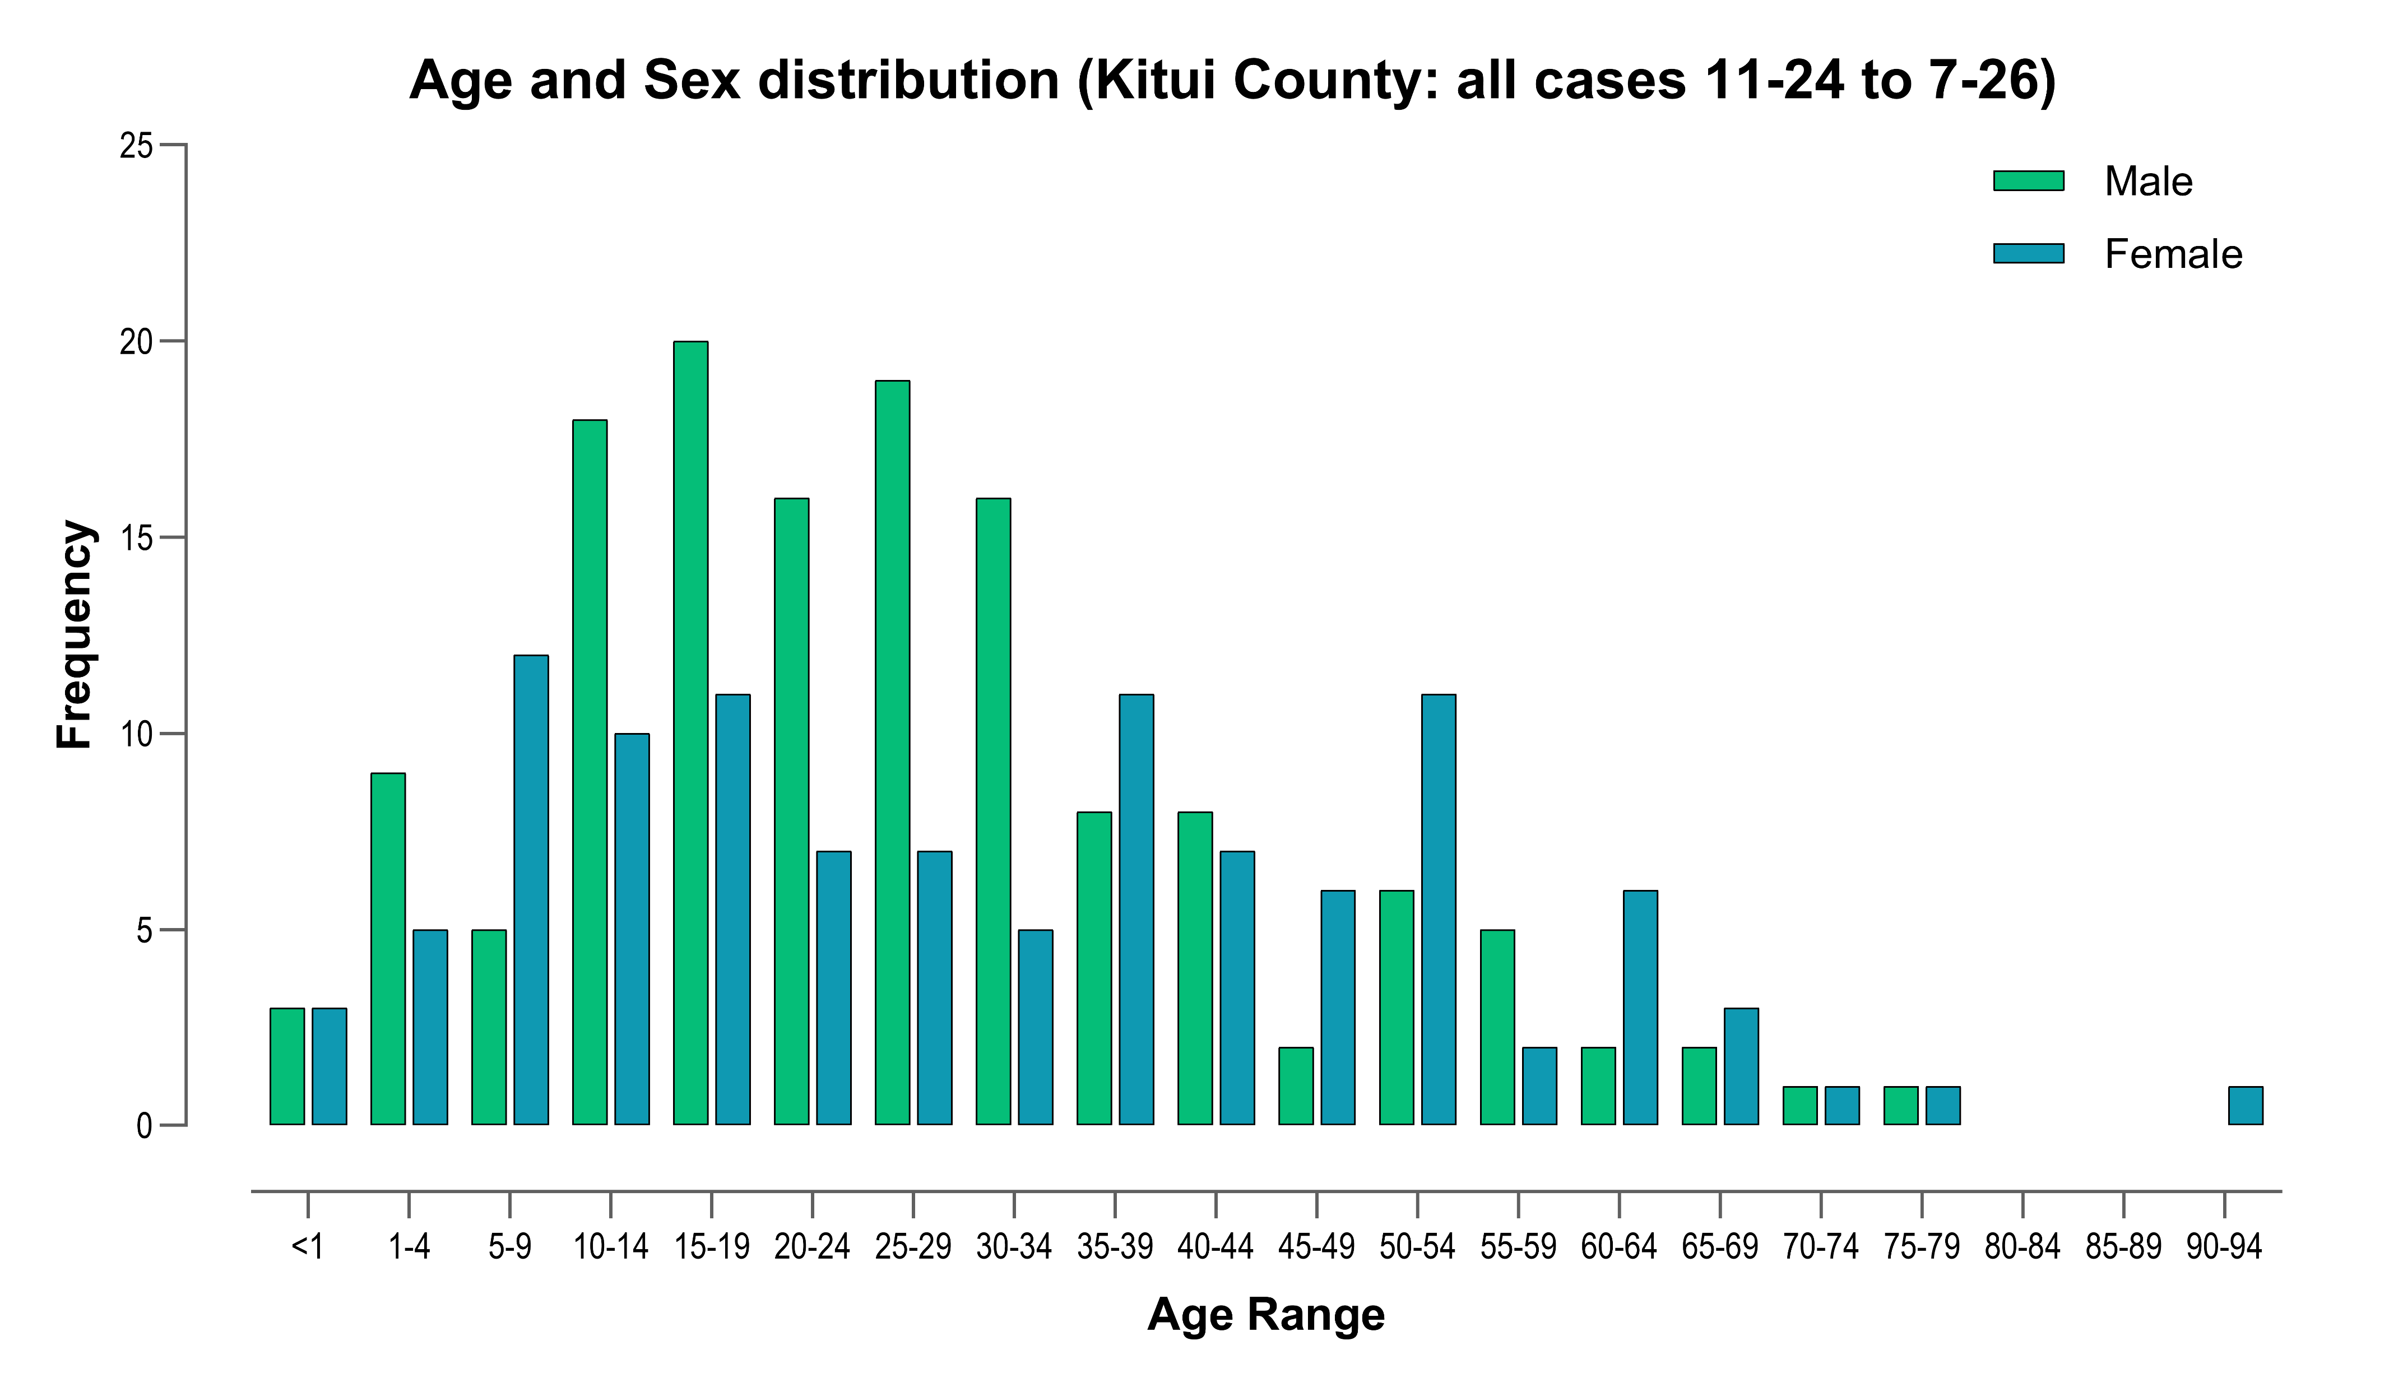
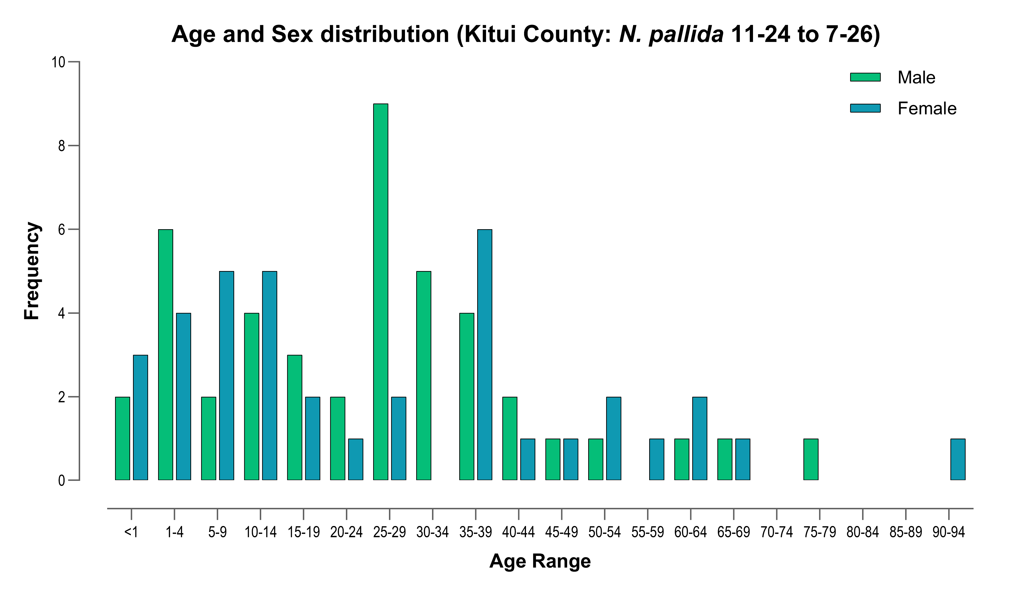
Age profiles
For males, 74.5% occur between 10-44 years, whereas for females, 74.3% were bitten between 5-54 years of age.
68.2% of Bitis arietans bites in males 10-29 years of age, whereas for females 66.7% of bites occurred between 30-79 years age.
For cobra bites, 84.0% of bites in males were 0-39 years of age, and for females, 75.7% were aged 0-39 years.

Slide 4
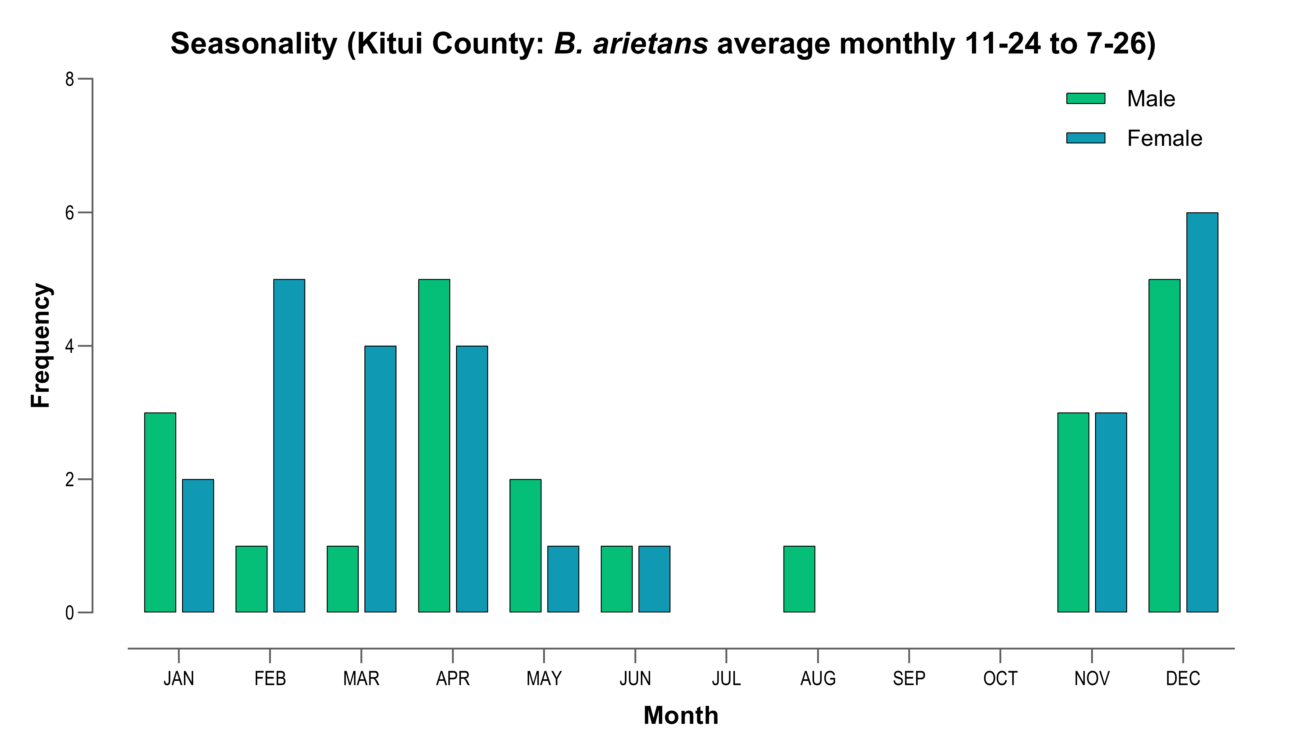
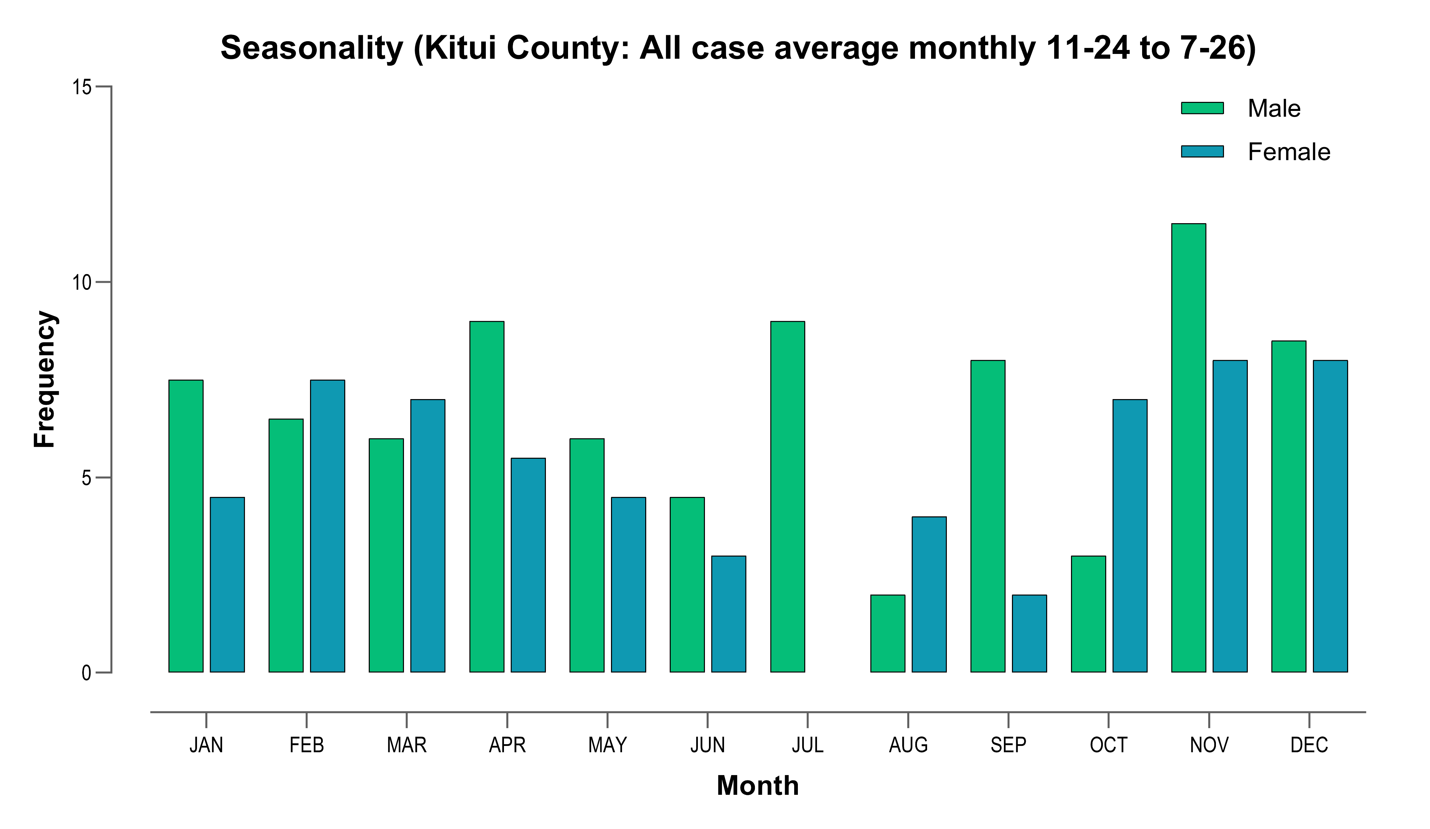
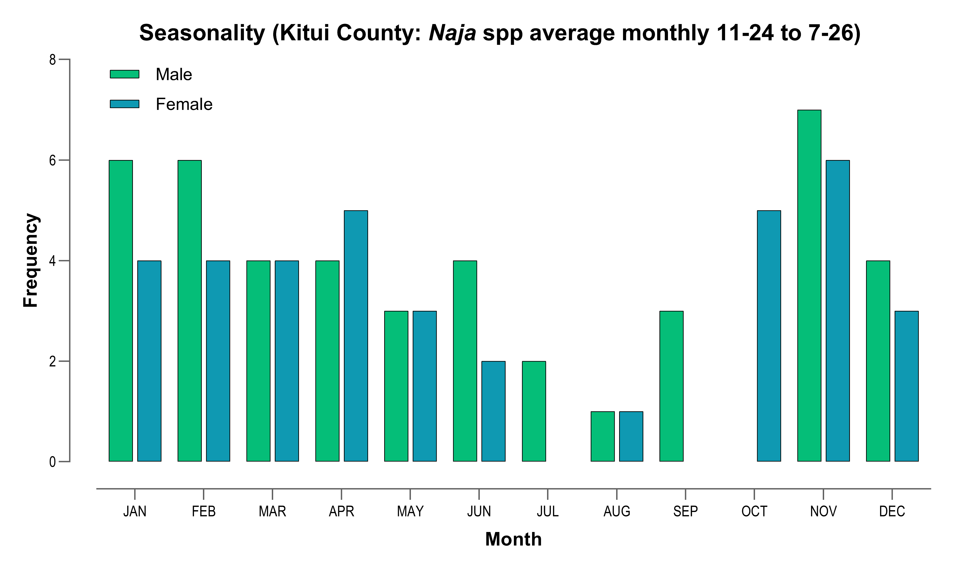
Seasonality
The average number of monthly cases is significantly higher (t=2.92, p=0.007) in the wet season:
13.4 cases/month (95% CI: 10.9-16.0 cases) in wet season (Nov-Jun).
8.8 cases/month (95% CI: 6.9-10.6 cases) in the dry season (Jul-Oct).

Slide 5
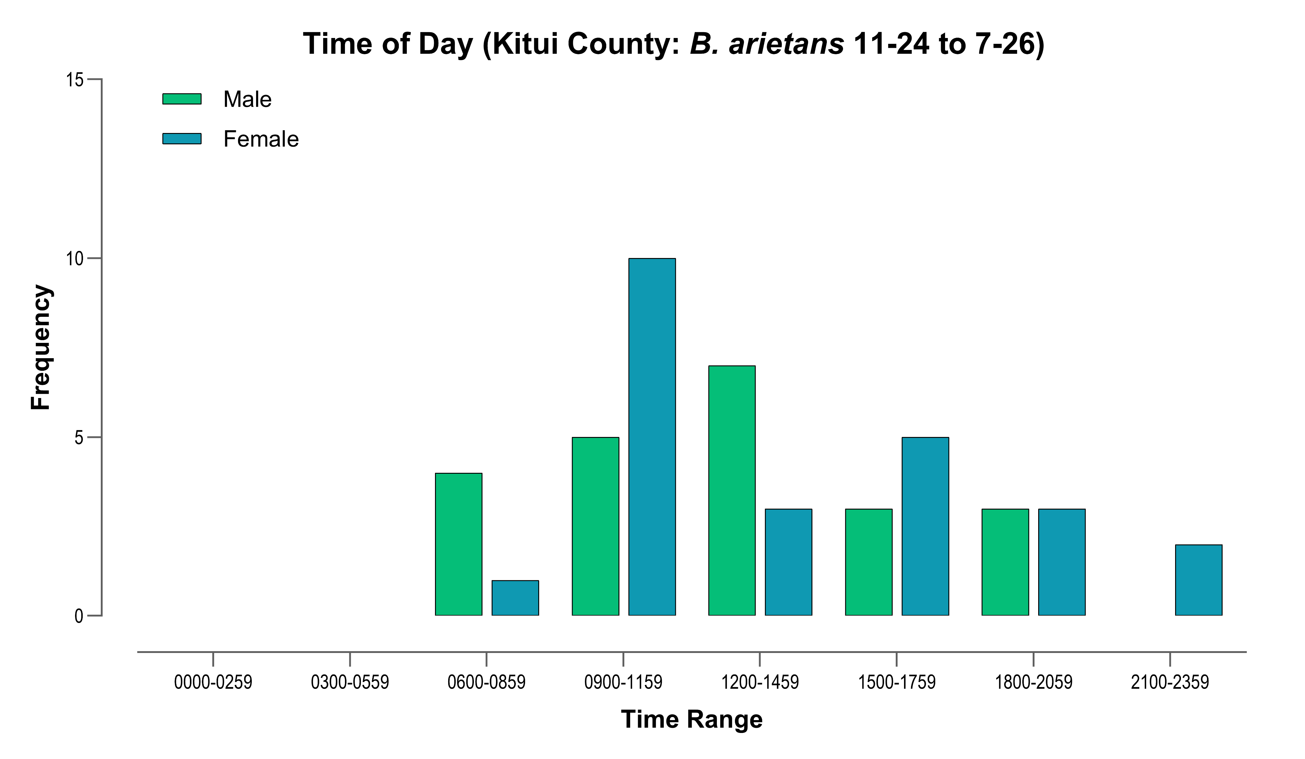
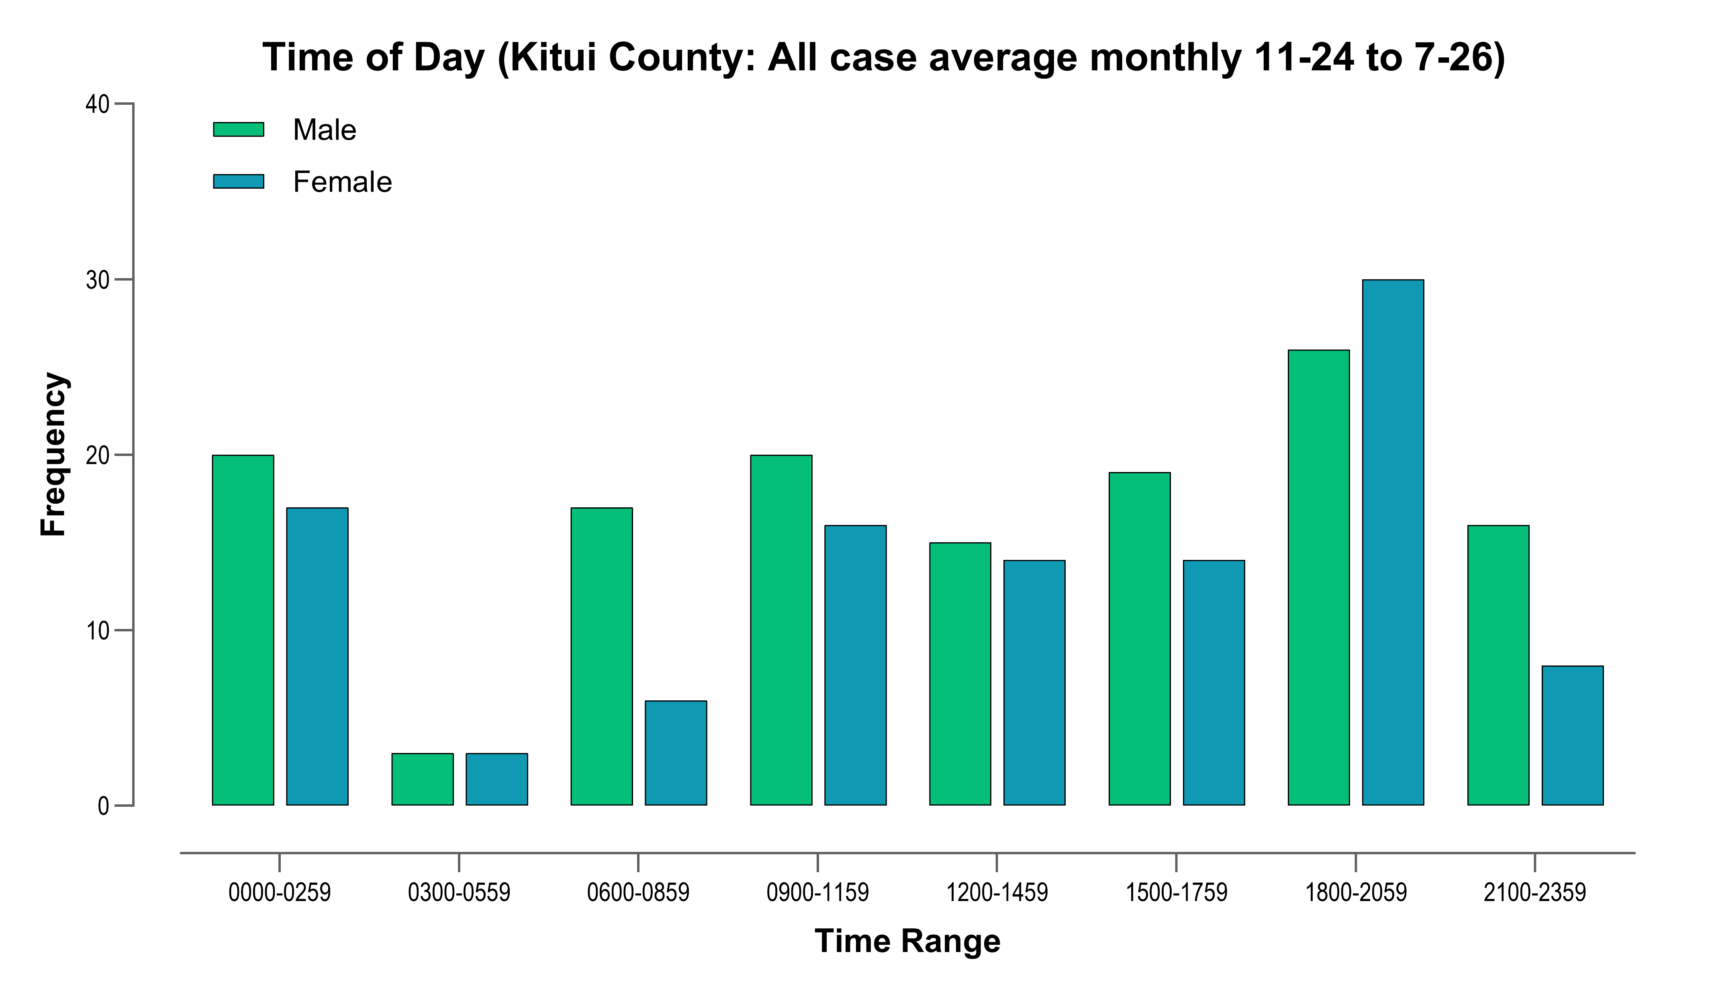
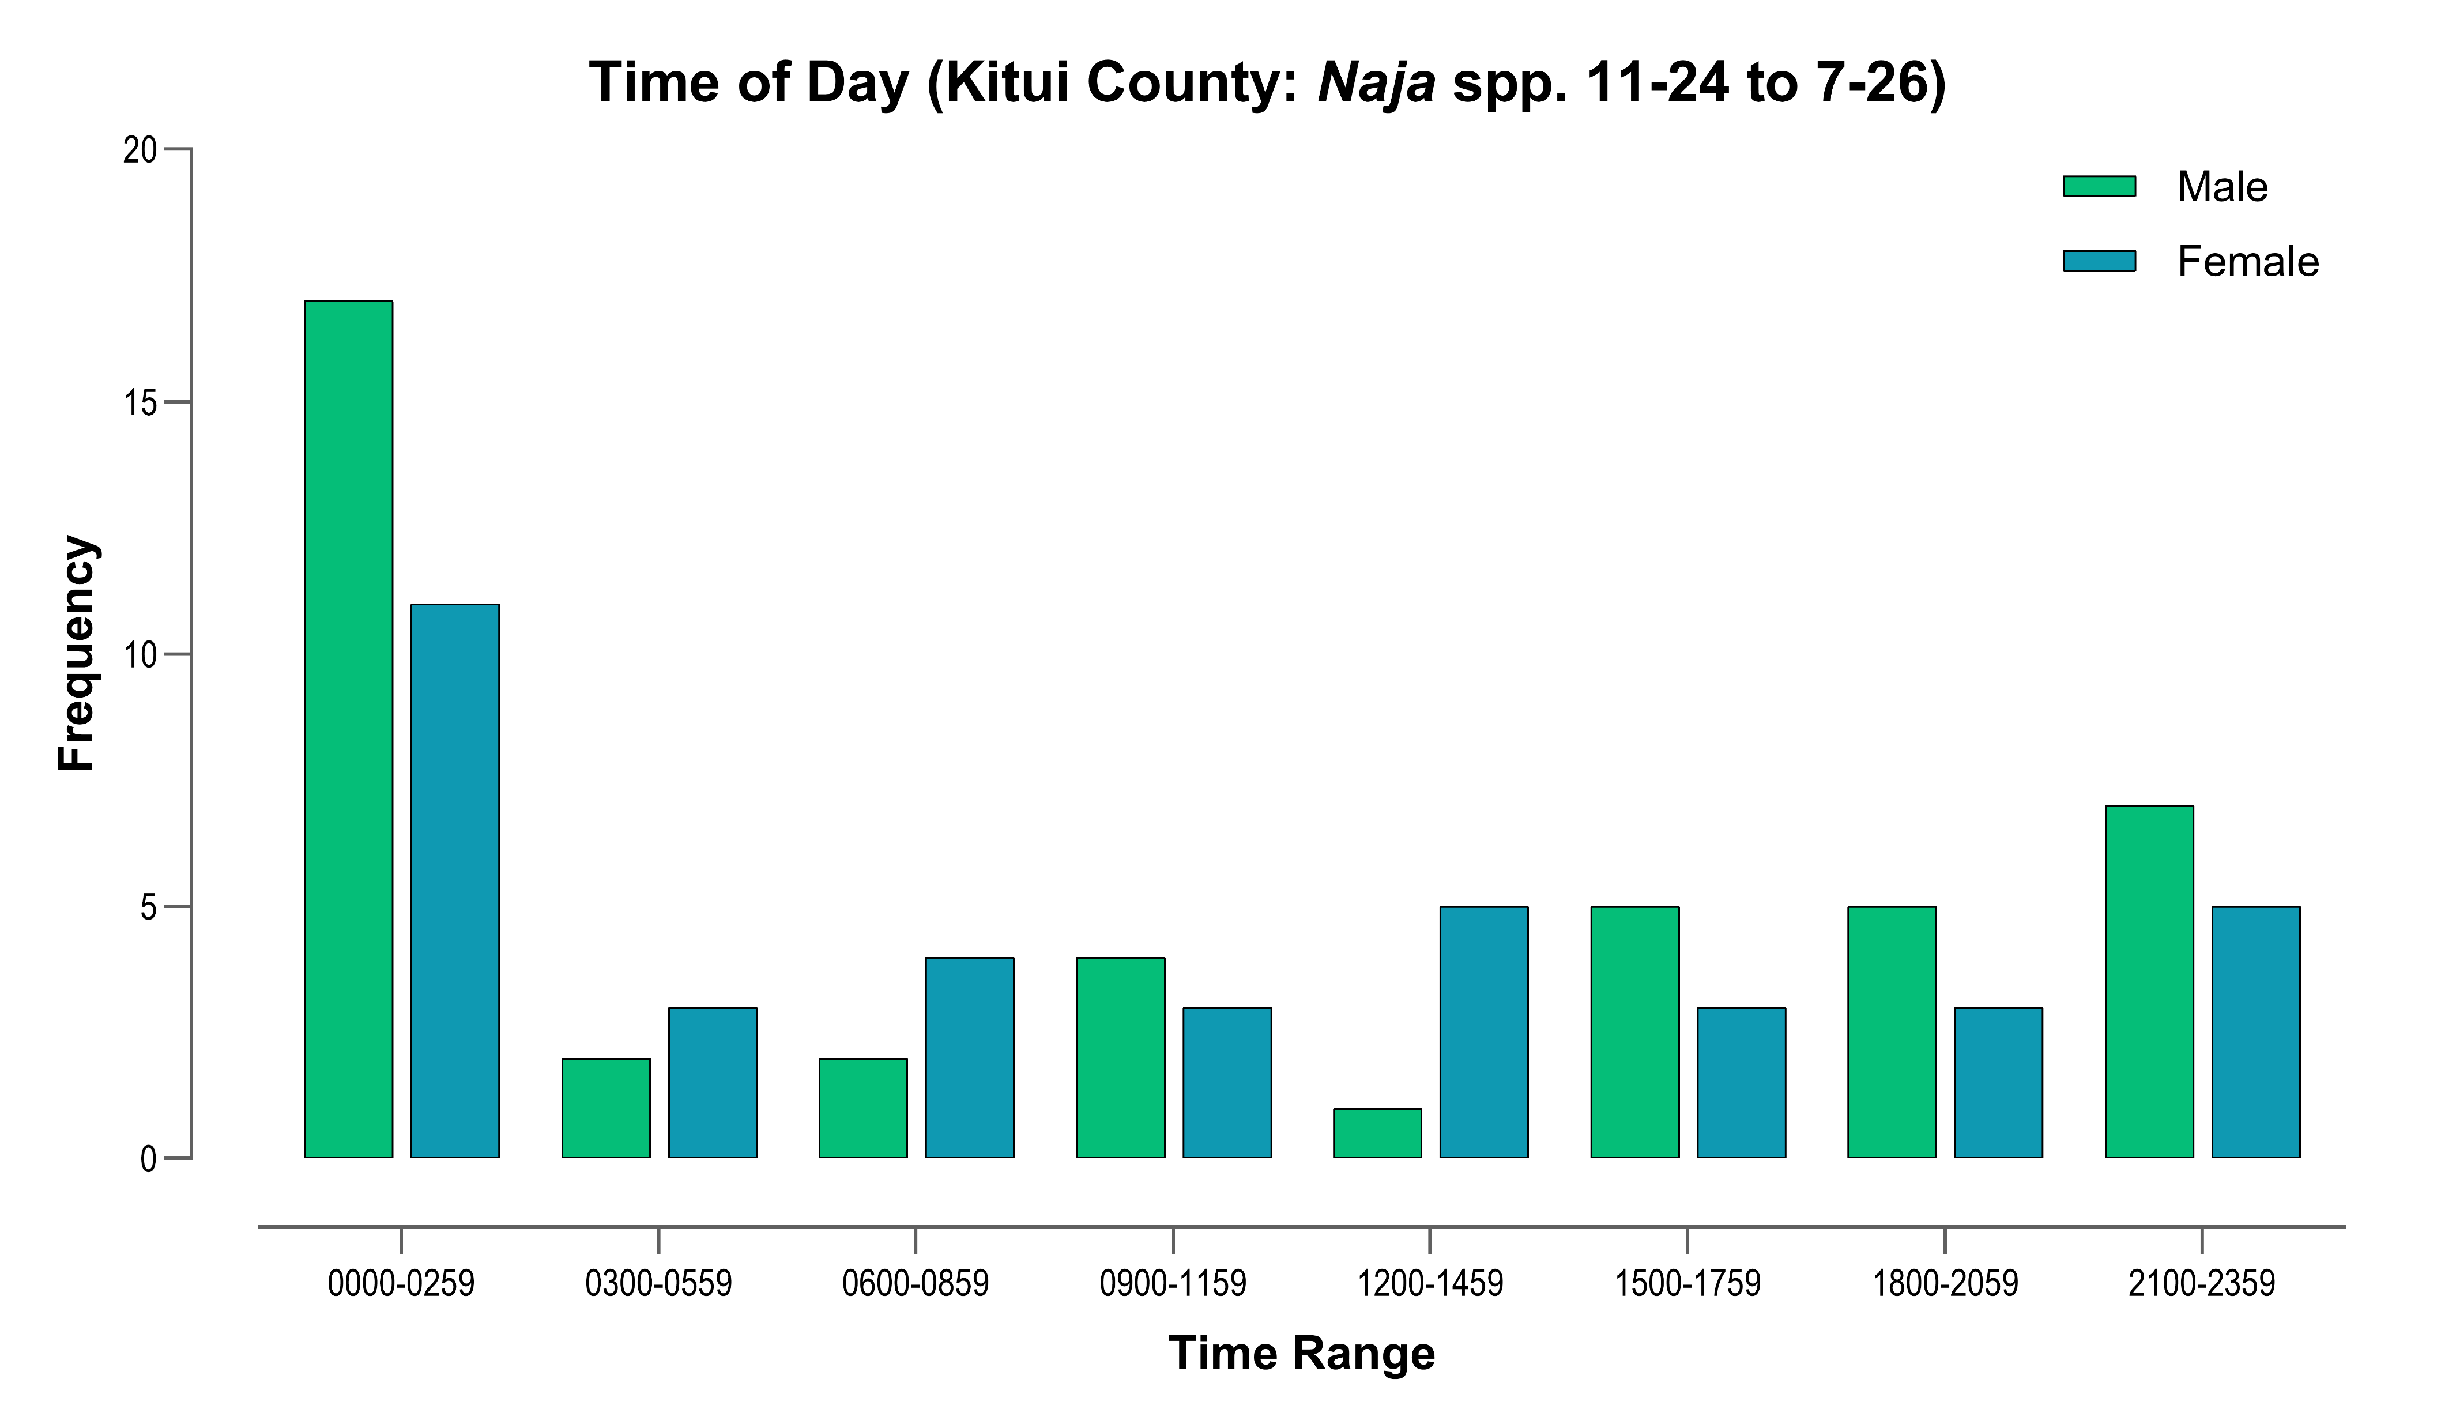
Time of Day
For cases where the time of bite was known (n=244) there was almost equal distribution between day and night:
50.4% occurred at night (18:01-06:00 hours), with the majority of these (95.1%) occurring between 18:01-02:59 hours.
49.6% occurred during the day (06:01-17:59 hours).
Bites by spitting cobras most frequent between midnight-02:59.

Slide 6
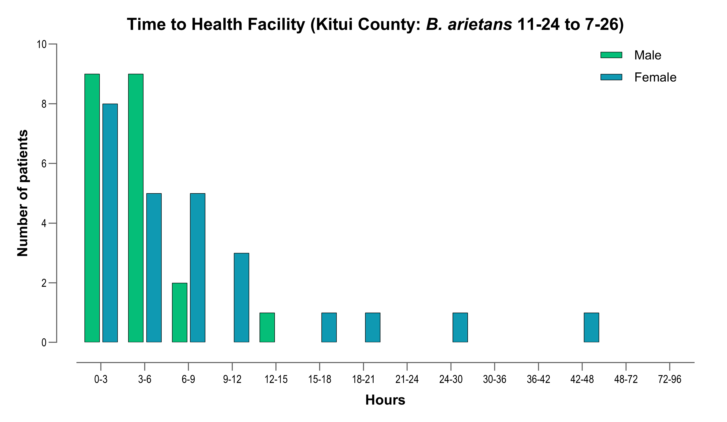
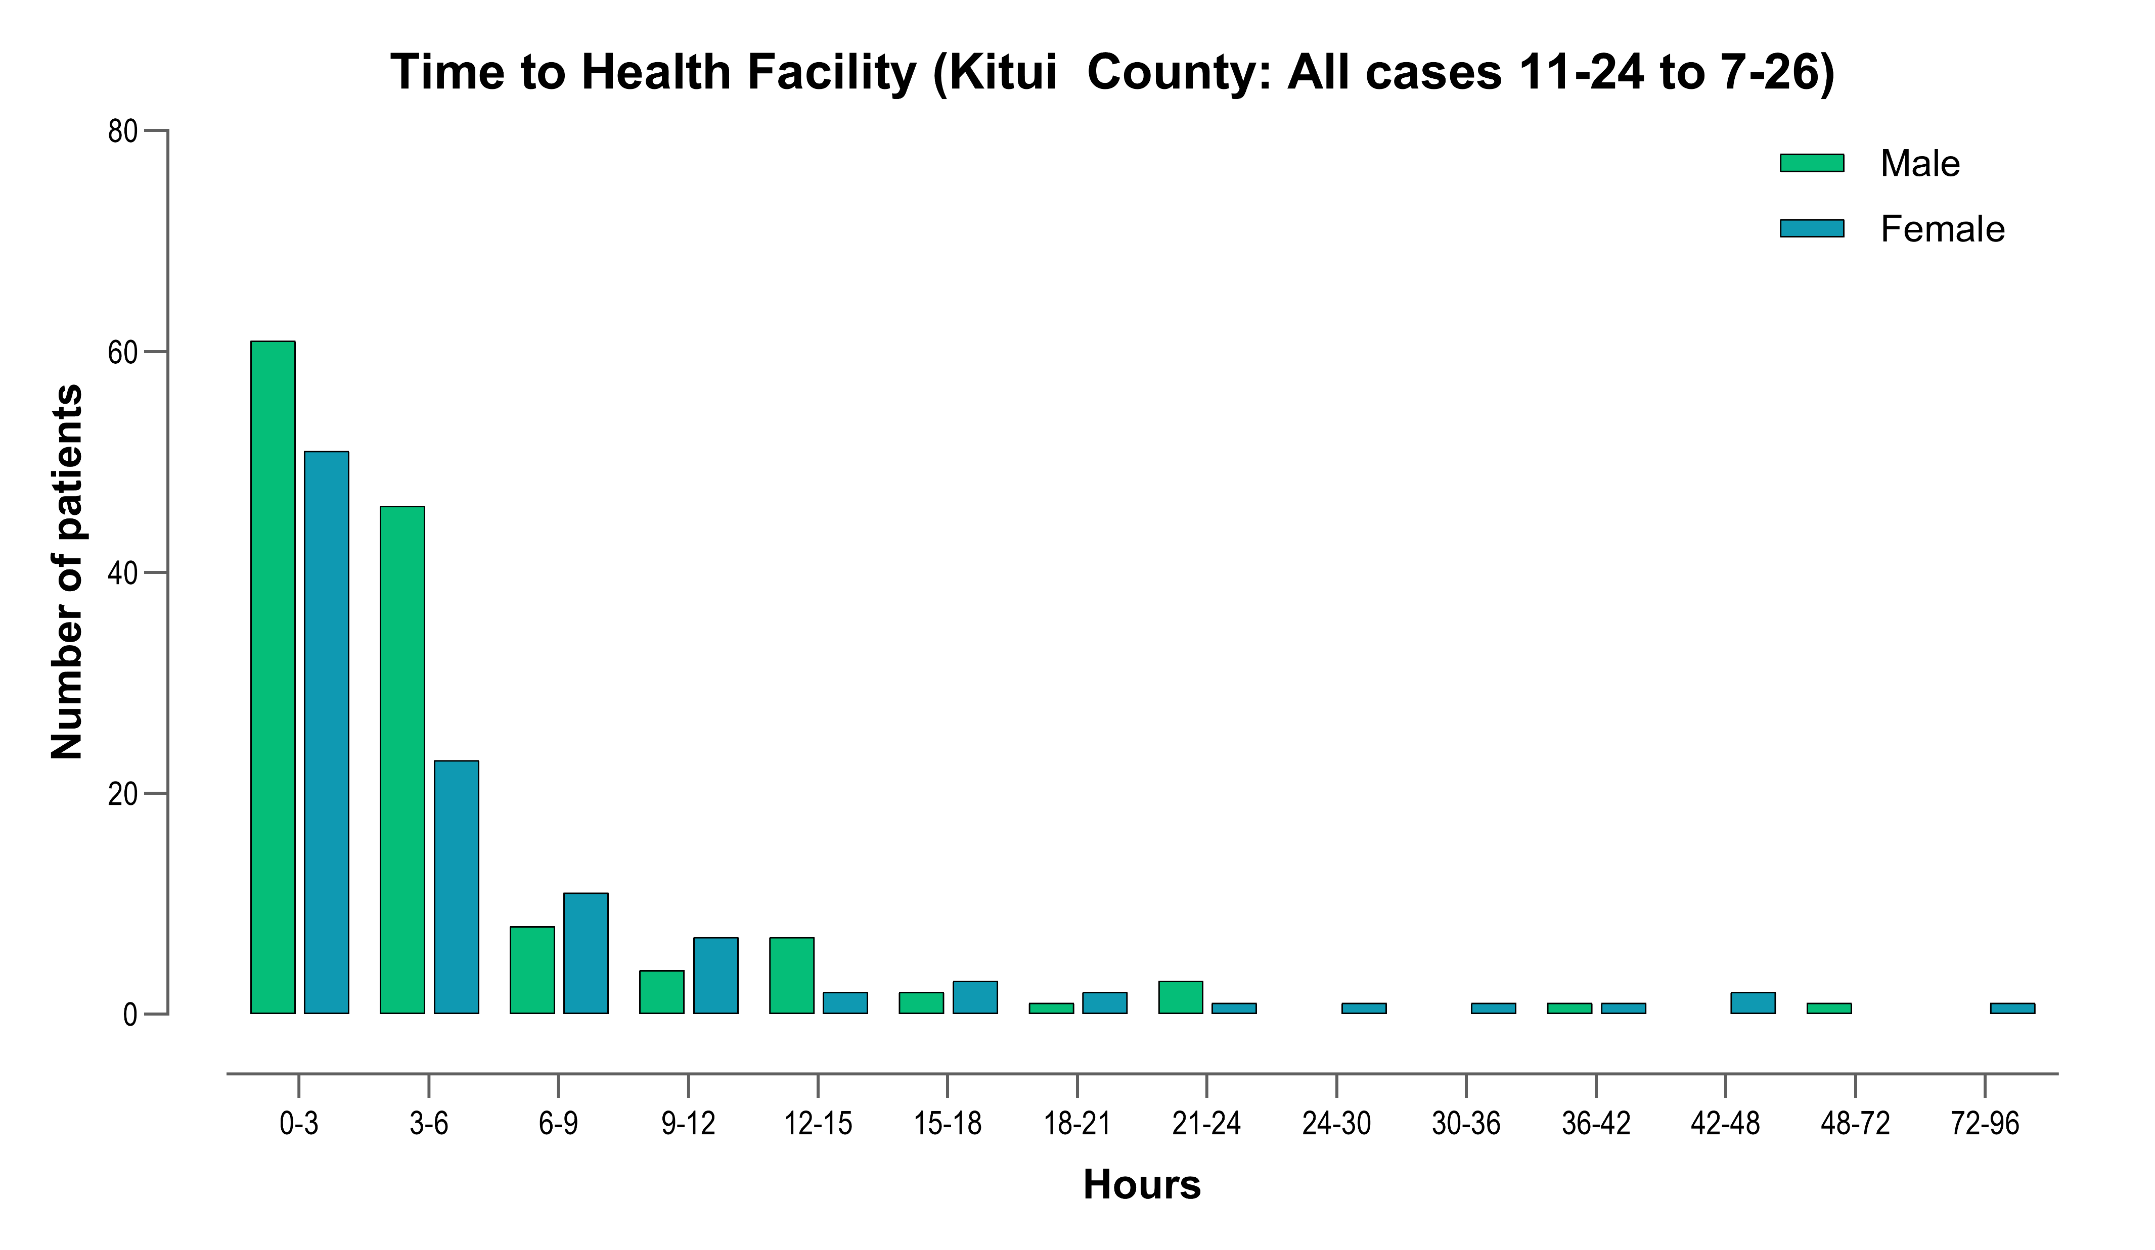
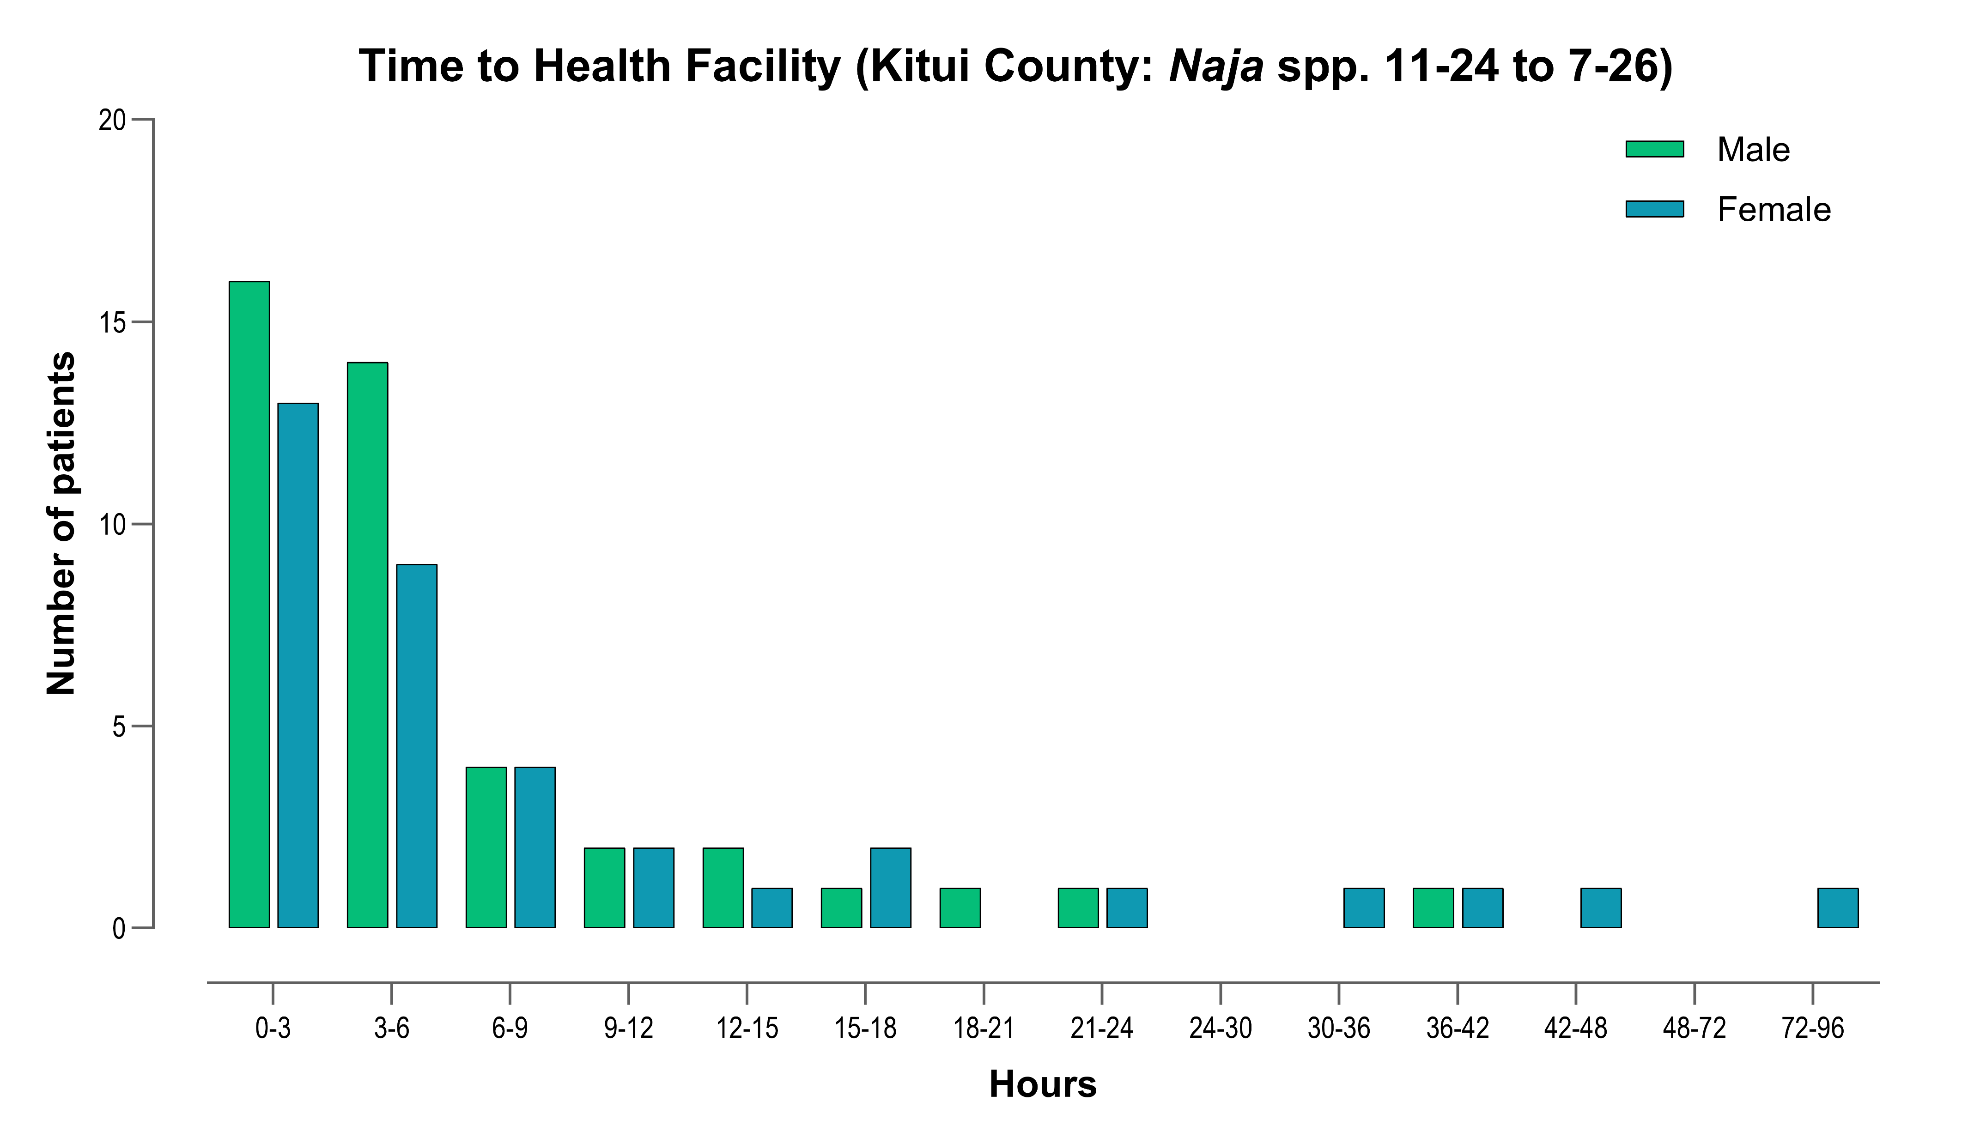
Time from bite to admission
Where the time interval between the bite and presentation to hospital was known (n=240) 79.8% of male and 69.8% of female patients arrived within the first 6 hours (75.4% overall).
For all cases, 96.7% presented within 24 hours, with 2.4% presenting the following day, and 0.8% taking 48-96 hours to arrive.
Early presentation to hospital is a key factor contributing towards better clinical outcomes for patients.

Slide 7
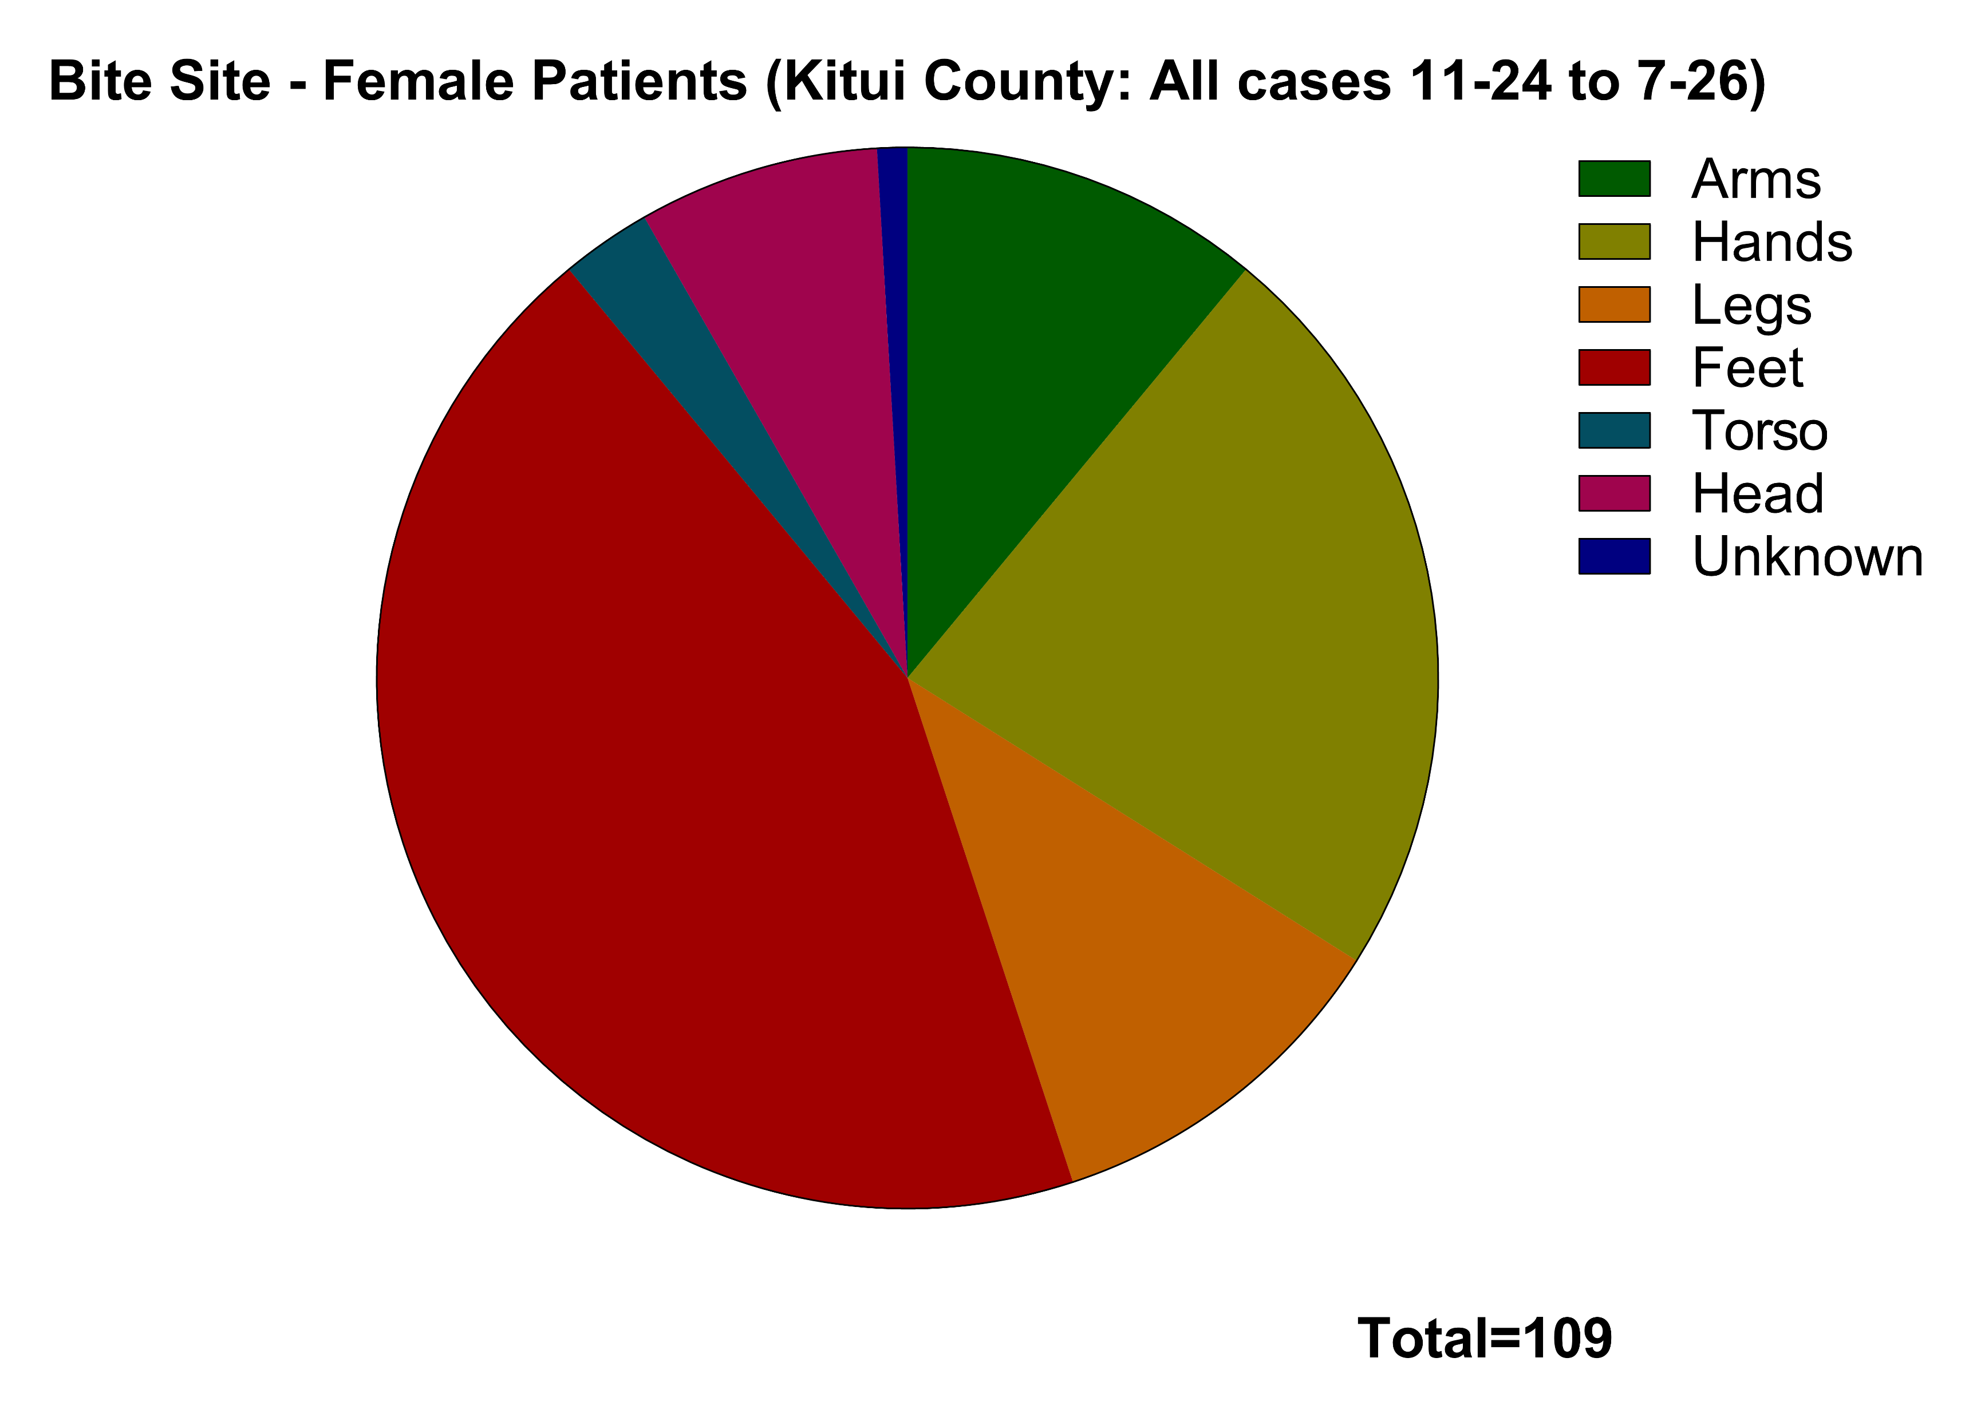
Bite sites
56.5% of all snakebites occurred on the feet, which reinforces the view that more than half of all cases could have been prevented if victims had been wearing shoes.
Another 31.1% involved bites to the hands or arms.
11.9% were on the legs above the ankles.
No significant differences between males and females.

Slide 8
Antivenom use
PANAF-Premium™ antivenom (Premium Serums & Vaccines, India) was administered to a total of 128 patients, with 6 others receiving Afriven™ (VINS Bioproducts, India) subject to availability.
No adverse reactions have been recorded in patients administered PANAF-Premium™, but all 6 patients who received Afriven™ (VINS Bioproducts, India) experienced reactions (without anaphylaxis).

Slide 9
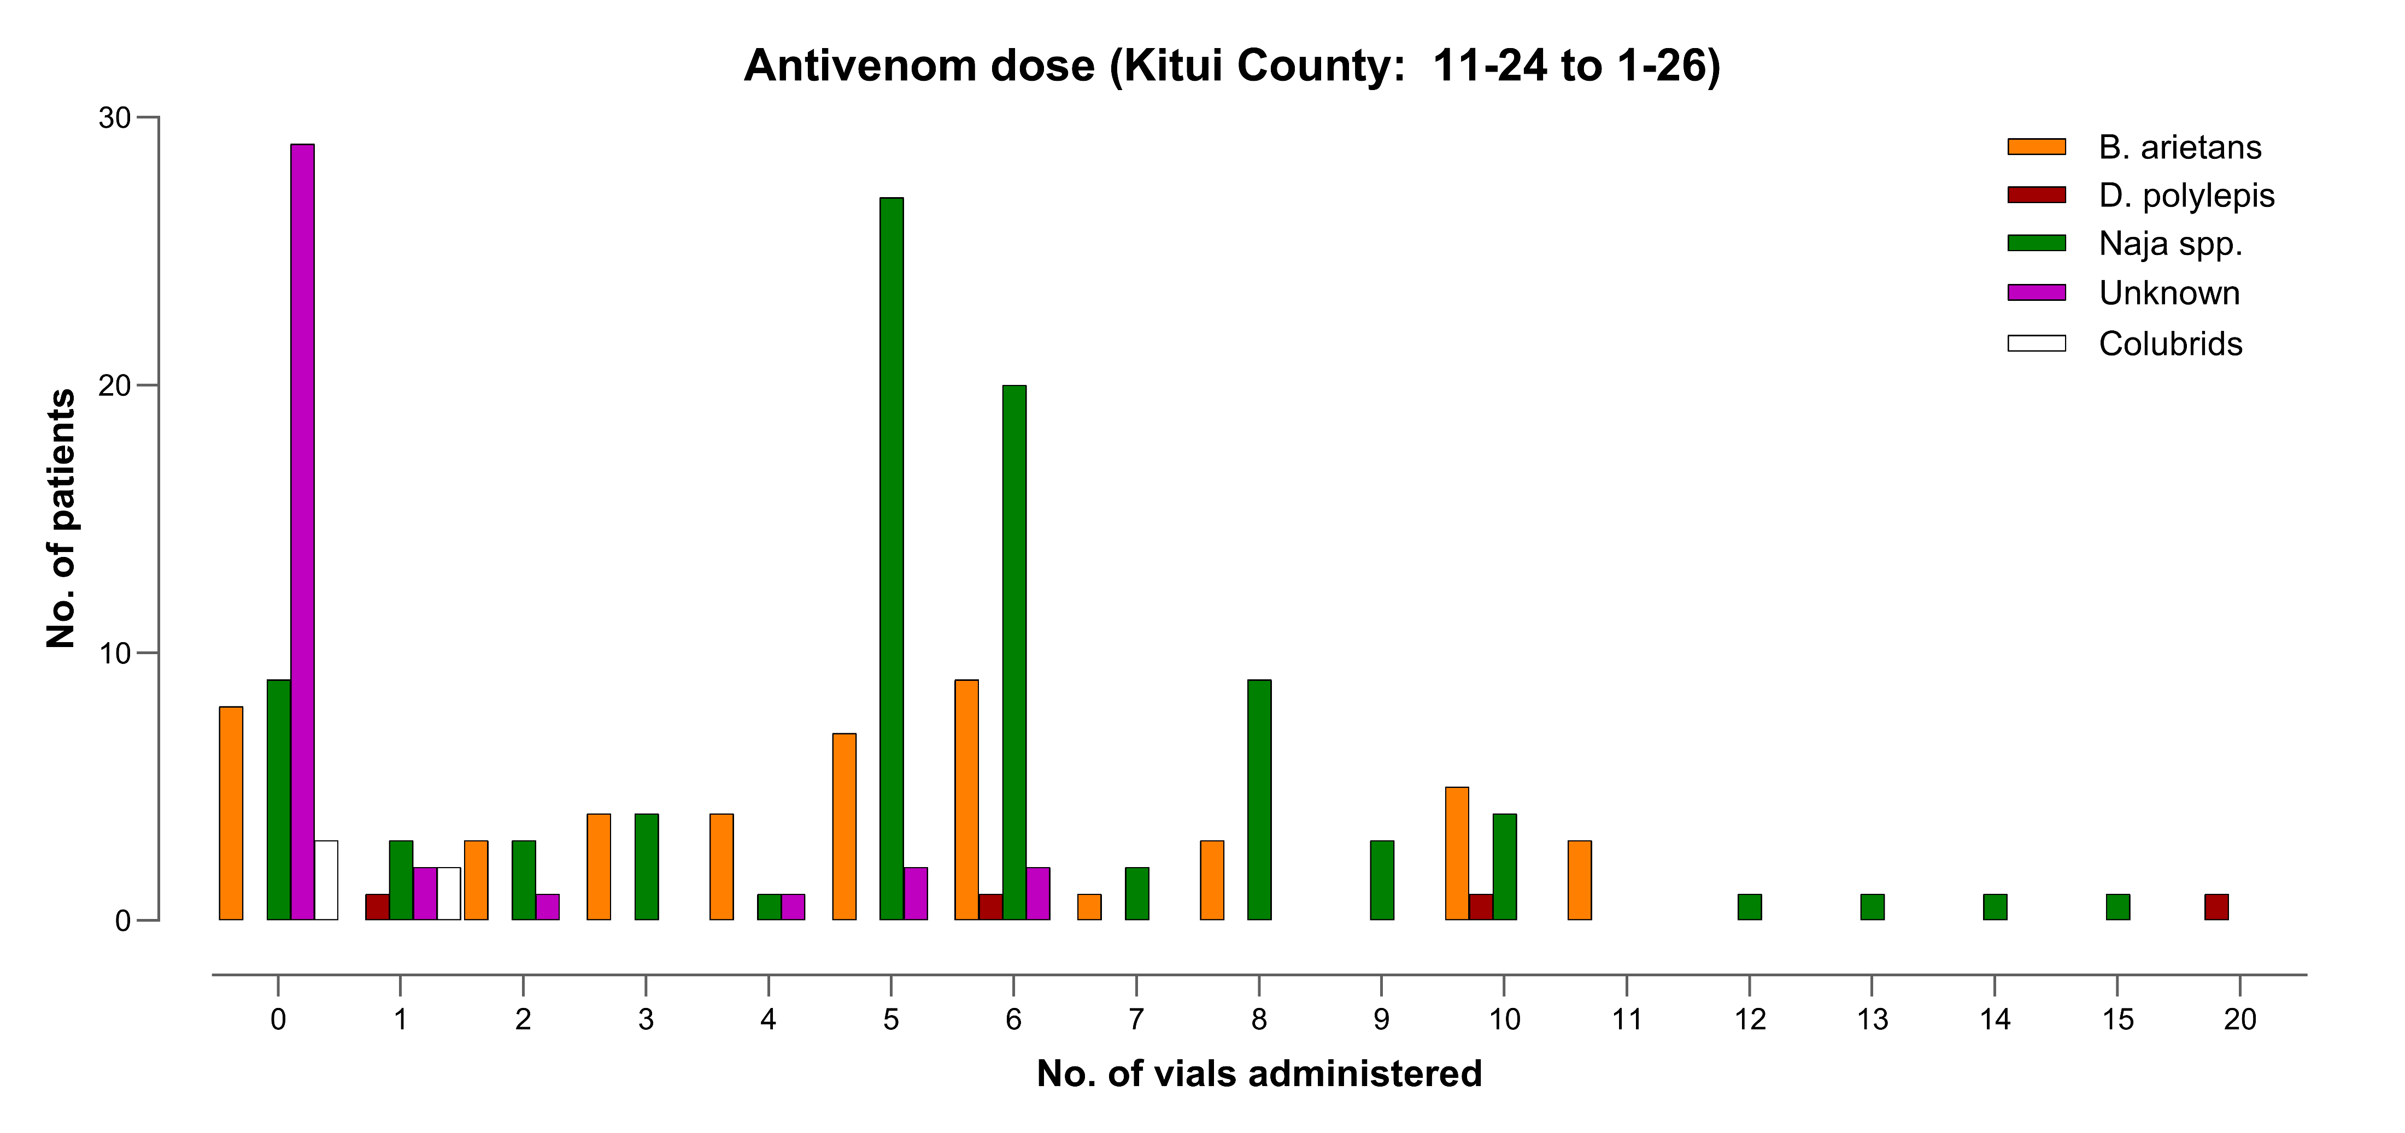
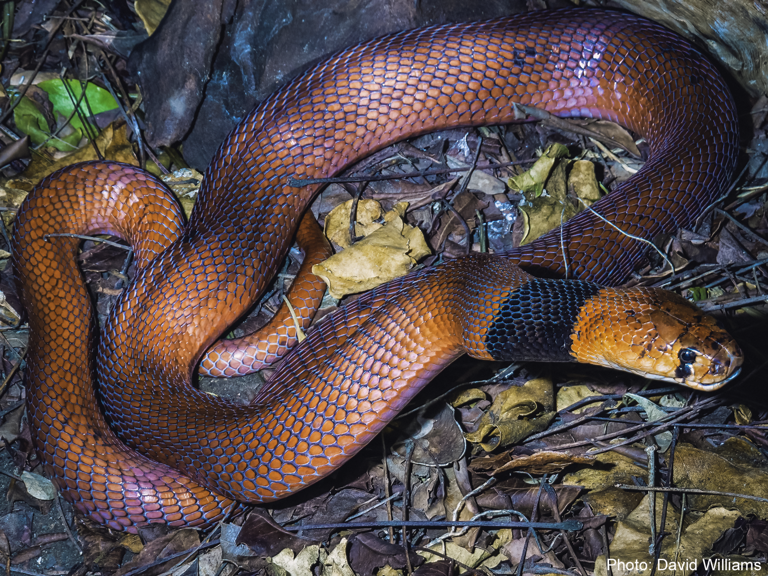
Antivenom use
KCRH is unique in that it employs a trained snake handler to identify biting species.
During the study period, 85.6% of the biting species were identified by a trained snake handler, with 61.6% of the case caused by venomous species (Atractaspididae, Elapidae, Viperidae). Some of the patients bitten by the 14.4% unidentified species were clinically envenomed.
The most common cause of snakebite was Naja pallida (n=81; 32.4%), followed by Bitis arietans (n=47; 18.8%).
Antivenom was administered to 88.8% of patients bitten by N. pallida, and to 83.0% of those bitten by B. arietans.
All 8 patients bitten by Naja nigricollis, as well as 1 person bitten by Naja ashei, and another bitten by an unidentified cobra received antivenom.
Four patients were bitten by Dendroaspis polylepis and received antivenom, with one of these cases ending fatally.
Antivenom was administered to 6 patients bitten by unidentified snakes, and to two patients bitten by colubrid species (Rhamphiophis rostratus and R. rubropunctatus)

Slide 10
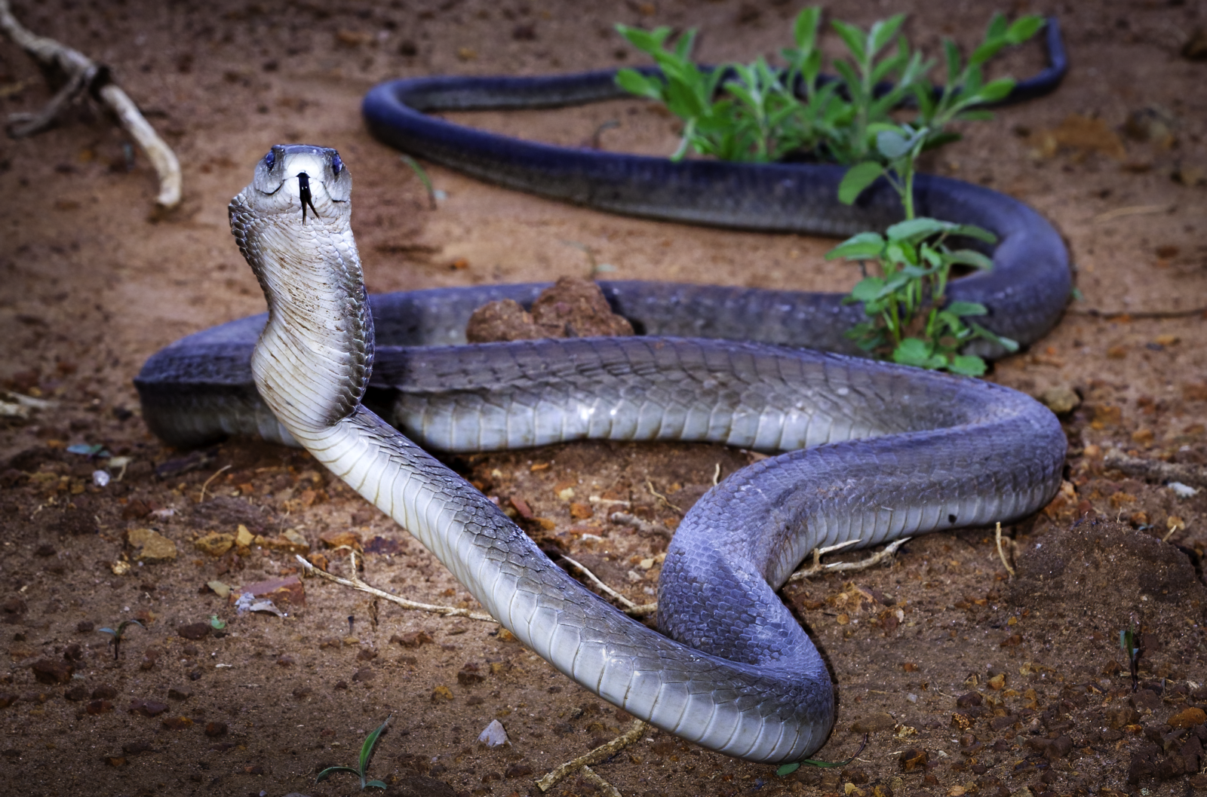
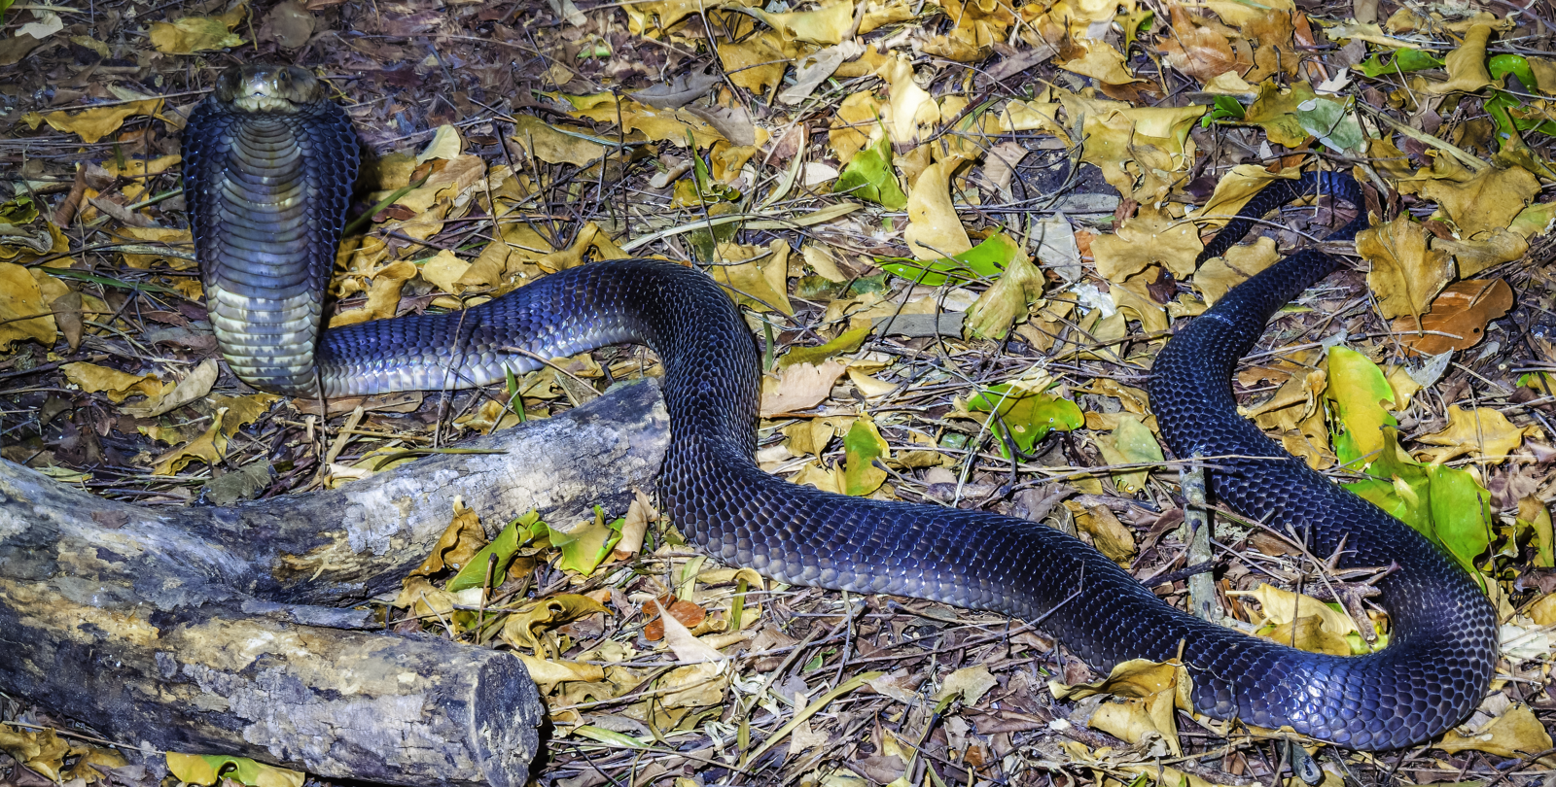
Antivenom use
In total there were two fatalities, a 1.5-year-old girl bitten by N. pallida, and a 27-year-old man bitten by D. polylepis.
The average dose of antivenom given to patients was 5.9 vials (95% CI: 5.4-6.5 vials) with a range of 1-20 vials.
Average doses of antivenom by species identity were:
  B. arietans (6.1 vials, 95% CI: 5.2-6.9 vials),
  N. pallida (5.9 vials, 95% CI: 5.4-6.5),
  N. nigricollis (6.1 vials, 95% CI: 4.6-7.7 vials)
  The three patients bitten by D. polylepis who survived received 6, 10, and 20 vials respectively, whereas the patient who died received only 1 vial.
  A single patient bitten by N. ashei received 15 vials.
These data emphasize that early presentation to hospital, appropriate care by experienced health professionals, and adequate doses of antivenom can result in good outcomes for patients.
A starting dose of 5-8 vials was effective for Bitis arietans, Naja pallida and Naja nigricollis bites, but for mambas and Naja ashei starting doses of 10-20 vials are warranted.

Slide 11
ACKNOWLEDGEMENTS
My family-Mbangula/Kitonyi Family
Kitui County Referral Hospital-Clinical Management Team
County Health Management Team-Clinical management Advisory Group
Dr. David Willium-Executive d=Director, Global Snakebite Initiative USA Foundation Inc
Watamu Snake Farm
Thank You – Ni Muvea

