Slide 1


h
KENYA CLINICAL OFFICERS’ ASSOCIATION
28th Annual Scientific
Conference 2026
CONFERENCE THEME
Building Resilient Health Systems
for Universal Health Coverage
FACTORS LEADING TO THE THIRD DELAY IN PROVIDING
EMERGENCY OBSTETRIC & NEWBORN CARE (EmONC)
AT MAKUENI COUNTY REFERRAL HOSPITAL.
MAINA JOSHUA KARANJA
HND-RH , Dip. CM
TANA RIVER COUNTY & KMTC MOMBASA CAMPUS
www.kecoa.org

Slide 2


Abstract
Third delay: operationally defined as the interval between arrival at the hospital and initiation of appropriate critical Emergency Obstetrics and Newborn Care (EmONC) intervention. A major Contributor to maternal & neonatal morbidity and mortality in low- and middle-income countries. Kenya ratio of 355 deaths per 100,000 live births.
Study estimated proportion of obstetric & newborn emergency cases experiencing third delay, measured admission-to-intervention times for key EmONC functions and identified facility-level determinants.
Design: Hospital-based cross-sectional study at Makueni County Referral Hospital(MCRH), over 2 months period.
A census of all eligible 74 obstetric and newborn emergency cases was undertaken.
Data was collected using structured data abstraction forms and WHO- based EmONC checklist. Admission-to-critical intervention times was assessed against predefined timelines on WHO-based EmONC framework. Analysis was done using SPSS v23, descriptive statistics and chi-square tests.
Results: Of the 74 EmONC cases, 46 (62.2%) experienced third delay, 28 (37.8%) including three (4.1%) newborn cases did not, indication that, third delay is common at MCRH largely driven by system constraints.
Addressing staffing, supply chain gaps and theatre capacity essential for timely EmONC signal functions.
www.kecoa.org
Building Resilient Health Systems for Universal Health Coverage
3

Slide 3
Background / Introduction
Maternal and neonatal mortality remains a major global health challenge with approximately 287,000 women dying annually from complications =1 death every 2 minutes [L Onambele et al., 2023].
The right to give birth safely is a fundamental human right, yet the vast majority of these preventable deaths occur in low- and middle-income countries (LMICs) [A Antsaklis et al., 2020].
Thaddeus & Maine 1994 -Three-Delay Model: Maternal outcomes are driven by three phases of delay: deciding to seek care (1st), reaching a facility (2nd), and receiving appropriate care upon arrival (3rd).
Kenya faces a high maternal mortality ratio of 355 deaths per 100,000 live births due to facility challenges like poor triage and limited surgical or blood supply capacity [KNBS, 2022; Mbalinda et al., 2020].
Makueni County’s maternal mortality ratio of approximately 400 deaths per 100,000 live births exceeds the national average (P Owira, et al.,2024).
Addressing the third delay was therefore critical for improving maternal and neonatal outcomes and reducing preventable maternal and neonatal deaths.
www.kecoa.org
Building Resilient Health Systems for Universal Health Coverage
3

Slide 4
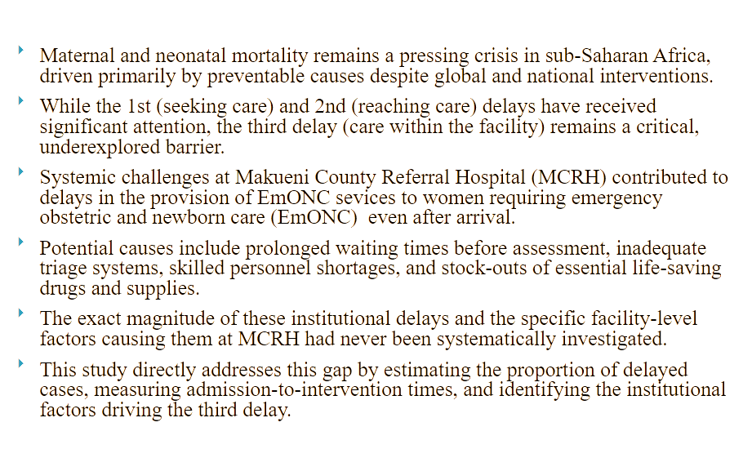
PROBLEM STATEMENT
www.kecoa.org
Building Resilient Health Systems for Universal Health Coverage
3

Slide 5
JUSTIFICATION
Preventable maternal and neonatal deaths remain high in Kenya despite of increased facility-based deliveries.
Third delay significantly contributes to preventable deaths showcasing critical health system preventable failures after the patient has already reached the hospital.
Failure to act timely lead to irreversible complications or death.
Examples: administration of uterotonics for PPH, MgSO₄ for pre-eclampsia and eclampsia, neonatal resuscitation.
At Makueni County Referral Hospital, delays were suspected but no systematic study had been done yet capturing the unique operational and structural realities specific to MCRH.
Findings to guide resource allocation, improve quality of care and support Makueni County in meeting national targets and the UN Sustainable Development Goals.
www.kecoa.org
Building Resilient Health Systems for Universal Health Coverage
3

Slide 6
Objectives
Broad Objective: To assess the factors leading to the third delay in the provision of Emergency Obstetric and Newborn Care (EmONC) at Makueni County Referral Hospital (MCRH).
Specific Objectives & Corresponding Questions:
Proportion: Estimate the magnitude of obstetric and newborn cases experiencing the third delay (Question: What proportion experience this delay?).
Timeframes: Measure admission-to-critical-intervention times for key EmONC signal functions (Question: What are the specific timelines?).
Determinants: Identify facility-level factors associated with the third delay (Question: Which facility-level factors contribute?).
www.kecoa.org
Building Resilient Health Systems for Universal Health Coverage
4

Slide 7
Methods I
Study Design: Hospital-based descriptive cross-sectional study
Study Area: Makueni County Referral Hospital,
Study Population: Women with obstetric emergencies and newborn emergencies
Sampling Frame: All obstetric and newborn emergency cases requiring EmONC signal functions during the study period
Sample Size:
  Cochran’s formula → adjusted for finite population & non-response
  Final sample size: 74 emergency cases
Sampling Technique: Census sampling of all eligible cases during the study period
www.kecoa.org
Building Resilient Health Systems for Universal Health Coverage
5

Slide 8
Methods II
Data Collection, Analysis & Ethics
Inclusion Criteria:
  Women (15–49 years) with documented obstetric emergencies
  Neonates requiring resuscitation
  Clear documentation of arrival and intervention times
Exclusion Criteria:
  Referred out before intervention
  Incomplete records
  Non-consenting participants
Data Collection Tools:
  Structured data abstraction tool
  WHO-based EmONC checklist
Data Collection Procedure:
  Prospective data collection over 2 months
  Direct observation and record review
Data Analysis:
  SPSS v23
  Descriptive statistics (frequencies, proportions, time intervals)
  Chi-square tests (p < 0.05)
Ethical Considerations:
  Ethical approval obtained
  Informed consent
  Confidentiality and voluntary participation ensured
www.kecoa.org
Building Resilient Health Systems for Universal Health Coverage
5

Slide 9
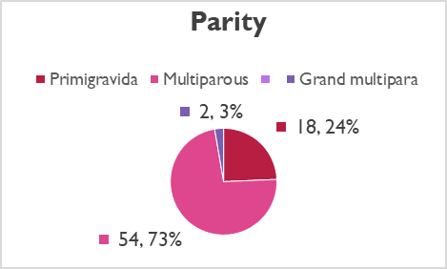
Data analysis
Socio-Demographic Characteristics (n = 74)
Age Distribution:
  Majority were young adults 20–24 years 26(35.1%). High delays in ages 15-24 (69.0%), no structural link (chi^2=2.62, p=0.454).
Parity:
  Multiparous: 54(73%) majority, delays in 36(66.7%), differences were insignificant (chi^2.96, p=0.227).
Referral Status:
  Facility referrals: participants referred 40(54%) were more likely to experience third delay (75.0%). Association significant (chi^2=4.63, p=0.031).
Education Level:
  No formal education had 83.3% delays, lacked statistical significance
  (Chi^2=2.91, p=0.406).
  Third delay is impersonal affects patients across all demographics backgrounds pointing toward institutional failures than patient
  characteristics.
Age Group | Frequency | Percentage (%)
15-19 | 3 | 4.0%
20-24 | 26 | 35.0%
25-29 | 20 | 27.0%
30-34 | 17 | 23.0%
35-39 | 8 | 11.0%
www.kecoa.org
Building Resilient Health Systems for Universal Health Coverage
6

Slide 10
Data analysis
Overall Third Delay:
  Out of all 74 EmONC cases, 46(62.2%) experienced a third delay, while 28(37.8%) including three new born cases(4.1%) received timely care.
Admission-to-Intervention Delays:
  Emergency Caesarean Section: 65.0%
  Oxytocin for PPH: 63.0%
  Magnesium sulphate for eclampsia: 63.0%
  Manual removal of placenta: 58.0%Blood transfusion: 57.0%
Key Finding: Delays were common across all major EmONC signal functions, indicating systemic challenges in timely emergency care
www.kecoa.org
Building Resilient Health Systems for Universal Health Coverage
6

Slide 11
Data analysis
Factors Associated with the Third Delay (Chi-Square Analysis)
Patient-Related Factors:
Facility referral status (p = 0.014)
Severe condition on arrival (p = 0.027)
Facility-level related factors:
Inadequate staffing (p = 0.0004)
High workload (p = 0.036)
Drug stock-outs (p = 0.0006)
Blood unavailability (p = 0.010)
Theatre unavailability (p = 0.002)
Summary: Chi-square analysis reveals that the third delay is heavily dictated by facility readiness, systemic workflows, and resource strains (n = 74):
Variable | Category | Third Delay Present n (%) | Third Delay Absent n (%) | χ² value | p-value
Referral status | Not referred | 16 (34.8) | 18 (64.3) | 6.10 | 0.014
 | Facility referral | 30 (65.2) | 10 (35.7)
Severity on arrival | Mild/Moderate | 19 (41.3) | 19 (67.9) | 4.91 | 0.027
 | Severe condition | 27 (58.7 | 9 (32.1)
Staffing level | Adequate | 15 (32.6) | 21 (75.0) | 12.54 | 0.0004
 | Inadequate | 31 (67.4) | 7 (25.0)
Workload | Normal | 18 (39.1) | 18 (64.3) | 4.41 | 0.036
 | High workload | 28 (60.9) | 10 (35.7)
Drug availability | Available | 14 (30.4) | 20 (71.4) | 11.78 | 0.0006
 | Stock-out | 32 (69.6) | 8 (28.6)
Blood availability | Available | 17 (37.0) | 19 (67.9) | 6.66 | 0.010
 | Not available | 29 (63.0) | 9 (32.1)
Theatre availability | Available | 16 (34.8) | 20 (71.4) | 9.36 | 0.002
 | Unavailable | 30 (65.2) | 8 (28.6)
www.kecoa.org
Building Resilient Health Systems for Universal Health Coverage
6

Slide 12
Discussion - Prevalence & Resource Complexity
Over 62.2% of emergency cases experienced the third delay, meaning 2 out of 3 mothers did not receive care within recommended timelines.
Inadequate staffing and high workloads significantly increased delays, forcing a few healthcare workers to juggle multiple life-threatening emergencies simultaneously (Ameh et al., 2016).
Delays were most severe in emergency C-sections (65.0%) and postpartum hemorrhage (PPH) management (63.0%).
• Interventions requiring coordination of multiple resources (theatres, blood supply, surgical staff) are highly vulnerable to delays.
Neonatal resuscitation was more timely because it relied on immediate, bedside equipment and skills (Moxon et al., 2015).
Health system constraints emerged as the most influential contributors of third delay compared to patient factors.
www.kecoa.org
Building Resilient Health Systems for Universal Health Coverage
7

Slide 13
Discussion - Comparison with other studies
62.2% of the 74 EmONC cases experienced third delay, similar to findings in other low-resource settings.
Knight et al. (2017) reported that, over 60% of maternal deaths occurred after reaching a facility due to internal delays.
Pacagnella et al. (2012) identified facility-level delays as a major cause of severe maternal morbidity.
Emergency C/S and PPH management were most delayed, consistent with:
Wilunda et al. (2015) – prolonged decision-to-incision times
Hussen et al. (2020) – delays due to drug and blood shortages.
Neonatal resuscitation was relatively timely, similar to findings by Moxon et al. (2015)
www.kecoa.org
Building Resilient Health Systems for Universal Health Coverage
7

Slide 14
Conclusion
The third delay represents a highly prevalent and dangerous bottleneck, with 62.2% of emergency cases at MCRH failing to receive care within recommended clinical timelines.
Operational failures are driven majorly by facility-level constraints rather than the socio-demographic characteristics of the patients.
Delays are acutely concentrated in complex, resource-heavy interventions—specifically emergency Caesarean sections (65.0%) and postpartum hemorrhage management (63.2%).
Highly significant statistical markers highlight inadequate staffing and critical drug stock-outs (p < 0.001) as the leading systemic vulnerabilities.
The significant delay faced by referred and severe cases exposes a critical gap in inter-facility coordination and rapid emergency triage pathways.
www.kecoa.org
Building Resilient Health Systems for Universal Health Coverage
7

Slide 15
Recommendations
Recommendations (MCRH HMT and County Department of Health – Makueni)
Optimize Human Resource: Deploy additional skilled healthcare professional to the maternity, theatre, and emergency units to alleviate workload strains and improve timely response to obstetric emergencies.
Secure the Medical Supply Chain: Guarantee a continuous supply of critical EmONC commodities, including uterotonics, magnesium sulphate, antibiotics and availability of safe blood and blood components for emergency transfusions.
Optimize Theatre Capacity: Maximize operating room availability, modern equipment readiness, dedicated on-call surgical teams and minimize incision delays by eliminating bottlenecks directly stalling emergency Caesarean sections.
Refine Triage and Referral Systems: Establish an agile triage protocol to instantly prioritize severe maternal and newborn emergencies upon arrival and improve on pre-referral communication networks.
www.kecoa.org
Building Resilient Health Systems for Universal Health Coverage
7

Slide 16
References
Thaddeus, S., & Maine, D. (1994). Too far to walk: Maternal mortality in context. Social Science & Medicine, 38(8), 1091–1110. https://doi.org/10.1016/0277-9536(94)90226-714.
Pacagnella, R. C., Cecatti, J. G., Osis, M. J. D., & Souza, J. P. (2012). The role of delays in severe maternal morbidity and mortality: expanding the conceptual framework. Reproductive Health Matters, 20(39), 155–163. https://doi.org/10.1016/S0968-8080(12)39601-8
Kenya National Bureau of Statistics (KNBS). (2022). Kenya Demographic and Health Survey 2022: Key Indicators Report. Nairobi, Kenya: KNBS.
Knight, H. E., Self, A., & Kennedy, S. H. (2017). Why are women dying when they reach hospital on time? A systematic review of the ‘third delay’. PLoS ONE, 8(5), e63846. https://doi.org/10.1371/journal.pone.0063846
Kesmodel, U. S. (2018). Cross-sectional studies – what are they good for? Acta Obstetricia et Gynecologica Scandinavica, 97(4), 388–393.
Kadam, P., & Bhalerao, S. (2010). Sample size calculation. International Journal of Ayurveda Research, 1(1), 55–57.
Cochran, W. G. (1977). Sampling techniques (3rd ed.). John Wiley & Sons.
Dillman, D. A., Smyth, J. D., & Christian, L. M. (2014). Internet, phone, mail, and mixed-mode surveys: The tailored design method (4th ed.). John Wiley & Sons.
www.kecoa.org
Building Resilient Health Systems for Universal Health Coverage
7

Slide 17

Thank You
Kenya Clinical Officers’ Association
28th Annual Scientific Conference 2026
www.kecoa.org
Building Resilient Health Systems
for Universal Health Coverage

