Slide 1


KENYA CLINICAL OFFICERS’ ASSOCIATION
28th Annual Scientific
Conference 2026
CONFERENCE THEME
Building Resilient Health Systems
for Universal Health Coverage
Transforming maternal newborn, child and adolescent health out comes: Impact of clinical officer led quality improvement interventions in Nyamira county
Floridah Abuga | Department of health Nyamira county / Masaba Sub County Hospital
www.kecoa.org

Slide 2


Background / Introduction
Despite national progress toward sustainable Development Goal 3
Nyamira county continues to experience a high burden of preventable maternal and child deaths
Maternal mortality ratio remains high 62.38% per live 100,000 births
Neonatal mortality rate 3.09%,
Still birth rate 10.76%,
Immunization coverage 74%,
Teenage pregnancy 28%,
www.kecoa.org
Building Resilient Health Systems for Universal Health Coverage
3

Slide 3
Cont. Background / Introduction
Drivers included gap in emergency obstetric care, referral networks, poverty,
limited youth friendly services, information gaps, peer pressure,
School dropouts and low service integration
Transforming health outcomes in Nyamira requires scalable,
Evidence based interventions
Addressing health system delays from primary care facilities to community units,
Clinical officers in Nyamira county decided to deliver
Frontline emergency obstetric, newborn and pediatric interventions
January 2025 to December 2025 to create an impact
www.kecoa.org
Building Resilient Health Systems for Universal Health Coverage
4

Slide 4
Objectives
To evaluate the one-year impact of Clinical Officer-led QI
interventions
Integrated health-system strengthening on
MNCAH outcomes in Nyamira County, January–December 2025.
www.kecoa.org
Building Resilient Health Systems for Universal Health Coverage
4

Slide 5
Methods
Retrospective
Study design
Jan–Dec 2025
Study period
65
RCH clinical officers
Facility scope
28 units
3,280
Women/newborns monitored
www.kecoa.org
Building Resilient Health Systems for Universal Health Coverage
5

Slide 6
Cont. Methods: Interventions
jnjhjbnb
BEmONC capacity building
Strengthened provider readiness for basic emergency obstetric and newborn care.
CHP referral work flow
Improved communication and community to facility referral coordination
Facility QI teams
Used clinical audits and structured improved cycles to address care gaps
MPDSR reviews
Reviewed maternal and perinatal deaths and followed up action points
Routine data use
Tracked ANC, skilled care delivery, early PNC, mortality and immunization indicators, KHIS data monitoring
Client and clinical feedback
Explore responsiveness, waiting time, feasibility and implementation barriers
www.kecoa.org
Building Resilient Health Systems for Universal Health Coverage
4

Slide 7
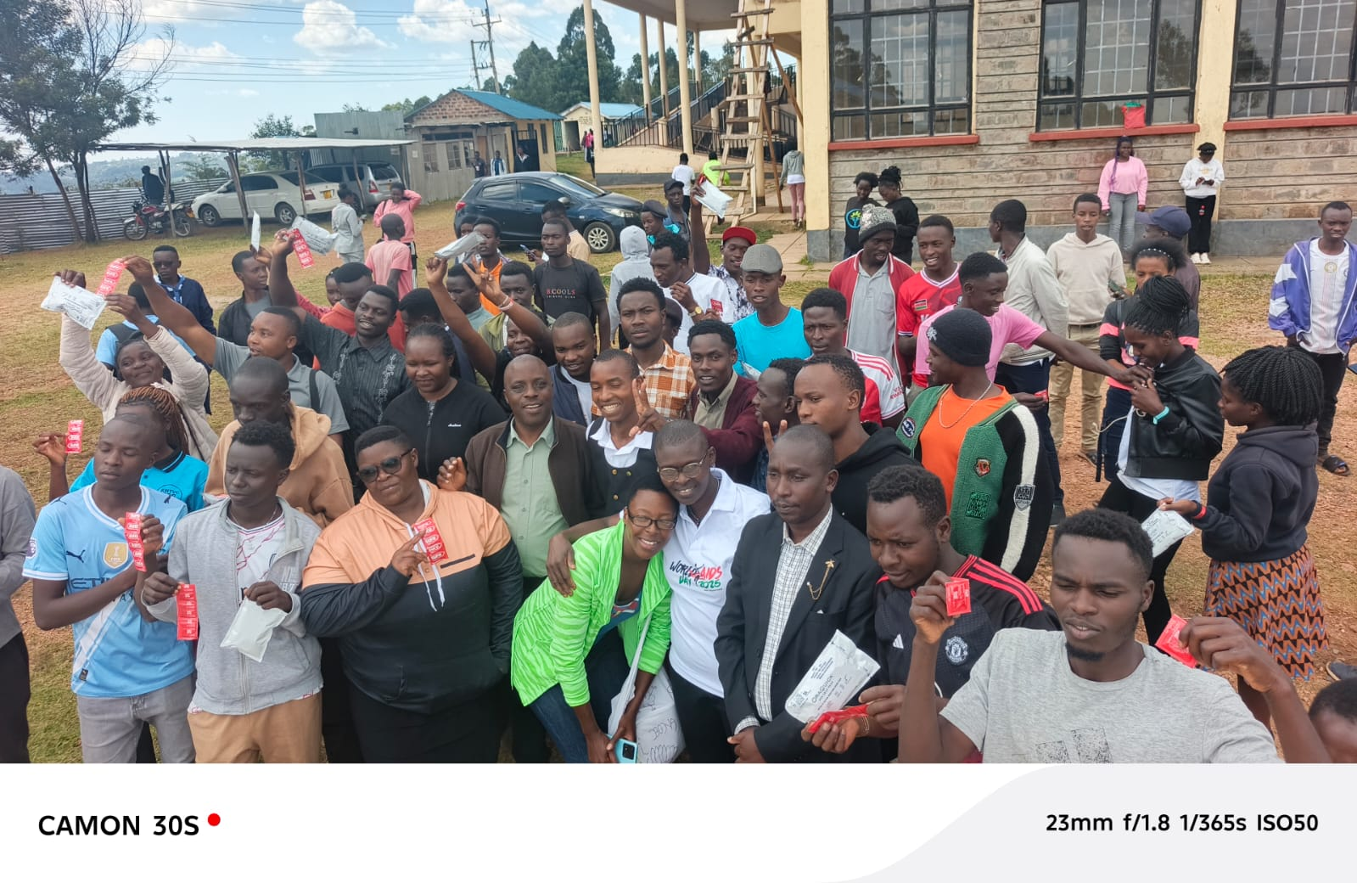
Youth Friendly Services
www.kecoa.org
Building Resilient Health Systems for Universal Health Coverage
4

Slide 8
Results: Quantitative
Outcome Indicator | Baseline (Jan 2025) | End line (Dec 2025) | Net Change / Improvement
Skilled Birth Attendance (SBA) | 68.00% | 84.00% | +16.00 percentage points (Cumulative improvement)
Early Postnatal Care (PNC) within 48 hrs. | Tracked at baseline | Accelerated coverage | Significant positive progression across 1 year
Maternal Mortality Ratio (MMR) | ~62.38 / 100,000 | 42.26 / 100,000 | 32% reduction
Neonatal Mortality Rate | 3.09% | 1.08% | 2.01 percentage points reduction
Fully Immunized Child (FIC) Coverage | 74% | 83.00% | 9% increase
Teenage Pregnancy Rate | 28.00% | 19.00% | 9.00 percentage points reduction
Recorded Stillbirth Rate | 10.76 % [157]1,000 | 13.48% [97] / 1,000) | Adjusted upward 2.72% despite lower absolute count[improved reporting]
www.kecoa.org
Building Resilient Health Systems for Universal Health Coverage
6

Slide 9
Cont. Results: Qualitative
Client perspective:
Clients reported improved clinician responsiveness
Clearer explanation of emergency care procedures
Reduced waiting times during referral transitions
Clinician perspective:
Clinical officers highlighted MPDSR audits and direct CHP communication
Fostered a proactive non punitive culture
Enabling rapid resolution of drug and equipment stock outs at facility level
www.kecoa.org
Building Resilient Health Systems for Universal Health Coverage
4

Slide 10
Discussion & Conclusion
H taggg
Addressing health system delays requires empowering frontline clinicians, facility level quality audits, paired with active community referral networks, optimize triage and emergency management across the system.
Targeted MNCAH clinical workflows led by Clinical officers significantly
Elevate skilled birth attendance and
Early postnatal monitoring,
Lowering both neonatal, maternal mortality rates and teenage pregnancy
Making Nyamira county a safe place to deliver
www.kecoa.org
Building Resilient Health Systems for Universal Health Coverage
7

Slide 11
Recommendation
Asses longitudinal sustainability of the QI project
Institutionalize facility-level QI and MPDSR teams with action owners and deadlines.
Maintain continuous mentorship in BEmONC, triage and early postnatal care
Formalize CHP-to-facility referral communication feedback and follow-up.
Strengthen adolescent-friendly services and child immunization defaulter tracing.
Monitoring and evaluation, Health Management and Information System and data quality assessment.
Secure sustained county resources for staffing, supplies, referral systems and primary healthcare infrastructure.
www.kecoa.org
Building Resilient Health Systems for Universal Health Coverage
4

Slide 12
References
Ministry of Health Kenya [2023] Kenya Demographic and Health Survey [KDHS] 2022
World Health Organization [2021], Every newborn: An Action to Plan to End Preventable Deaths
Nyamira county Department of Health Services [2023-2033], County Health Strategic Plan [KHSP] and KHIS Annual report
Social and clinical Audit working group [2022-2024] Maternal and Perinatal Death Surveillance and Response [MPDSR[ Implementation Guidelines
www.kecoa.org
Building Resilient Health Systems for Universal Health Coverage
4

Slide 13

Thank You
Kenya Clinical Officers’ Association
28th Annual Scientific Conference 2026
www.kecoa.org
Building Resilient Health Systems
for Universal Health Coverage

