Slide 1


KENYA CLINICAL OFFICERS’ ASSOCIATION
28th Annual Scientific
Conference 2026
CONFERENCE THEME
Building Resilient Health Systems
for Universal Health Coverage
RELATIONSHIP BETWEEN ADVERSE CHILDHOOD EXPERIENCES AND DEPRESSION AMONG UNIVERSITY STUDENTS AT KIRINYAGA UNIVERSITY, KENYA
Dr Molly Muiga (PsyD) | Kirinyaga University, USIU-Africa University , Kenya
www.kecoa.org

Slide 2


Background / Introduction
Depression in university students is becoming a major public health issue in most parts of the world, as it has been a case of diminished academic performance, poor social functioning and increased risk of suicide.
Simultaneously, childhood stressors (ACEs), such as abuse, neglect, and household dysfunction, are becoming known to be significant determinants of mental health throughout the lifespan.
There is evidence of adversity in early life that alters emotional development and makes one prone to depressive disorders in young adulthood, especially in university, where the level of psychological stress is high (World Health Organization, 2022; CDC, 2021).
www.kecoa.org
Building Resilient Health Systems for Universal Health Coverage
3

Slide 3
ACEs Consequences
ACEs are related to :
Poor long-term physical, mental, and reproductive health (Boullier & Blair, 2018; Chegeni et al., 2020).
Impaired development of brain structure, function, and connectivity (Teicher, Samson, Anderson, & Ohashi, 2016),
Cognitive and language development problems (Vink et al., 2019).
Reduced academic, work, and social performance (Joshi, Raina, Tonmyr, MacMillan, & Gonzalez, 2021).
Suicidality and high-risk behaviors such as substance use and high-risk sexual behaviors (Chegeni et al., 2020).
Reduced life expectancy (Boullier & Blair, 2018; Felitti et al., 1998).
www.kecoa.org
Building Resilient Health Systems for Universal Health Coverage
5

Slide 4
Objectives
Overall objective
Relationship between adverse childhood experiences and depressive symptoms among university students at Kirinyaga university, Kenya
Specific objectives
1. Prevalence and Distribution of Adverse Childhood Experiences (ACEs)
2. Level of depression among university students at Kirinyaga University
3• Assess the relationship between ACE and depression.
www.kecoa.org
Building Resilient Health Systems for Universal Health Coverage
4

Slide 5
Literature review.
Adverse childhood experiences lead to both psychological susceptibility and biological and cognitive changes such as poor stress management and lack of cognitive control.
There is a correlation between childhood abuse and lower heart rate variability and more mood symptoms (Stevens et al., 2023), and between abuse and neglect and worse cognitive control in people with depressive and related disorders (Tjoelker et al., 2022).
These impacts concur with the theory of trauma and stress
Childhood family dysfunction predisposes the suicidal behavior and emotional instability in different developmental stages.
A meta-analysis and systematic review revealed that family-related adversities considerably increase the risk of suicidal behavior in adolescents (Pu et al., 2025). early adversity weakens resilience and predisposes one to depressions during adulthood.
www.kecoa.org
Building Resilient Health Systems for Universal Health Coverage
4

Slide 6
The Theory of Trauma and Stress Sensitization: Explaining the Relationship Between Adverse Childhood Experiences (ACEs) and Depression
Adverse childhood experiences childhood experiences
Abuse, neglect, violence, loss or chronic family conflict
Developing vulnerability
Changes in stress regulation, emotional development, cognition and attachment
Stress sensitization
Increased vulnerability or altered reactivity to later stressful experiences
Subsequent life stressors
Relationship difficulties, unemployment, bereavement, financial hardship or academic stress
Increased risk of depression
Persistent low mood, hopelessness, loss of interest and other depressive symptoms
www.kecoa.org
Building Resilient Health Systems for Universal Health Coverage
5

Slide 7
Methodology
Design & participants
• The design used in this study was a cross-sectional descriptive correlational study design
Study Population : undergraduates. 3,242 students across four schools.
Sample size:323
• Sampling : Proportionate stratified random sampling.
• Response rate: 320 (99%) complete responses analyzed.
Administration: Researcher administered.
Tools & analysis
• ACEs: Adverse Childhood Experiences International Questionnaire (ACE-IQ).
• ACE groups: 0, 1–3, or ≥4.
• Depression: Patient Health Questionnaire (PHQ-9); ≥5 any symptoms, ≥10 moderate-to-severe.
• SPSS v31.0; prevalence with 95% CIs, chi-square tests, PRs and ORs.
www.kecoa.org
Building Resilient Health Systems for Universal Health Coverage
5

Slide 8
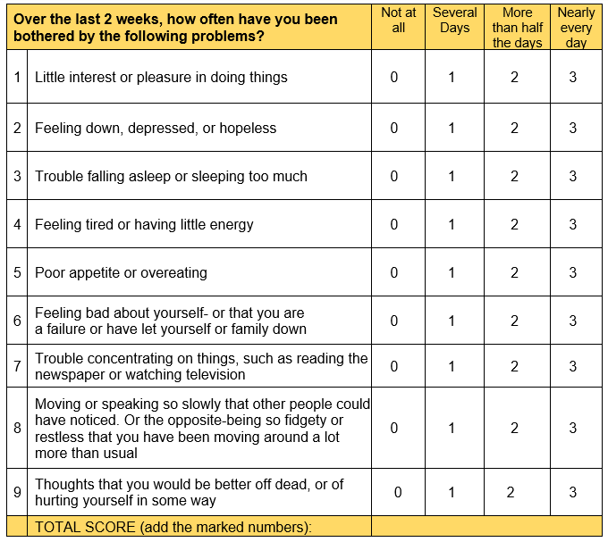
PHQ 9
Significantly, there was a statistically significant relationship between ACEs and depression ( 2 = 32.614, p < .001), and a significant dose-response effect was found in which depression severity increased with more exposure to ACEs. Students who had 4 or more ACEs had significantly more moderate to severe depression than those who had no ACEs. This trend is consistent with Desch et al. (2023), who have shown that cumulative exposure to ACE is correlated with the risk and severity of depression in young adulthood.
www.kecoa.org
Building Resilient Health Systems for Universal Health Coverage
4

Slide 9
ACE International Questionnaire (ACE-IQ)
One of the most used measures of ACEs is the Adverse Childhood Experiences International Questionnaire (ACE-IQ; World Health Organization WHO 2012) because it has a culturally neutral design that serves to measure ACEs in several countries.
Its questions cover family dysfunction, physical, sexual and emotional abuse, and neglect by parents or caregivers; peer violence; witnessing community violence, and exposure to collective violence.
It guides its administration, interpretation and ethical considerations to the participants, it is freely accessible, and it has been used in High-, Middle- and Low-Income Countries (Baban,Cosma,Blazsi,Sethi, &Olsavszky, 2013: Raleva, Peshevska, & Sethi, 2013).
www.kecoa.org
Building Resilient Health Systems for Universal Health Coverage
4

Slide 10
Results : ACE Domain Distribution
ACE Domain | Prevalence n (%) | 95% CI
Emotional abuse | 222 (69.4%) | 64.3–74.5
Physical abuse | 137 (42.8%) | 37.4–48.2
Sexual abuse | 38 (11.9%) | 8.4–15.4
Emotional neglect | 214 (66.9%) | 61.7–72.1
Physical neglect | 54 (16.9%) | 12.8–21.0
Household dysfunction | 120 (37.5%) | 32.2–42.8
Witnessing domestic violence | 87 (27.2%) | 22.4–32.0
Peer violence/bullying | 116 (36.2%) | 31.0–41.4
Community violence | 101 (31.6%) | 26.6–36.6
www.kecoa.org
Building Resilient Health Systems for Universal Health Coverage
6

Slide 11
ACE Score Category Distribution
ACE Score Category | Frequency (n) | Prevalence % (95% CI)
0 ACEs | 58 | 18.1 (13.9–22.3)
1–3 ACEs | 146 | 45.6 (40.1–51.1)
≥4 ACEs | 116 | 36.3 (31.0–41.6)
Total | 320 | 100
www.kecoa.org
Building Resilient Health Systems for Universal Health Coverage
6

Slide 12
Results: Level of Depression Among University Students
PHQ-9 Score Range | Depression Level | Frequency (N=320) | Percentage
0–4 | Minimal | 79 | 24.70%
5–9 | Mild | 101 | 31.60%
10–14 | Moderate | 76 | 23.80%
15–19 | Moderately severe | 41 | 12.80%
20–27 | Severe | 23 | 7.20%
Total |  | 320 | 100.00%
www.kecoa.org
Building Resilient Health Systems for Universal Health Coverage
6

Slide 13
Relationship Between ACE Categories and Depression Levels
Significantly, there was a statistically significant relationship between ACEs and depression ( 2 = 32.614, p < .001), and a significant dose-response effect was found in which depression severity increased with more exposure to ACEs. Students who had 4 or more ACEs had significantly more moderate to severe depression than those who had no ACEs. This trend is consistent with Desch et al. (2023), who have shown that cumulative exposure to ACE is correlated with the risk and severity of depression in young adulthood.
ACE Category | Minimal n (%) | Mild n (%) | Moderate n (%) | Mod. Severe n (%) | Severe n (%) | Total n (%) | χ² | p-value
0 ACEs | 30 (51.7) | 18 (31.0) | 7 (12.1) | 2 (3.4) | 1 (1.7) | 58 (100.0)
1–3 ACEs | 35 (24.0) | 60 (41.1) | 32 (21.9) | 13 (8.9) | 6 (4.1) | 146 (100.0)
≥4 ACEs | 14 (12.1) | 23 (19.8) | 37 (31.9) | 26 (22.4) | 16 (13.8) | 116 (100.0) | 32.614 | 0.000
Total | 79 (24.7) | 101 (31.6) | 76 (23.8) | 41 (12.8) | 23 (7.2) | 320 (100.0)
www.kecoa.org
Building Resilient Health Systems for Universal Health Coverage
4

Slide 14
RESULTS: Relationship Between ACE Categories and Depression Levels
Significantly, there was a statistically significant relationship between ACEs and depression (X 2 = 32.614, p < .001),
A significant dose-response effect was found in which depression severity increased with more exposure to ACEs.
Students who had 4 or more ACEs had significantly more moderate to severe depression than those who had no ACEs.
This trend is consistent with Desch et al. (2023), who have shown that cumulative exposure to ACE is correlated with the risk and severity of depression in young adulthood.
1
www.kecoa.org
Building Resilient Health Systems for Universal Health Coverage
4

Slide 15
Discussion & Conclusion
ACE exposure and depressive symptoms were both common.
Depressive symptoms increased in a graded pattern with greater ACE exposure.
The majority of students have had at least one ACE, and the proportion of students reporting depressive symptoms was quite high with a high percentage of mild to severe symptoms.
The findings revealed that students who are more exposed to ACE had a higher probability of developing server depression.
These results highlight the significance of considering childhood adversity as a key contributor to student mental health and well-being.
www.kecoa.org
Building Resilient Health Systems for Universal Health Coverage
7

Slide 16
Recommendations
Institutionalization of routine mental health screening at universities.
At the policy level, teachers and stakeholders ought to focus on early childhood interventions as the means of avoiding abuse, neglect, and dysfunctional families, as the major causes of subsequent mental health challenges.
There is also a need to have community-based awareness efforts that can help to bring out the long-term psychological effects of negative childhood experiences
Future studies to investigate links among ACEs and other mental health conditions.
www.kecoa.org
Building Resilient Health Systems for Universal Health Coverage
5

Slide 17

Thank You
Kenya Clinical Officers’ Association
28th Annual Scientific Conference 2026
www.kecoa.org
Building Resilient Health Systems
for Universal Health Coverage

