Slide 1


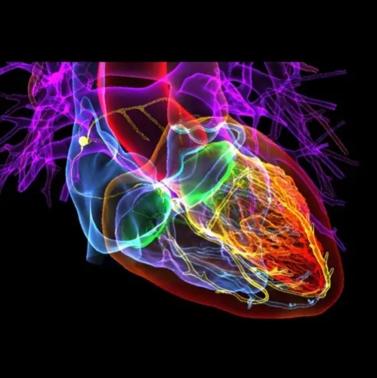
KCOA 2026 • CAMPFIRE SESSION
Early-Onset Atrial Fibrillation: A Case Study Of Delayed Diagnosis & Long-term Symptom Burden
By: Arnold Kihima,
The Karen Hospital Medical College
& Vihiga County Referral Hospital
28TH ANNUAL SCIENTIFIC CONFERENCE
Building Resilient Health Systems for Universal Health Coverage

Slide 2


Outline
Acknowledgement
Introduction & Background Information
Atrial Fibrillation, Physiology, Classification
Study Objectives
Significance of the Study
Problem Statement
Study Methodology
Case Narrative
Physical Exam
Diagnostic Workup
Management
Discussions
Conclusion
Role of Clinical Officers in Management of Atrial Fibrillation
kecoa.org
28TH ANNUAL SCIENTIFIC CONFERENCE 2026 • MOMBASA, KENYA
02

Slide 3




Acknowledgements
The Lecturers and non-teaching staff of The Karen Hospital Medical Training College.
I single out my supervisors: Dr. Masese Charles, Dr. Timothy W. Mwangi and Ms. Winjoy Gatwiri
  For their outstanding professional guidance, encouragement and support they accorded me throughout the process of developing this research project.
My Employer County Government of Vihiga
The Management and Staff of Vihiga Teaching and Referral Hospital
  For the support and opportunity given to me to pursue and advance my career in Clinical Cardiology
kecoa.org
28TH ANNUAL SCIENTIFIC CONFERENCE 2026 • MOMBASA, KENYA
02

Slide 4
Introduction and Background Information
Atrial fibrillation (AF) is the most common sustained cardiac arrhythmia encountered in clinical practice and is characterized by rapid, disorganized atrial electrical activity leading to ineffective atrial contraction and an irregular ventricular response (Hindricks et al., 2021).
The condition affects millions of people worldwide, and its prevalence continues to rise due to population aging, improved survival from cardiovascular diseases, and enhanced detection methods (Chugh et al., 2014).
AF is associated with significant morbidity and mortality, including an increased risk of ischemic stroke, heart failure, systemic thromboembolism, hospitalization, cognitive impairment, and premature death (January et al., 2019).
kecoa.org
28TH ANNUAL SCIENTIFIC CONFERENCE 2026 • MOMBASA, KENYA
02

Slide 5
Introduction, Cont.
Atrial fibrillation substantially contributes to healthcare costs and negatively impacts patients’ quality of life through symptoms such as palpitations, fatigue, dyspnea, dizziness, and exercise intolerance (Kirchhof et al., 2016).
Although the condition predominantly affects older adults, AF may also occur in younger individuals, where diagnosis is often delayed due to its intermittent nature and lower clinical suspicion.
AF occurring before the age of 60 years is commonly referred to as Early-Onset AF is linked to genetic predisposition, structural heart diseases, Endocrine, metabolic, and other modifiable risk factors (Chung et al., 2023; Lubitz et al., 2021).
kecoa.org
28TH ANNUAL SCIENTIFIC CONFERENCE 2026 • MOMBASA, KENYA
03

Slide 6
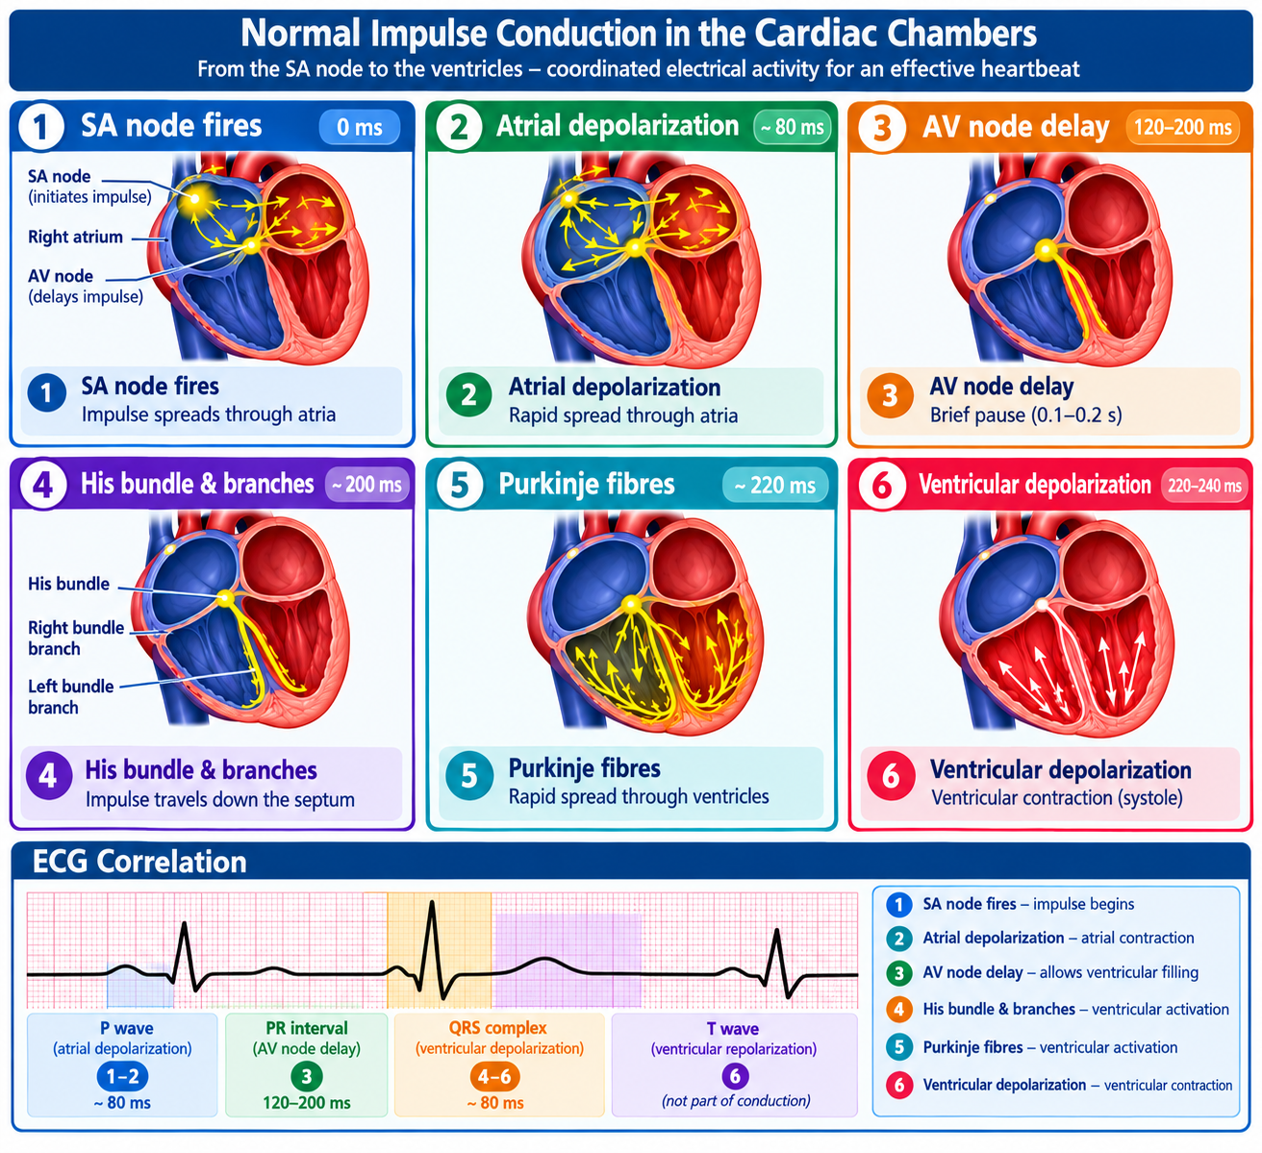
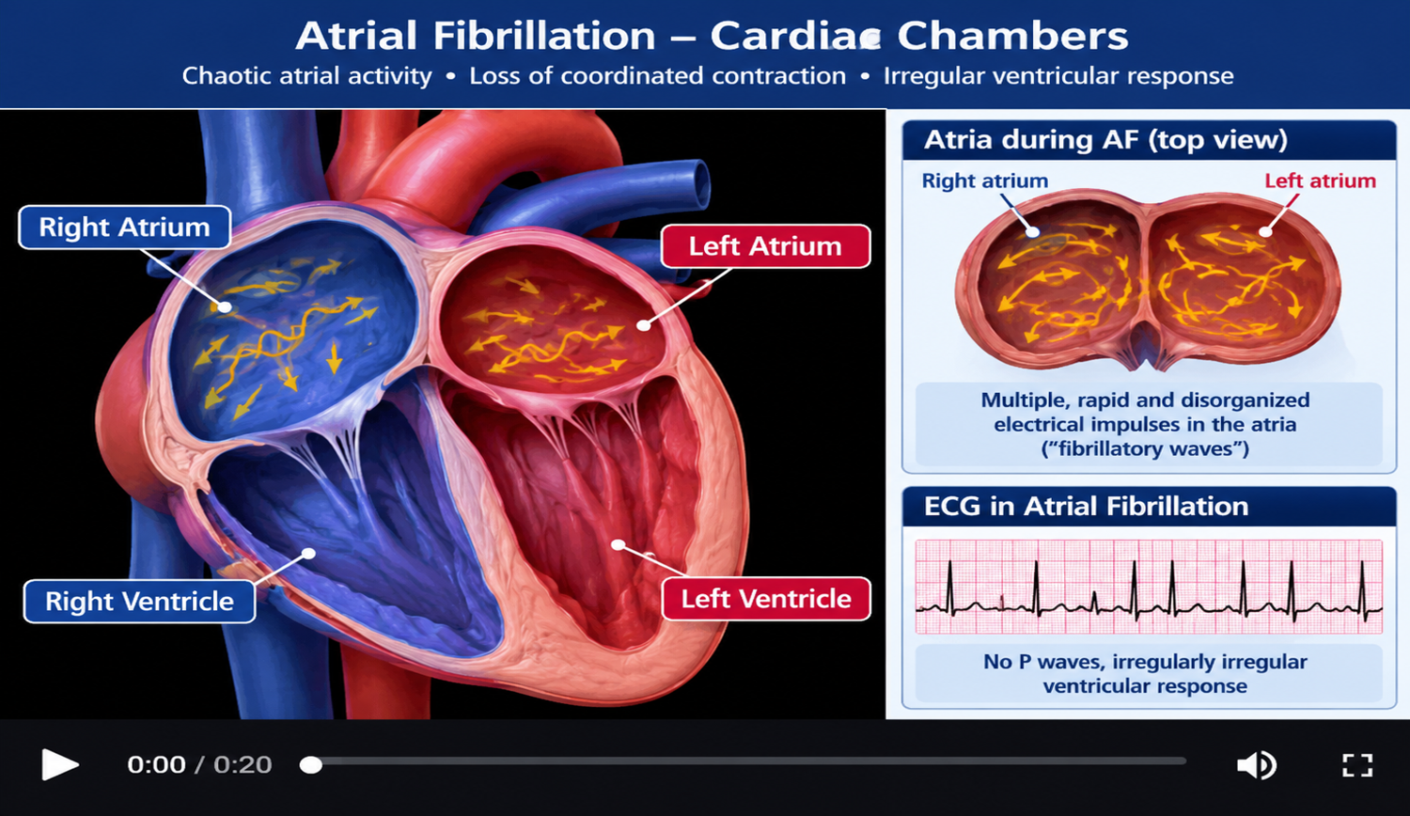
Normal Impulse Conduction Vs Atrial Fibrillation
https://medlineplus.gov/ency/anatomyvideos/000021.htm?utm_source=chatgpt.com
kecoa.org
28TH ANNUAL SCIENTIFIC CONFERENCE 2026 • MOMBASA, KENYA
03

Slide 7
Atrial Fibrillation: Classification
AF is classified into several categories based on duration and pattern:
  First-diagnosed AF
  Paroxysmal AF (self-terminating within 7 days)
  Persistent AF (lasting more than 7 days)
  Long-standing persistent AF
  Permanent AF
Paroxysmal atrial fibrillation (PAF) is defined as AF that terminates spontaneously or with intervention within seven days of onset, with most episodes resolving within 48 hours (January et al., 2019).
kecoa.org
28TH ANNUAL SCIENTIFIC CONFERENCE 2026 • MOMBASA, KENYA
03

Slide 8
Study Objectives
General Objective
To examine the clinical presentation, diagnostic evaluation, management, and outcomes newly diagnosed with paroxysmal atrial fibrillation experiencing symptoms for 16 years.
Specific Objectives
To describe the clinical presentation of a patient with early-onset Atrial Fibrillation.
To evaluate the diagnostic workup in the assessment of early-onset AF.
To discuss management approaches employed in early onset Atrial Fibrillation.
To assess the impact of early-onset AF on the patient's quality of life.
kecoa.org
28TH ANNUAL SCIENTIFIC CONFERENCE 2026 • MOMBASA, KENYA
03

Slide 9
Significance of The Study
The findings of this study are necessary for clinicians in recognizing AF among younger patients presenting with recurrent palpitations and unexplained cardiovascular symptoms.
Early diagnosis and appropriate management have been shown to reduce symptom burden and improve quality of life (Kirchhof et al., 2016).
The study also contributes to the growing body of literature concerning early-onset AF and may provide useful information for future research on risk factors, diagnosis, and management strategies in young adults.
kecoa.org
28TH ANNUAL SCIENTIFIC CONFERENCE 2026 • MOMBASA, KENYA
03

Slide 10
Problem Statement
Atrial fibrillation is frequently perceived as a disorder affecting older adults, which may contribute to under-recognition in younger individuals presenting with recurrent palpitations, dizziness, or unexplained cardiovascular symptoms.
Delayed diagnosis may result in persistent symptoms, reduced quality of life, repeated healthcare encounters, and increased risk of complications associated with untreated AF.
Understanding these factors may contribute to earlier recognition and improved management of AF among young adults
kecoa.org
28TH ANNUAL SCIENTIFIC CONFERENCE 2026 • MOMBASA, KENYA
03

Slide 11

Study Methodology
Study Design
A descriptive case study design was employed.
Data Collection
Information was obtained from:
  Patient interviews.
  Physical examination findings.
  Electrocardiographic records.
  Holter monitoring reports.
  Echocardiographic studies.
  Laboratory investigations.
  Medical records review.
Study Area
kecoa.org
28TH ANNUAL SCIENTIFIC CONFERENCE 2026 • MOMBASA, KENYA
03

Slide 12

Case Narrative
A 30-year-old male software engineer was rushed to the accident and emergency unit by his workmates complaining of sudden-onset of:
  rapid irregular heartbeat and
  chest fluttering lasting about an hour.
Symptoms were associated with lightheadedness, mild shortness of breath and occasional chest discomfort, worsened on exertion.
He felt well before this episode; denied having any symptoms of infection in the recent past preceding the episode.
He reported increased stress at work in the recent past.
kecoa.org
28TH ANNUAL SCIENTIFIC CONFERENCE 2026 • MOMBASA, KENYA
03

Slide 13
Case Narrative, Cont.
He had no significant personal or family history of CVDs
Reported previous history of similar episodes, first episode at 16 years age,
Noticed that symptoms were unpredictable, and mostly associated with
  increased emotional,
  psychosocial and
  physical stress, as well as
  heavy alcohol use
kecoa.org
28TH ANNUAL SCIENTIFIC CONFERENCE 2026 • MOMBASA, KENYA
03

Slide 14
Case Narrative, Cont.
He Had sought medical attention at several health facilities during symptomatic episodes. However, no definitive diagnosis had been established.
Previous evaluation had inconclusive findings and had been treated for various conditions including:
  Pneumonia,
  GERD,
  H-Pylori,
  musculoskeletal pains and
  was at one time referred to a psychologist for psychological evaluation and counselling, with a diagnosis of anxiety disorder
kecoa.org
28TH ANNUAL SCIENTIFIC CONFERENCE 2026 • MOMBASA, KENYA
03

Slide 15

Physical Examination
Young adult in fair general condition, anxious though fairly stable. Not in distress, afebrile not pale, jaundiced or edematous.
  Blood pressure: 118/72 mmHg
  Pulse rate: 92 beats/minute, irregularly irregular and full bounding
  Respiratory rate: 29 breaths/minute
  Oxygen saturation: 95% on room air
  Weight 76.4Kg
  Height 1.72M
  BMI 25.8 (Overweight)
  BSA 1.87M2
kecoa.org
28TH ANNUAL SCIENTIFIC CONFERENCE 2026 • MOMBASA, KENYA
03

Slide 16

Physical Exam, Cont.
Head and neck examination were unremarkable
Cardiovascular examination revealed:
  Irregularly irregular pulse.
  No Jugular venous distention
  Irregular heart rate ranging from 90–110 beats/minute.
  Audible S1 and S2 with no gallops, rubs or murmurs
  No signs of heart failure.
Pulmonary exam: Vesicular breath sounds with good air entry bilaterally.
His abdomen was soft and non-tender with no palpable masses;
Thyroid exams revealed no abnormalities. He had no peripheral edema.
kecoa.org
28TH ANNUAL SCIENTIFIC CONFERENCE 2026 • MOMBASA, KENYA
03

Slide 17
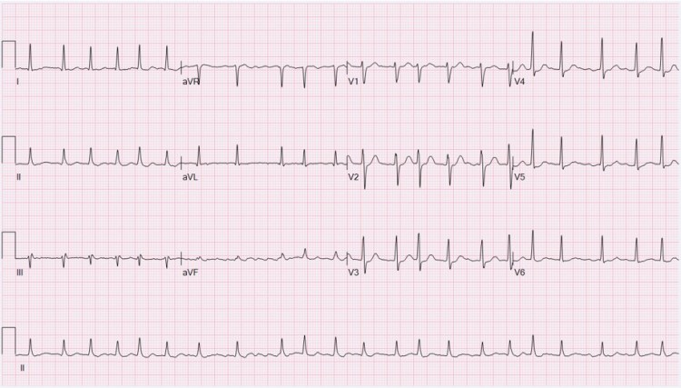
Diagnostic Workup: ECG
At Presentation, an urgent 12-Lead ECG done which revealed:
  Irregularly irregular RR intervals.
  Absence of distinct P waves.
  Narrow QRS complexes.
  Fibrillatory waves
  Variable ventricular rate between 75-132 beats per minute.
These findings were consistent with Atrial Fibrillation.
kecoa.org
28TH ANNUAL SCIENTIFIC CONFERENCE 2026 • MOMBASA, KENYA
03

Slide 18
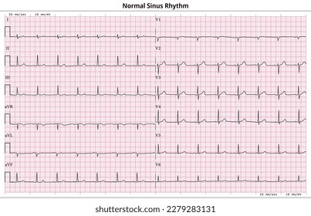
Diagnostic Workup: Repeat ECG
A repeat ECG about an hour after presentation was done, this was after the patient reported spontaneous resolution of symptoms revealing:
  A Normal sinus rhythm heart rate 84 bpm with normal PR interval, normal QRS complexes and QTc intervals, and no signs of ventricular pre-excitation (Wolff-Parkinson-White syndrome).
kecoa.org
28TH ANNUAL SCIENTIFIC CONFERENCE 2026 • MOMBASA, KENYA
03

Slide 19

Laboratory Workup
Test | Patient Value | Reference Range | Comments
Hemoglobin | 15.6 g/dL | 12–16 g/dL | Normal
WBC (Total White Blood Cells) | 4.28 ×10⁹/L | 4–11 ×10⁹/L | Normal
Platelets | 316 ×10⁹/L | 140–450 ×10⁹/L | Normal
Creatinine | 69 µmol/L | 50–120 µmol/L | Normal
Serum Urea | 5.3 mmol/L | 1.7–8.33 mmol/L | Normal
Potassium | 4.1 mmol/L | 3.5–5.5 mmol/L | Normal
Sodium | 139 mmol/L | 135–145 mmol/L | Normal
Calcium | 9.3 mg/dL | 8.5-10.2 mg/dL | Normal
Bicarbonate | 26 mmol/L | 22-29 mmol/L | Normal
TSH | 3.1 mIU/L | 0.4–4.0 mIU/L | Normal
T3 | 2.6 pg/mL | 2.3–4.2 pg/mL | Normal
T4 | 1.3 ng/dL | 0.8–1.8 ng/dL | Normal
Total Cholesterol | 5.35 mmol/L | 3.5–5.5 mmol/L | Normal
Triglycerides | 1.7 mmol/L | 0.5–2.0 mmol/L | Normal
HDL | 1.05 mmol/L | >0.8 mmol/L | Normal
LDL | 2.60 mmol/L | <4.9 mmol/L | Normal
HDL/LDL Ratio | 0.40 | ≥0.24 | Normal
Test | Patient Value | Reference Range | Comments
HbA1c | 5.7% | 4.5–6.5% | Normal
ALP | 271 U/L | 35–305 U/L | Normal
ALT | 11 U/L | 0–50 U/L | Normal
AST | 32 U/L | 0–50 U/L | Normal
GGT | 8 U/L | <11.5 U/L | Normal
Total Protein | 66 g/L | 66–87 g/L | Normal
Albumin | 43.22 g/L | 35–52 g/L | Normal
Total Bilirubin | 22.17 µmol/L | 5–17 µmol/L | Normal
Procalcitonin | 0.12 ng/mL | <0.5 ng/mL | Normal
CRP | 5.2 mg/L | <10 mg/L | Normal
INR | 1.10. | 0.8–1.2 | Normal
PT | 12.4 sec | 11–13.5 sec | Normal
LDH | 182 U/L | 140–280 U/L | Normal
BNP | 67 pg/mL | <100 pg/mL | Normal
Troponin I | 0.02 ng/mL | <0.04 ng/mL | Normal
Troponin T | 7 ng/L | <14 ng/L | Normal
D-Dimer | 278 ng/mL | <500 ng/mL | Normal
Uric Acid | 4.3 mg/dL | 3.5–7.2 mg/dL | Normal
kecoa.org
28TH ANNUAL SCIENTIFIC CONFERENCE 2026 • MOMBASA, KENYA
03

Slide 20
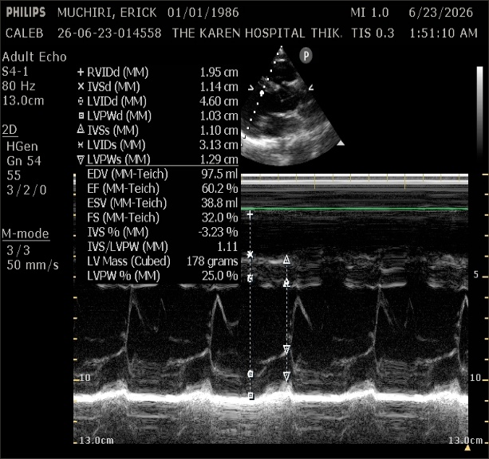
Diagnostic Workup: Echocardiography
Confirmed a structurally and functionally normal heart:
Normal cardiac chamber dimensions
Normal left ventricular global systolic function, with Left ventricular ejection fraction (LVEF) of 62% with no regional wall motion abnormalities.
Normal RV size and function with a TAPSE of 21mm and no evidence of pressure and volume overload
Normal diastolic function
Normal right and left atrial sizes, The Left Atrial Volume Index (LAVI) was normal at 28 mL/m², indicating no structural remodeling or atrial enlargement.
Valvular morphology and function were pristine with no significant valvular abnormalities or vegetations.
No intracardiac thrombus or mass.
Normal pericardium, with no effusion or evidence of constrictive physiology
No evidence of pulmonary hypertension, Normal IVC
kecoa.org
28TH ANNUAL SCIENTIFIC CONFERENCE 2026 • MOMBASA, KENYA
03

Slide 21
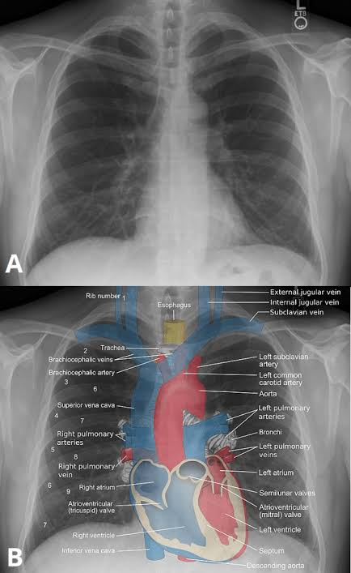
Diagnostic Workup: Chest Radiography
Normal chest radiograph:
Trachea central and patent. Carina normal.
Visualized osseous structures intact without visible deformities. Soft tissues of the chest wall unremarkable.
Cardiac Silhouette normal, with normal configuration.
Hemidiaphragms smooth and intact, Costophrenic and cardiophrenic angles sharp and clear bilaterally, showing no evidence of pleural effusion or pneumothorax.
Lung fields fully expanded, clear of focal airspace consolidation, interstitial opacities, masses, or nodules. Vascular markings normal throughout all zones.
Great Vessels and Mediastinal contours are normal and within expected limits for width. Aorta and pulmonary trunk show no abnormal prominence.
Hilar structures normal in size, density, and position without lymphadenopathy.
kecoa.org
28TH ANNUAL SCIENTIFIC CONFERENCE 2026 • MOMBASA, KENYA
03

Slide 22
Diagnostic Workup
24-Hour Holter Monitor
Successfully captured an irregular, tachycardic rhythm lasting 42 minutes with spontaneous conversion to sinus rhythm, matching the patient’s exact symptomatic description.
The tracing showed absent P-waves replaced by rapid, chaotic fibrillatory waves and a variable ventricular response fluctuating between 110 and 155 bpm, confirming a diagnosis of Paroxysmal Atrial Fibrillation.
A Cardiac MRI was performed on a 3.0 MR system in axial, long axis and short axis planes.
Multiplanar post contrast images and delayed contrast images demonstrated a structurally and functionally normal myocardium, pericardium, valves with no regurgitation, stenosis or vegetations.
Great vessels too were normal. This excluded structural abnormalities as the cause of the arrhythmia.
kecoa.org
28TH ANNUAL SCIENTIFIC CONFERENCE 2026 • MOMBASA, KENYA
03

Slide 23

Diagnosis
A diagnosis of Paroxysmal Atrial Fibrillations was made on the basis of the following:
Patient’s clinical presentation (history of intermittent symptoms of palpitations),
ECG findings (initial confirming Atrial Fibrillation during the episode, and a Normal ECG done later upon resolution of symptoms)
a Holter Monitor which captured an irregular, tachycardic rhythm with spontaneous conversion to sinus rhythm, matching the patient’s exact symptomatic description.
Possible Triggers and Causal Associations
From the Patient’s history and physical examination, the following were identified as the possible triggers and drivers to the arrhythmia:
  Physical, emotional and psychological stress
  Anxiety
  Excessive alcohol consumption
  Excessive consumption of caffeine (coffee)
  Overweight
No structural, Endocrine or metabolic abnormalities were identified during the exam
kecoa.org
28TH ANNUAL SCIENTIFIC CONFERENCE 2026 • MOMBASA, KENYA
03

Slide 24

Management
Management focused on the following Key Strategies:
  Acute management (Hemodynamic stability)
  Rate & Rhythm Control
  Thromboembolic risk assessment and management
  Counselling on risk factor management
  Referred for Electrophysiologic Studies (EPS) for assessment and possible Catheter Ablation
  Long term follow- up
Lifestyle and Risk Factor Modification
  Reduction of Physical, emotional and psychological stress:
  Alcohol consumption: Avoid Binge drinking
  Avoid excessive consumption of caffeine (coffee)
  Weight management: Maintain Healthy weight
  BP Control and management
kecoa.org
28TH ANNUAL SCIENTIFIC CONFERENCE 2026 • MOMBASA, KENYA
03

Slide 25
Discussions
This case illustrates early-onset paroxysmal atrial fibrillation in an otherwise healthy young adult.
AF occurring before the age of 20 years is uncommon and warrants careful evaluation for underlying structural, genetic, metabolic, and electrophysiological abnormalities.
The patient's symptoms significantly affected quality of life despite the absence of major cardiovascular risk factors.
Echocardiographic findings demonstrated preserved cardiac structure and function, supporting a diagnosis of lone or idiopathic atrial fibrillation.
kecoa.org
28TH ANNUAL SCIENTIFIC CONFERENCE 2026 • MOMBASA, KENYA
03

Slide 26
Discussions, Cont.
Several mechanisms may contribute to AF in younger individuals, including:
  Genetic predisposition.
  Enhanced vagal tone.
  Atrial electrical remodeling.
  Triggered activity originating from pulmonary veins.
Long-standing recurrent AF may lead to progressive atrial remodeling, increasing the risk of transition from paroxysmal to persistent AF. Therefore, early rhythm-control strategies may be beneficial in selected patients.
kecoa.org
28TH ANNUAL SCIENTIFIC CONFERENCE 2026 • MOMBASA, KENYA
03

Slide 27
Conclusion.
Atrial fibrillation can occur in young individuals and may present with recurrent symptoms beginning in adolescence.
This case demonstrates the importance of thorough diagnostic evaluation to exclude structural and secondary causes of AF.
Long-term management should focus on symptom control, prevention of disease progression, and regular monitoring for complications.
Young patients with symptomatic recurrent AF may benefit from early consideration of rhythm-control strategies, including catheter ablation, to improve quality of life and long-term outcomes.
kecoa.org
28TH ANNUAL SCIENTIFIC CONFERENCE 2026 • MOMBASA, KENYA
03

Slide 28
Role of Clinical Officers in Atrial Fibrillation Management
Initial Assessment and Diagnosis of CVDs
Diagnostics and Electrocardiography
Medical Treatment and Prescribing
Stroke risk assessment and anticoagulation
Patient Education and Lifestyle modification and disease management
Monitoring and adjusting treatment plans/ Referral
kecoa.org
28TH ANNUAL SCIENTIFIC CONFERENCE 2026 • MOMBASA, KENYA
06

Slide 29
Around the Campfire
What are the Classical Symptoms and Signs of Atrial Fibrillation?
kecoa.org
28TH ANNUAL SCIENTIFIC CONFERENCE 2026 • MOMBASA, KENYA
09

Slide 30



