Slide 1


KENYA CLINICAL OFFICERS’ ASSOCIATION
28th Annual Scientific
Conference 2026
CONFERENCE THEME
Building Resilient Health Systems
for Universal Health Coverage
Frontline Fragility: Ebola Outbreak Preparedness Among Clinical Officers in a High-Risk Kenyan Corridor Facility
Kevin Miruka, Terryann Chebet, Lencie Alwala et al. | MMUST & GLUK
www.kecoa.org

Slide 2


Background / Introduction
• EVD is a severe, often fatal illness caused by Orthoebolavirus (Filoviridae family) ( Rai et al.. 2022)
• Largest outbreak: West Africa 2013–2016 (28,652 cases; 11,325 deaths; CFR 39.5%)
• Kenya has not experienced a major EVD outbreak but remains at high risk due to porous borders with Uganda/DRC and major transport corridors, coupled with the newly confirmed cases.
• Clinical Officers form the backbone of Kenya’s primary & secondary care and are often the first point of contact in initial patient management.
• Facility-level preparedness of Clinical Officers for high-consequence pathogens remains under-studied in inland corridor settings
www.kecoa.org
Building Resilient Health Systems for Universal Health Coverage
2

Slide 3
Problem Statement
• 32 EVD outbreaks since 1976 have caused >15,000 deaths
• Healthcare workers faced 21–32× higher infection risk during the West African outbreak
• KELIN & KUCO (2020) assessment of Kenyan Clinical Officers:
– 58% had no preparedness/response training
– 93% reported inadequate PPE; 82% forced to reuse PPE
– 43% of facilities lacked entry screening
• Inland facilities along transport corridors receive less prioritisation than border points yet face importation risk
• Gaps in knowledge, training, PPE and isolation capacity compromise safe response
www.kecoa.org
Building Resilient Health Systems for Universal Health Coverage
3

Slide 4
Justification of the Study
• Clinical Officers provide the majority of clinical services in Kenyan public facilities, especially rural and underserved areas
• Uasin Gishu lies on the Uganda–Nairobi Northern Corridor; Burnt Forest Sub-County Hospital is the farthest Level-4 facility from MTRH
• Greater transfer distance places heavier operational demands on local staff for initial isolation and management
• Studying an inland corridor facility fills an evidence gap on readiness of non-border hospitals
• Findings can inform facility-level resilience and similar inland settings across Kenya
www.kecoa.org
Building Resilient Health Systems for Universal Health Coverage
4

Slide 5
Study Objectives
The study explored the preparedness of clinical officers in the management of Ebola Virus Disease at Bunt Forest Sub-County Hospital as a representative of mainland facilities exposed to a high risk of Ebola Virus Disease.
It delved into an in-depth understanding of clinical officers’ knowledge, perceived preparedness, IPC practices, outbreak response capacities, and the contextual barriers and facilitators influencing preparedness at the facility before an active case of Ebola Virus Disease was confirmed in Kenya
www.kecoa.org
Building Resilient Health Systems for Universal Health Coverage
5

Slide 6
Research Questions
1. What is the level of preparedness of Clinical Officers for EVD outbreak management at Burnt Forest Sub-County Hospital?
2. What is the extent of knowledge and understanding of EVD management among Clinical Officers?
3. How do Clinical Officers perceive their preparedness for EVD management?
4. What are the existing IPC practices and outbreak response capacities at the facility?
5. What contextual barriers and facilitators influence Clinical Officers’ preparedness for EVD outbreak management?
www.kecoa.org
Building Resilient Health Systems for Universal Health Coverage
6

Slide 7
Methods: Design & Setting
• Design: Cross-sectional descriptive qualitative study
• Theoretical orientation: Socio-Ecological Model + Bandura’s Self-Efficacy Theory
• Conceptual framework adapted from Ali et al. (2021)
• Setting: Burnt Forest Sub-County Hospital (Level 4), Ainabkoi Sub-County, Uasin Gishu County
– ~30 km from Eldoret on the Eldoret–Webuye / Northern Corridor highway
– Key referral facility serving surrounding health centres; elevated importation risk from Uganda/DRC traffic
• Ethical approval: MMUST-ISREC (MMUST/ISERC/331/2026); NACOSTI Licence No. NACOSTI/P/26/4197197
www.kecoa.org
Building Resilient Health Systems for Universal Health Coverage
7

Slide 8
Methods: Population & Sampling
• Target population: All Clinical Officers in Kenyan public facilities involved in patient assessment and management
• Accessible population: Clinical Officers employed at Burnt Forest Sub-County Hospital (≥1 month permanent/contract/locum)
• Sampling: Convenience sampling of the entire accessible population (n=12)
• Final sample: 9 Clinical Officers interviewed (saturation reached at 9th interview)
• One participant unreachable during industrial action; one declined interest
• Qualifications: 7 Diploma, 2 Bachelor’s in Clinical Medicine
• Experience: 1–15 years; majority 2–5 years at the facility
www.kecoa.org
Building Resilient Health Systems for Universal Health Coverage
8

Slide 9
Methods: Data Collection & Analysis
• Instrument: Semi-structured interview guide based on study objectives, literature and WHO EVD standards
• Mode: In-depth interviews (physical and virtual); 30–45 minutes; audio-recorded with consent
• Pilot: Conducted at Moi Teaching and Referral Hospital (n=5); guide refined; pilot participants excluded
• Analysis: Primarily deductive thematic analysis guided by objectives and conceptual framework; open to inductive insights
• Process: Familiarisation → analytical framework → systematic coding (3 coders) → matrix → synthesis
• Trustworthiness: Member checking, reflexive journal, peer debriefing, audit trail, thick description
• COREQ 32-item checklist applied
www.kecoa.org
Building Resilient Health Systems for Universal Health Coverage
9

Slide 10
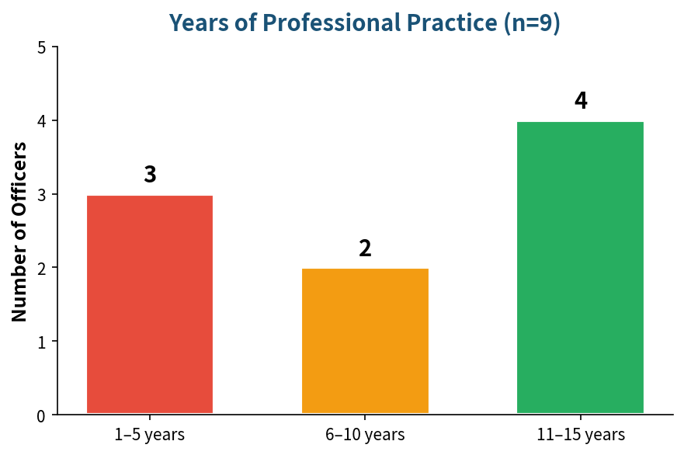
Results: Participant Demographics
Nine Clinical Officers interviewed (saturation at interview 9)
Highest qualification
• Diploma in Clinical Medicine …… 7
• Bachelor’s in Clinical Medicine … 2
Years of professional practice
• 1–5 years …… 3
• 6–10 years … 2
• 11–15 years … 4
Duration of service at facility
• <2 years …… 1
• 2–5 years … 6
• >5 years …… 2
Prior EVD/VHF training: Limited (mostly virtual CME or none)
www.kecoa.org
Building Resilient Health Systems for Universal Health Coverage
10

Slide 11
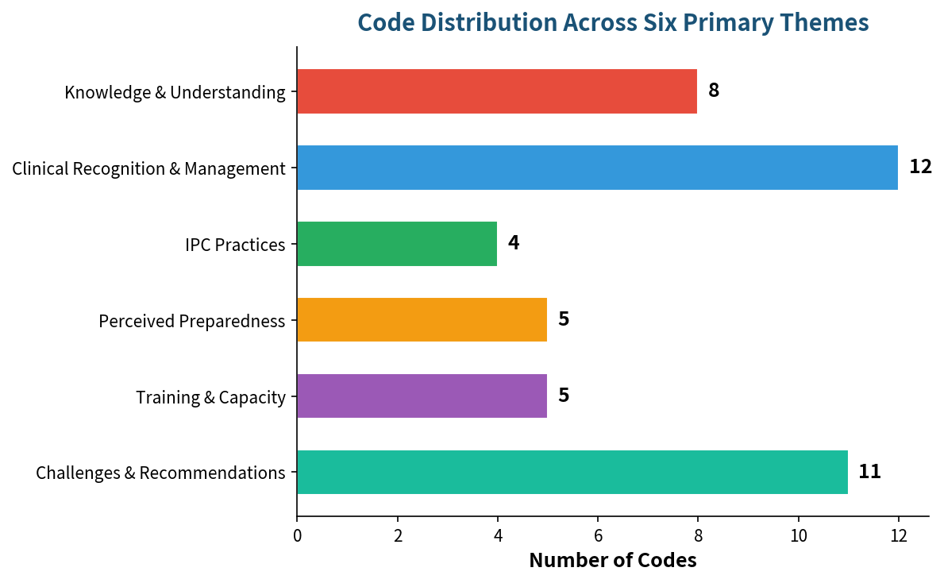
Results: Overview of Themes
Six primary themes generated (45 codes → 13 sub-themes)
1. Knowledge & Understanding of EVD
2. Clinical Recognition, Diagnosis & Case Management
3. Infection Prevention & Control (IPC) Practices
4. Perceived Preparedness & Risk Assessment
5. Training, Capacity Building & Information Sources
6. Challenges, Barriers & Recommendations
Themes aligned with study objectives and supported by anonymised verbatim quotations
www.kecoa.org
Building Resilient Health Systems for Universal Health Coverage
11

Slide 12
Results: Knowledge & Understanding of EVD
• Most correctly identified EVD as a viral disease transmitted by contact with infected body fluids, contaminated equipment and animals
• Endemic zones correctly named: DRC, Uganda, West Africa; travel history recognised as key risk factor
• Gaps:
– No participant named specific ebolavirus species (Zaire, Sudan, Bundibugyo)
– One clear misconception that EVD is airborne
• Knowledge level: foundational but incomplete for safe outbreak response
www.kecoa.org
Building Resilient Health Systems for Universal Health Coverage
12

Slide 13
Results: Clinical Recognition & Case Management
• Early non-specific symptoms (fever, headache, malaise, diarrhoea, vomiting) and late haemorrhage widely recognised
• Travel & contact history identified as primary diagnostic clues
• Laboratory confirmation (PCR / government lab) mentioned
• Diagnostic challenge: overlap with malaria and gastritis acknowledged
• Core management steps described: immediate isolation, notification of County ER/surveillance team, supportive care, contact tracing
• Confidence higher for identification than for full case management
www.kecoa.org
Building Resilient Health Systems for Universal Health Coverage
13

Slide 14
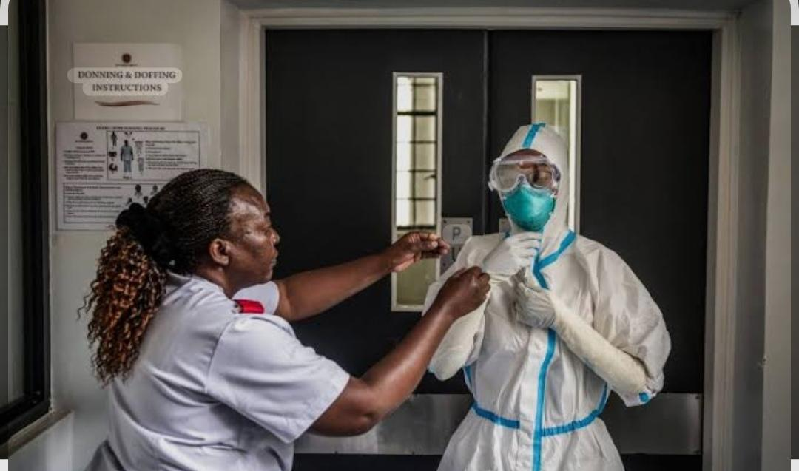
Results: Infection Prevention & Control Practices
• PPE: Widespread uncertainty or confirmed inadequacy of EVD-specific PPE
• Isolation: No dedicated isolation ward at facility; county isolation centre referenced for referral
• Triage: Described as unready and requiring significant improvement
• Hand hygiene & environmental cleaning mentioned but secondary to structural gaps
• Facility-level IPC infrastructure is the most critical deficit undermining safe response
www.kecoa.org
Building Resilient Health Systems for Universal Health Coverage
14

Slide 15
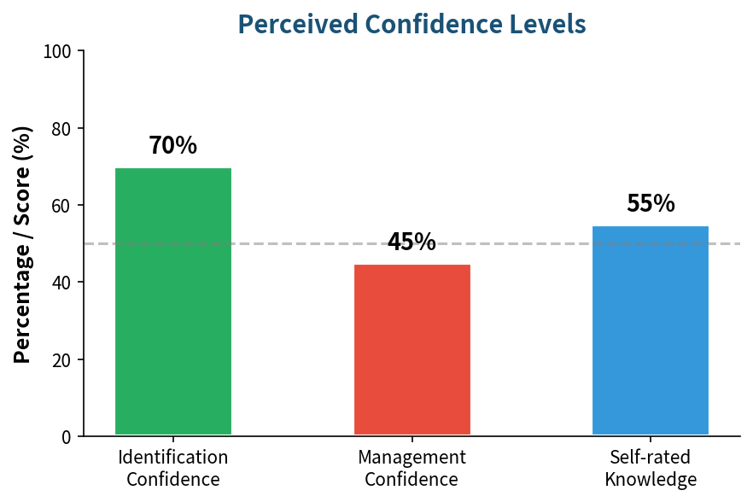
Results: Perceived Preparedness & Risk Assessment
• Self-rated knowledge clustered at 40–70% (commonly 4–7/10)
• Identification confidence higher (~70%) than management confidence (<50%)
• Facility preparedness judged inadequate for both identification and especially management
• Near-unanimous high concern about importation risk linked to highway corridor and truck-driver traffic from endemic areas
• Occupational risk perception high; structural gaps systematically lower self-efficacy
www.kecoa.org
Building Resilient Health Systems for Universal Health Coverage
15

Slide 16
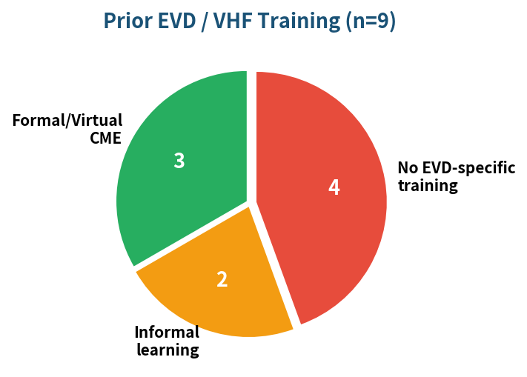
Results: Training, Capacity Building & Information
• Formal structured EVD training limited; several reported only virtual CME/sensitisation or none
• No participant reported attending EVD-specific simulation drills
• Information sources predominantly informal: media, social media, colleagues, posters
• Formal sources (facility briefings, webinars) less frequent
• Participants recognised that current information is insufficient for confident diagnosis and management
www.kecoa.org
Building Resilient Health Systems for Universal Health Coverage
16

Slide 17
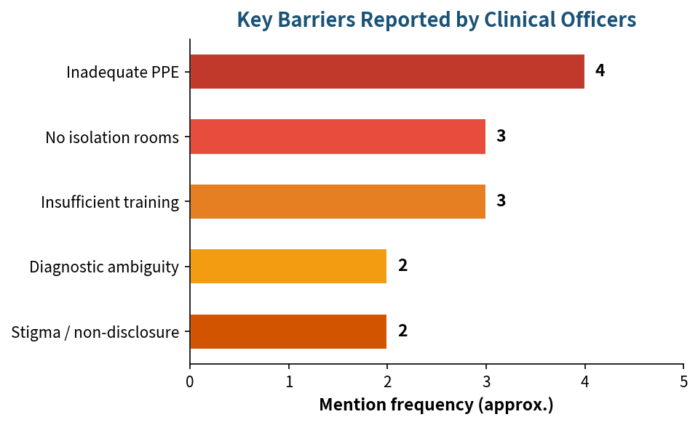
Results: Challenges, Barriers & Recommendations
Key Barriers
• Inadequate PPE and related supplies
• Absent isolation rooms & limited diagnostic capacity
• Insufficient training, knowledge gaps and specialist shortage
• Diagnostic ambiguity of early symptoms
• Stigma / non-disclosure (especially among truck drivers)
Main Recommendations
• Expanded, structured EVD training & CMEs for all cadres
• Reliable PPE stocks and dedicated isolation infrastructure
• Strengthened triage, surveillance and notification pathways
• Multisectoral policy alignment drawing on COVID-19 lessons
• Research and vaccine development for high-risk groups
www.kecoa.org
Building Resilient Health Systems for Universal Health Coverage
17

Slide 18
Discussion
• Findings consistent with regional literature: foundational knowledge exists but practical and structural gaps dominate (Uganda, Nigeria, Somalia, DRC studies)
• Socioeconomic Theory: knowledge alone is insufficient; enabling conditions (training, PPE, isolation, systems) are required to translate knowledge into confident action
• Health-system resilience lens: Burnt Forest represents a “high-risk, low-resilience” inland corridor facility
• Gap between identification confidence and management confidence illustrates that clinicians trust their diagnostic skills more than the systems in which they would operate
• Risk awareness is high; institutional readiness has not kept pace
www.kecoa.org
Building Resilient Health Systems for Universal Health Coverage
18

Slide 19
Conclusion & Key Recommendations
Conclusion
Clinical Officers possess foundational theoretical knowledge of EVD but face substantial practical and facility-level gaps in PPE, isolation capacity, training and response systems. Perceived preparedness is moderate to low while occupational and importation risk perception is high.
Priority Recommendations
• Facility: EVD preparedness audit, dedicated committee, fortnite simulation drills, clear patient-flow protocols
• County: Operational isolation centre, EVD-specific PPE packs, supportive supervisory visits
• National: Institutionalise EVD preparedness in routine health-system strengthening, curriculum and accreditation standards
• Training: Competency-based modules with practical simulation for boh priae and public hopitals
www.kecoa.org
Building Resilient Health Systems for Universal Health Coverage
19

Slide 20
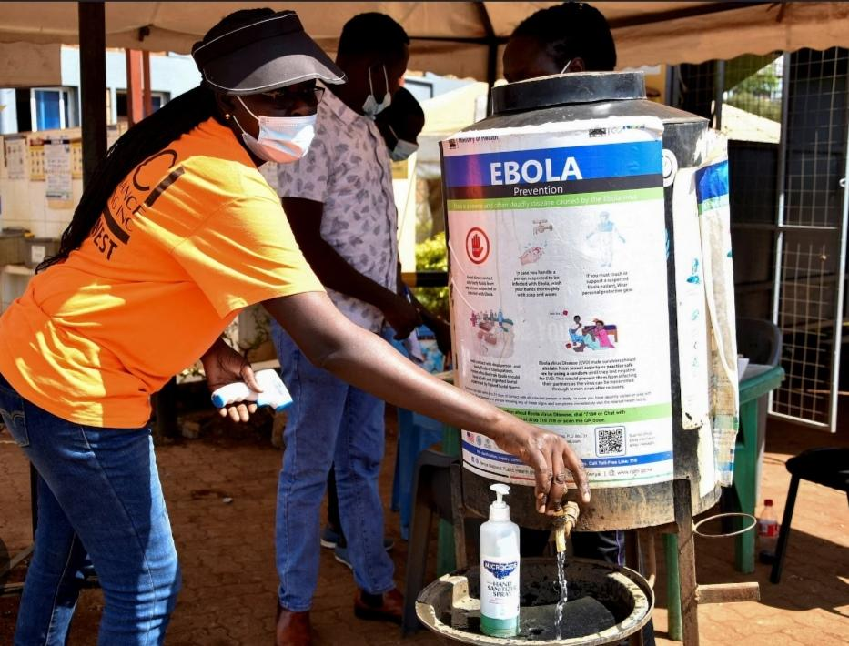
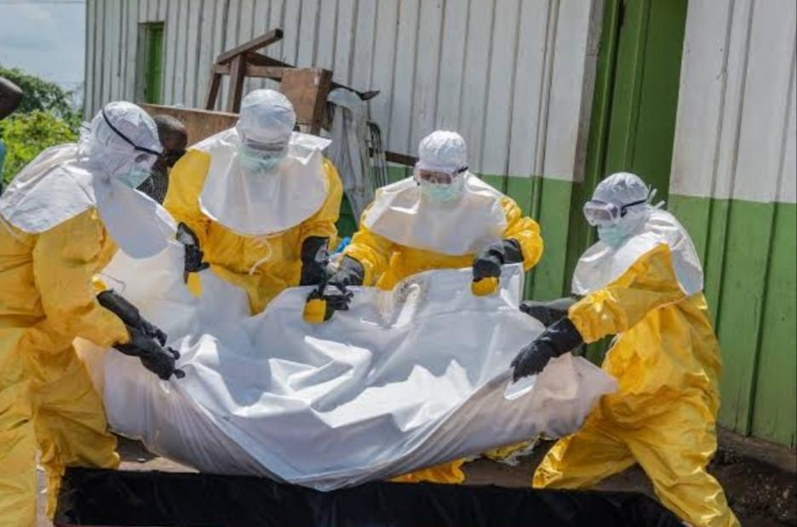
EVD Preparedness in Action
Community hand-hygiene & EVD prevention messaging
Safe & dignified burial practices in full PPE
www.kecoa.org
Building Resilient Health Systems for Universal Health Coverage
20

Slide 21

Thank You
Kenya Clinical Officers’ Association
28th Annual Scientific Conference 2026
www.kecoa.org
Building Resilient Health Systems
for Universal Health Coverage

