Slide 1


KENYA CLINICAL OFFICERS’ ASSOCIATION
28th Annual Scientific
Conference 2026
CONFERENCE THEME
Building Resilient Health Systems
for Universal Health Coverage
MEDHIST : AI POWERED CLINICAL SIMULATION FOR EQUITABLE MEDICAL EDUCATION
Angel Cephas . Ann Wangari | KMTC HOMABAY
www.kecoa.org

Slide 2


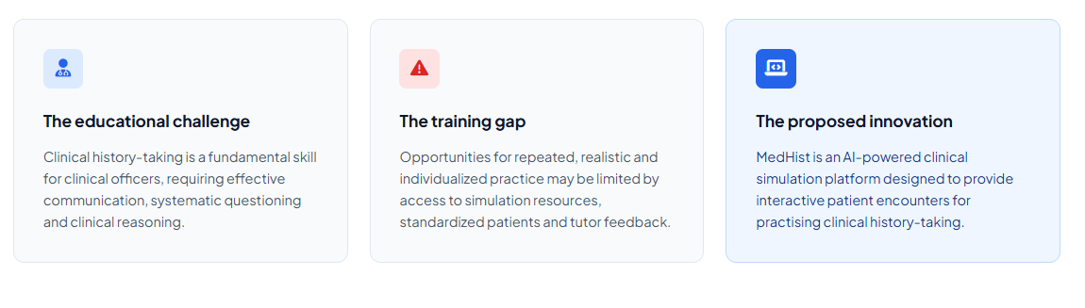
Background / Introduction
www.kecoa.org
Building Resilient Health Systems for Universal Health Coverage
3

Slide 3
Clinical Training Gap
Students | Tutors
Limited opportunities for repeated history-taking practice | High student-to-preceptor ratios
Limited exposure to varied patient cases | Limited time for individual supervision
Little immediate, structured feedback | Difficult to monitor every student's progress
Confidence may lag behind theoretical knowledge | Repetitive assessment and feedback increases workload
Students need more practice. Tutors need better ways to support and monitor that practice.
www.kecoa.org
Building Resilient Health Systems for Universal Health Coverage
4

Slide 4
Objectives
Medhist : Practice. Feedback. Progress
STUDENT
Practice → Evaluation → Feedback → Improvement
INTERGRATED TUTOR PORTAL
Monitor students, assign cases, and track progress.
www.kecoa.org
Building Resilient Health Systems for Universal Health Coverage
4

Slide 5
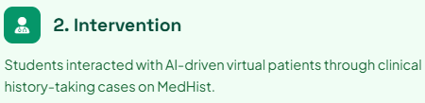
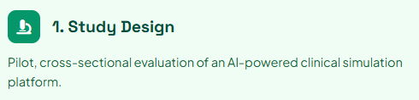
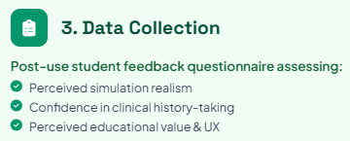
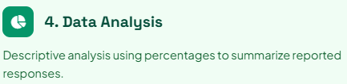
Methods
www.kecoa.org
Building Resilient Health Systems for Universal Health Coverage
5

Slide 6
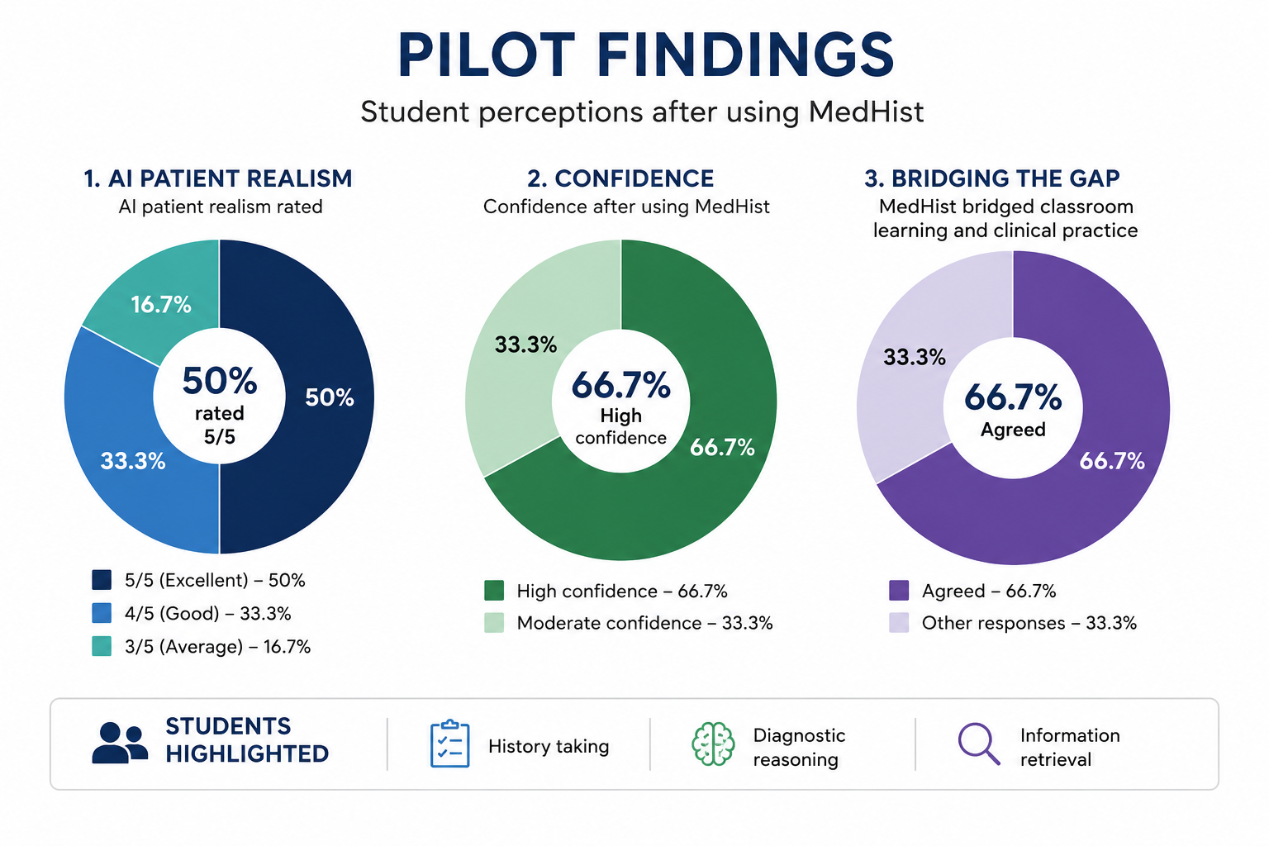
Results
www.kecoa.org
Building Resilient Health Systems for Universal Health Coverage
6

Slide 7
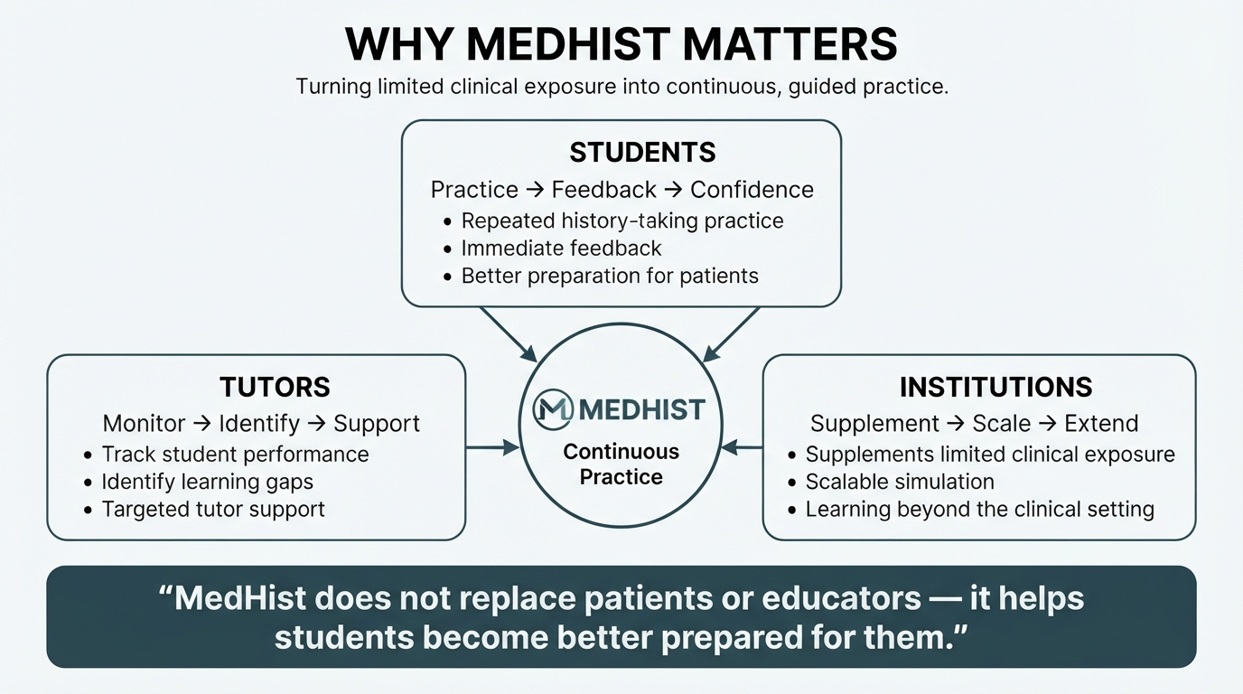
www.kecoa.org
Building Resilient Health Systems for Universal Health Coverage
4

Slide 8
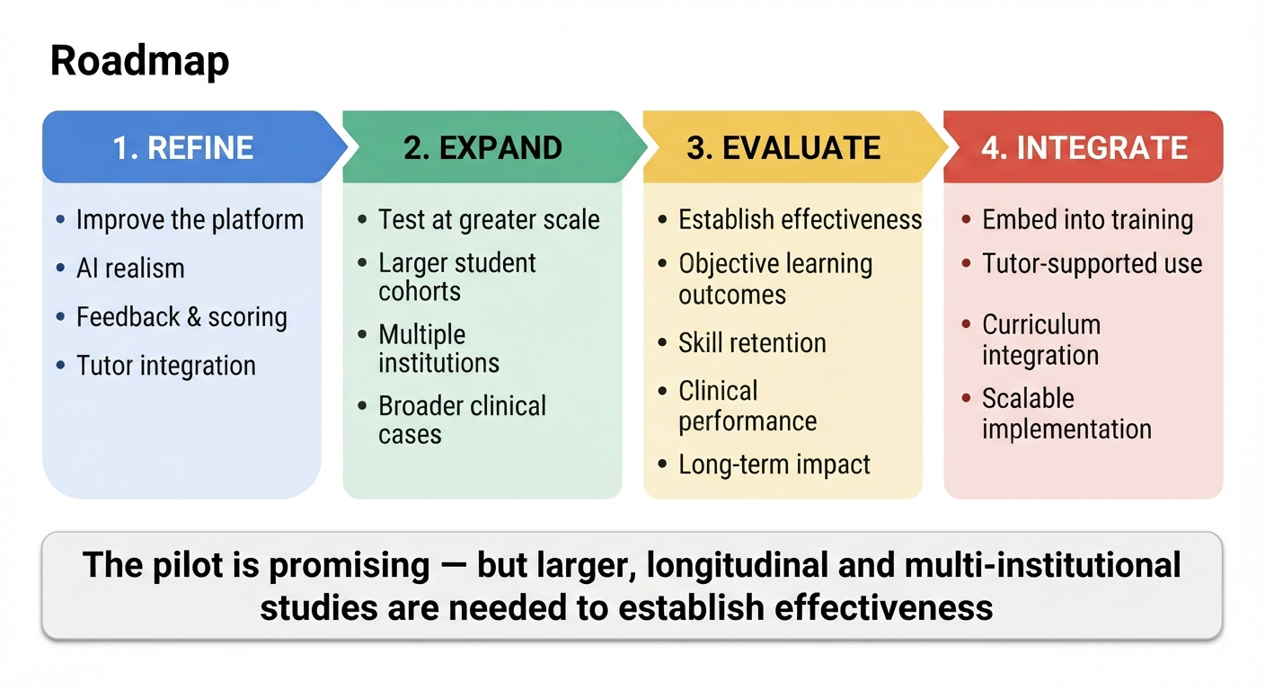
Discussion & Conclusion
www.kecoa.org
Building Resilient Health Systems for Universal Health Coverage
7

Slide 9

Medhist
Thank You
Kenya Clinical Officers’ Association
28th Annual Scientific Conference 2026
www.kecoa.org
Building Resilient Health Systems
for Universal Health Coverage

