Slide 1

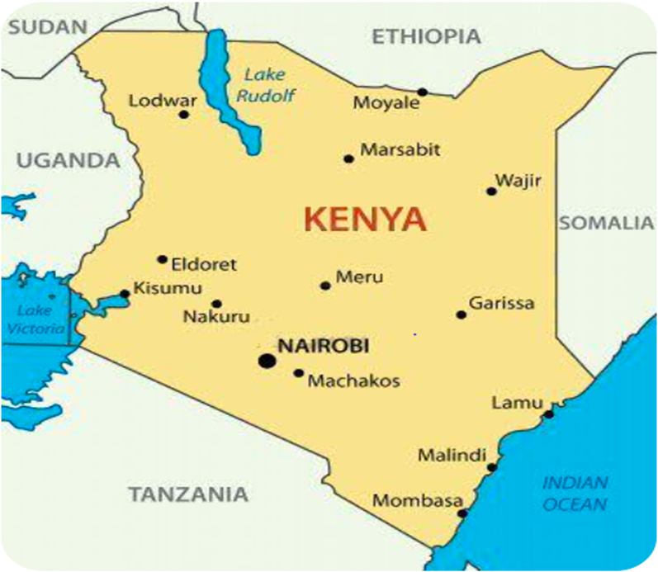
KENYA CLINICAL OFFICERS’ ASSOCIATION | 28TH ANNUAL SCIENTIFIC CONFERENCE 2026
Assessment of Contact Management uptake, and its contribution to active TB case finding and outcomes in Machakos County
Johannes Ndambuki •Dept. of Medical Services, Ministry of Health, Machakos County, Kenya
Building Resilient Health Systems for Universal Health Coverage
BACKGROUND
RESULTS
DISCUSSION
Contact management plays a key role in detection and preventing progression of latent TB to active TB disease. It is estimated that a quarter of the world is latently infected and about 10 per cent of them are likely to progress to TB disease.
Total screened contacts 3684
(86%)
Asymptomatic
3540 (82%)
Symptomatic contacts 757 (18%)
Proportion with line listed contacts 4297 (1:1.3)
Total BC Patients 3188
Put on TPT 3006
85%
Investigation outcome
No TB 665 (88%)
DSTB 92 (12%)
Males contacts and those living with HIV were more likely to experience unfavourable outcomes (p < 0.05).
HIV-positive contacts were significantly more likely to have unfavourable outcomes (AOR 1.80; 95% CI 1.20–2.70).
Male contacts had higher odds of unfavourable outcomes (AOR 1.45; 95% CI 1.05–2.01)
OBJECTIVES
All DST put on Treatment
TPT completion-98%
To assess the uptake of contact management amongst bacteriologically confirmed index TB cases, its yield on active case finding and TPT outcomes in Machakos County.
CONCLUSION
Of 3188 bacteriologically confirmed TB cases, 4297 contacts were documented. 56% were aged 30 years and below. 590 (14%) had a documented HIV status with 11 (0.3%) confirmed HIV Positive
Scaling up contacts management will be key in identifying new TB cases early and prevent disease transmission. The contacts index case ratio was below the set national target of > 3:1 and hence the county should aim at over 90 percent TPT initiation among contacts.
METHODS
Study design:
Descriptive retrospective study
Bivariate and multivariable analysis was done to identify factors associated with TPT uptake and outcomes
Setting:
Machakos county: 178 TB treatment sites
Study population and period:
All contacts of bacteriologically confirmed index TB cases (1st Jan 2024- 31st Dec 2025)
Data sources
Patients log books, registers and TIBU
IMPLICATIONS
Reduction in community TB spread due to early identification of presumptives
strengthen health systems to ensure availability and accessibility of diagnostic services for LTBI treatment and care
Among 4297 contacts, 3684 (90%) were screened for tuberculosis. 757 (18%) contacts were symptomatic with 92 (2%) diagnosed with TB started on treatment. 3006 (73%) of the contacts were initiated on TPT with majority 48% started on 3HP regimen
REFERENCES & CONTACT
Email: johannes.ndambuki@gmail.com
Tel: +254720787345
28–30 OCTOBER 2026 • PRIDEINN PARADISE, SHANZU, MOMBASA
www.kecoa.org

