Slide 1

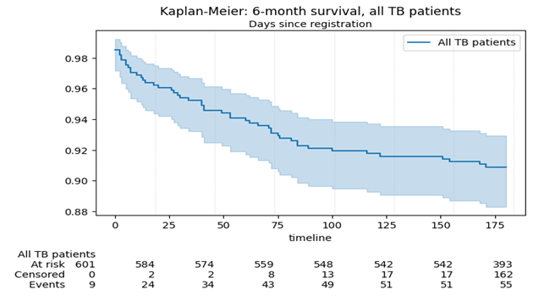
Tuberculosis (TB) death remains a significant barrier to the “End TB strategy targets.
Mortality rate in Kenya 6% (2021)
Kathiani SC 9.5% (2021)
KENYA CLINICAL OFFICERS’ ASSOCIATION | 28TH ANNUAL SCIENTIFIC CONFERENCE 2026
Predictors of Tuberculosis (TB) death outcome: A survival analysis of TB patients notified in Kathiani subcounty, Machakos county, Kenya, January 2021-Dec 2023
Eunice Kiilu, J Kimuyu,J Ndambuki) • Kathiani subcounty, Machakos ,, Kenya
Building Resilient Health Systems for Universal Health Coverage
BACKGROUND
RESULTS
DISCUSSION
Tuberculosis (TB) death remains a significant barrier to the “End TB strategy targets.
Mortality rate in Kenya 6% (2021)
Kathiani SC 9.5% (2021)
T
Kathiani subcounty mortality exceeds national average highlighting local challenges.
Majority of the deaths occurring during the intensive phase
Specific subgroups experience higher mortality (HIV + ve, with comorbidities)
OBJECTIVES
To determine the survival rates and predictors of death among TB patients notified in Kathiani subcounty
ADD YOUR CHART, TABLE,
PHOTO, OR VISUAL RESULT
CONCLUSION
Risk of TB-related death remains high attributable to HIV infection, comorbidities and type of TB.
METHODS
Baseline characteristics
Male 444(73%)
median age 35yrs IQR (27-45)
Bacteriologically confirmed 40 (66%)
TB/HIV co infection 120 (20%)
Pulmonary TB 531(87%)
Undernutrition 385(63%)
comorbidities 273(46%)
Outcome summary
Deaths during the period 58(9.8%)
6month survival probability 0.909
Extrapulmonary TB had lower survival probabilities 0.819
Significant predictors (Multivariate analysis)
HIV positive status a HR 3.05 (CI 1.78-5.21)
Presence of comorbidities a HR 2.82 (CI 1.40-5.71)
[Key references • Contact email / QR code]
Retrospective cohort study .
Data were extracted from the TIBU patient management system.
Key Analysis
Kaplan Meier....Survival probabilities
Log rank test…assessed differences between groups
Cox proportional hazard model… predictors related to TB death
IMPLICATIONS
Need for integrated patient centered TB and Lung health care
Strengthen TB/HIV joint services
Improve management of chronic conditions
Establish high risk clinics, mentorship and enhanced community health education.
Adapt each patient is unique care model as opposed to traditional one size fits all programmatic issues
28–30 OCTOBER 2026 • PRIDEINN PARADISE, SHANZU, MOMBASA
www.kecoa.org

