Slide 1


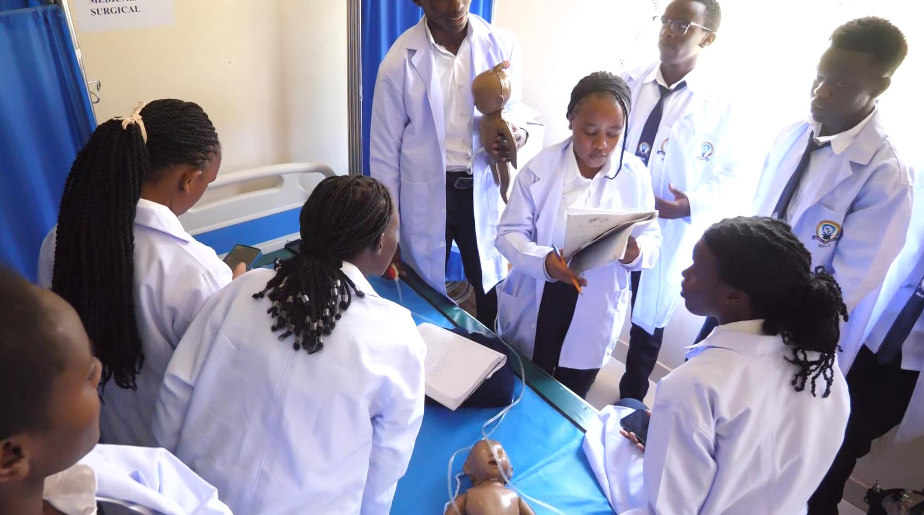
KCOA 2026 • PECHAKUCHA 20×20
IMPLEMENTATION OF DIPLOMA CLINICAL MEDICINE CURRICULUM IN MEDICAL TRAINING INSTITUTIONS IN KERICHO COUNTY, KENYA
PRESENTER: ANDREW KIPYEGON KIRUI
M.Sc. Medical edu.(HPE) - MMUST
Bsc-Clin.Med-UOK
Dip- Clin med- Moshi ,TZ
SUPERVISORS: PROF GLADYS MENGICH (Phd)
DR DAVID KANIARU (Phd)
KCOA CONFERENCE PRESENTATION ,2026
28/10/2026
VENUE:PRIDE INN TICC, SHANZU.
01

Slide 2


Introduction
.
CURRICULUM
(Young, 2014).
Structured framework
Guiding teaching and learning processes
CURRICULUM IMPLEMENTATION
(Smith, 2021).
Curriculum design
Stakeholder involvement
-Tutors
-Students
-Administrators
Dip clin. Med curriculum
EFFECTIVE CURRICULUM IMPLEMENTATION
Content
Pedagogy
Assesments
Evaluation
Reporting
KCOA 2026 • PECHAKUCHA
02

Slide 3
Background of Study
Globally- China
Gaps in clinical training
And interdisciplinary approaches
(432 Medicine graduates) Zhang et,al 2015
CURRICULUM
REPLACE WITH ONE STRONG IMAGE
Regionally- LMIC’S- ( Tanzania)
Challenges in curriculum management and supervision
Smith J.A 2021
CURRICULUM IMPLEMENTATION
EFFECTIVE CURRICULUM
Locally-In Kenya
Still Existing Challenges in
Competency based medical education(Seritan et al., 2024)
03

Slide 4
Problem Statement of Study
Problem Statement of Study
Challenges in Competency-Based Curriculum Implementation
Inadequate resources: Limited infrastructure, teaching materials, clinical exposure, and qualified instructors (Kimura et al., 2016).
Weak collaboration: Poor coordination among training institutions, healthcare facilities, and government agencies in Kericho County (Kericho County Health Department, 2022).
Research gap: Limited local evidence comparing curriculum implementation challenges in public and private institutions.
Study motivation: To investigate these challenges and address the existing evidence gap.
KCOA 2026 • PECHAKUCHA
04

Slide 5



Research Objectives
Main objective:
To evaluate implementation of clinical medicine curriculum in medical training institutions in Kericho county
Objective one
To determine the process of implementation of clinical medicine curriculum in medical training institutions in Kericho County, Kenya
Objective Two
To determine institutional compliance towards implementation of diploma clinical medicine curriculum as per regulator standards (COC
Objective three
To determine the students and tutor’s perceptions towards curriculum implementation in medical training institutions in Kericho County, Kenya
KCOA 2026 • PECHAKUCHA
06

Slide 6

Justification of study
Justification: This study addressed gaps in curriculum implementation of clinical medicine that affect the quality of healthcare training in Kenya.
REPLACE WITH ONE STR IMAGE
Significance
Improves training
quality
Helps policymakers
Supports Universal Health Coverage (UHC)
07
Ref : Assesment by MOH and Capacity Kenya 2011. MOH and intra health 2014
KCOA 2026 • PECHAKUCHA

Slide 7
CONCEPTUAL & THEORETICAL FRAMEWORK
INDEPENDENT VARIABLES
INTERVENING VARIABLES
DEPENDENT VARIABLES
Implementation process
Implementation strategies
Clarity of curriculum guidelines
Flexibility of curriculum adaptation
Institutional factors e.g infrastructure
Theoretical Framework
The study was based on the Diffusion of Innovations Theory by Everett Rogers, Dearing et., al (2018).
It explains how new ideas and practices are adopted within institutions.
Helps analyze how curriculum changes are implemented in medical training institutions.
Quality of clinical medicine curriculum implementation
Effectiveness
Level of compliance
Perceptions towards curriculum
Regulator standards (COC)
Specific compliance requirements
Institutional capacity, Qualified staff and administrative policies
Management's support for compliance
Perception, Participant role, and background factors
Confidence in curriculum implementation
Experience with curriculum implementation
Communication and feedback mechanisms
Gender
Age
Environmental Factors
Key
Studied variable
Non-Studied variable
Researcher, 2025
08
KCOA 2026 • PECHAKUCHA

Slide 8

]
Sample size determination
The Sample Size was Determined By The Use Of Taro Yamane Formula (1967) Where
n=N/(1+n(e⁾²)
n=signifies The Sample Size
N= Signifies The Population Under Study= 448 Participants
‘E’= Signifies The Margin Error (It Could Be 0.10, 0.05 Or 0.01)
Campuses | Number of respondents- N |  | Sample size- n
University of Kabianga | Students | 148 | 69
 | Tutors | 12 | 11
Kapkatet MTC | Students | 150 | 71
 | Tutors | 9 | 8
Litein MTC | Students | 150 | 71
 | Tutors | 8 | 7
Total | Students | 448 | 211
Total | Tutors | 29 | 29
KCOA 2026 • PECHAKUCHA
10

Slide 9
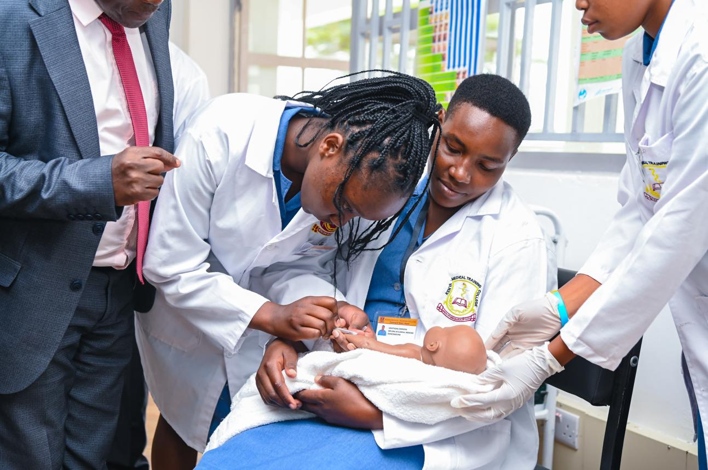
CRITERION
2. Inclusion criteria
Tutors in the Clinical Medicine Department.
Students undertaking Clinical Medicine.
3. Exclusion criteria
Individuals who were not clinical medicine tutors or did not work in the department.
Students not undertaking Clinical Medicine or who had deferred their studies.
1. Sampling methods
Purposive sampling: Clinical medicine tutors from three medical training institutions (Thomas, 2022).
Random sampling: Clinical medicine students selected across their years of study (Noor et al., 2022) and from their respective stratas.
KCOA 2026 • PECHAKUCHA
11

Slide 10
Study site and Pilot study
Study Area: Medical Training institutions in Kericho county- University of Kabianga, Kapkatet MTC and Litein mission hospital.
Study Design: Descriptive cross-sectional Design.
Pilot study was Conducted at Bomet KMTC.
Findings: the three variables were positively and significantly correlated with a number of setbacks primarily on perception of students taught by unqualified personnel.
Reliability of instruments: A test-retest method was used to ensure that the instruments was reliable.
Validity: Content, construct, internal and external validity of the questionnaire was determined through a pilot study;
its faced validity was assured to experts' judgment in school of public health, biomedical sciences and technology also working closely with the supervisors.

Slide 11
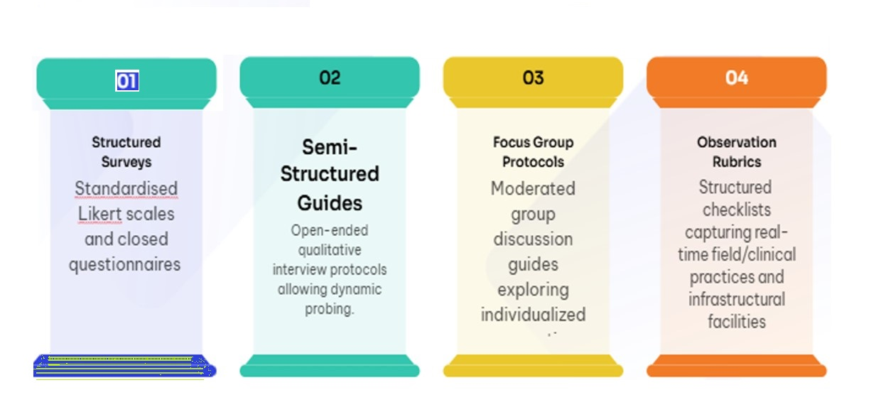
Data Collection Tools/Analysis
Verbatim responses obtained from institutional heads (Source: Interview Transcripts, Mtc Kco 02, 2025), (source: interview transcripts, mtc kco 01, 2025) and
Transcribed responses from student participants (source: interview transcripts, MTC KCO 03, 2025)
Qualitative data: obtained from observation checklists. scheduled interviews and foussed group disussions.
12
KCOA 2026 • PECHAKUCHA

Slide 12
Ethical consideration and approval
Approval of research proposal was sought from Masinde Muliro University of Science And Technology post graduate office -ISREC.
Management of the three medical training institutions.
Research permit- NACOSTI obtained.
Participants privacy and confidentiality was upheld throughout the entire study.
KCOA 2026 • PECHAKUCHA
13

Slide 13
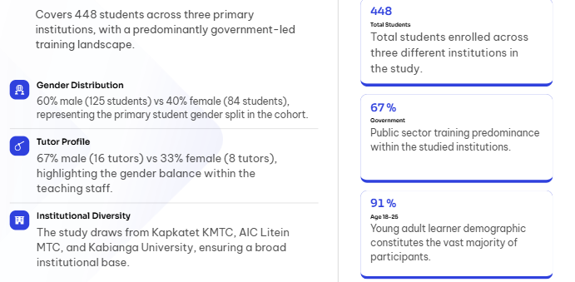
Socio-demographic Profile
KCOA 2026 • PECHAKUCHA
17

Slide 14
RESULTS
S/No | Variables | Test Method | Tested Values | Critical Value
1 | The process involved in curriculum implementation | Chi-square | x²=81.36 | 26.30
2 | Compliance to COC regulation | Correlation coefficient | r=0.83 | 1.00
3 | The Tutors and students’ perceptions | Chi-square | x²=213.5 | 36.42
KCOA 2026 • PECHAKUCHA
14

Slide 15
Objective 1
The process of implementation of clinical medicine curriculum in medical training institutions .
Study findings- Positive and significant correlation between the process and curriculum implementation.
Chi-square analysis- underscored a significant divergence in perceptions which were not uniformly distributed across different aspects of the program.
χ² value of 81.36, exceeded critical value
critical value of 26.30
significance level -5% , 0.05

Slide 16
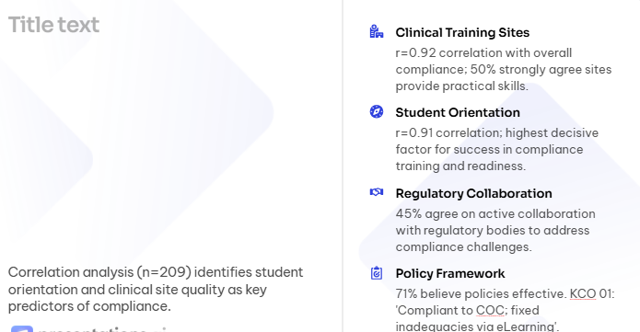

Objective 2
Compliance To COC Regulatory Standards
KCOA 2026 • PECHAKUCHA
18

Slide 17

Objective three
c)The students and tutor’s perceptions towards curriculum implementation in medical training institutions in Kericho .
Study findings- Positive and strong correlation between perception and curriculum implementation .
Chi-square analysis- There was significant differences across various curriculum aspects. The high total χ² value (213.5) far exceeds the critical value (36.42), and the p-value is less than 0.001.
This indicates that perceptions are not uniform but vary markedly among different components such as trainer training, clinical supervision, resources, and monitoring.

Slide 18
CONCLUSION
Curriculum implementation is moderately effective but limited by inadequate staffing, insufficient infrastructure, and limited clinical exposure opportunities.-in tandem with Kimura et,.al 2016 findings.
There’s Contravention of CMTA 2021- regulation 8(1)
-Lack of use of BSc trained tutors- majority were diploma holders.
-Skills lab and classroom recommended capacities was exceeded.
Recommended : Skill lab-1:15
Classroom-1:25 as opposed to a finding of 1:50
There is still utilization of Part timing lecturers and e learning platforms to bridge gap in tutor shortage,while other groups of student‘s are under supervision in their clinical sites by interdisciplinary teams.

Slide 19
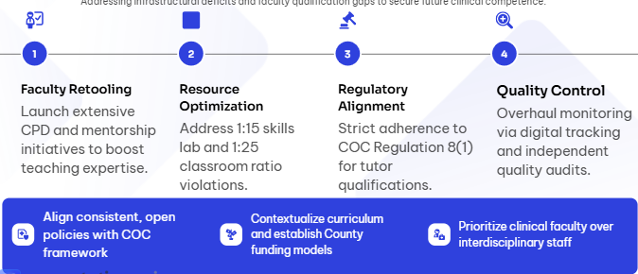
Recommendation
KCOA 2026 • PECHAKUCHA
19

Slide 20

In conclusion, successful curriculum implementation requires effective planning, adequate teaching and learning resources, competent teachers, and support from all stakeholders. Teachers play a key role in translating the curriculum into meaningful learning experiences for learners. Regular assessment, monitoring, and evaluation are also essential to identify challenges and improve learning outcomes.
Thank you for your attention.
20

