Slide 1

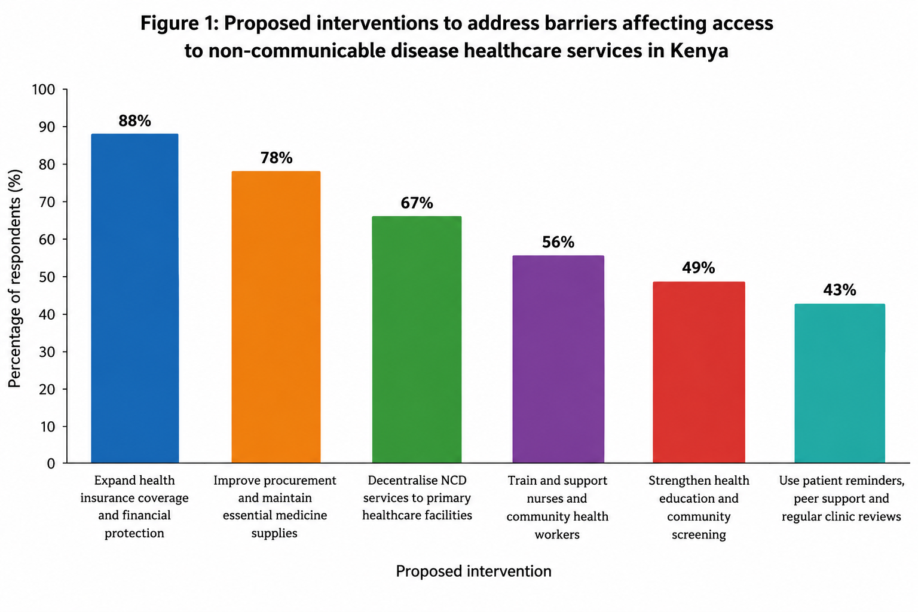
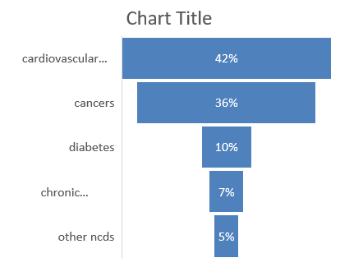
BARRIERS TO CARE AFFECTING CLIENTS WITH NCDS ATTENDING NCD CLINIC AT VIHIGA COUNTY
Author Sophie omutere Degree in clinical medicine and surgery, diploma in clinical medicine and surgery
Affiliations :Vihiga county referral hospital
Background and objective Non communicable diseases including diabetes, cardiovascular diseases and hypertension are increasingly contributing to morbidity and mortality in Kenya. In vihiga county, the growing burden of ncds poses significant challenges to the healthcare system and the affected individuals
this abstract identifies socio economic, health system, geographical and individual level factors that hinder effective ncd management and access to care
Methods the study was conducted in a form of an oral interview, with the target population of 50, being clients attending ncd clinic between July and September 2025
Background and objectives- noncommunicable diseases including diabetes, cardiovascular diseases and hypertension are increasingly contributing to morbidity and mortality in Kenya. In vihiga county, the growing burden of ncds poses significant challenges to the healthcare system and the affected individuals
this abstract identifies socio economic, health system, geographical and individual level factors that hinder effective ncd management and access to care
Methods the study was conducted in a form of an oral interview, with the target population of 50, being clients attending ncd clinic between July and September 2025
Findings financial constraints including the cost of consultations, medications, increasingly contributing to morbidity to the facility were identified as major obstacles to access to care diagnostic tests, and transport to the facility were identified as major obstacles to access to care
Others included limited availability of essential medicines, inadequate coverage of the services by SHA/SHIF and shortage of trained personnel further compromised service delivery
For the geographical barriers, it was noted that majority of the clients with ncds reside in the rural/ remote areas resulting in long travel distances, increased transport costs leading to missed appointments and poor adherence
Additionally, low levels of health literacy, inadequate skills on ncd management, cultural beliefs and reliance on traditional remedies contribute to delay in health seeking behaviour. Weak referral systems and inconsistencies in follow-up collectively increase the risk of disease complications
Conclusion Addressing these challenges requires strengthening primary healthcare services, improving availability of and affordability of essential medicines, enhancing community awareness, expanding health insurance coverage and investing in health workforce capacity
Targeted interventions aimed at reducing these barriers are essential for improving health outcomes and ensuring equitable access to quality NCD care in vihiga county
Methods
[INSERT GRAPH / FIGURE]
. Study Design
The study adopted a descriptive cross-sectional study design to assess barriers affecting healthcare service delivery among clients with non-communicable diseases (NCDs) attending the NCD clinic between July and September 2025. This design was appropriate because data were collected from clients during a defined period to obtain information about their experiences, challenges and perceptions regarding access to healthcare services. The study focused on identifying financial, geographical, health-system and patient-related barriers to NCD care.
2. Data Collection Methods
Data were collected through oral interviews with clients attending the NCD clinic. The target population was 50 clients during the study period. The interviews sought information on the challenges clients experienced when accessing healthcare services, including the cost of treatment, availability of medicines, waiting time, transport expenses, healthcare worker availability, referral services and adherence to treatment.
The interviewer asked participants questions and recorded their responses for subsequent analysis. Oral interviews enabled participants to explain their experiences in their own words and allowed clarification of questions where necessary.
3. Data Analysis
The collected data were reviewed, organized and analyzed according to the study objectives. Responses from the oral interviews were grouped into common themes representing the barriers affecting healthcare service delivery. These themes included financial constraints, inadequate medicine supplies, shortages of healthcare workers, geographical accessibility, long waiting times, limited patient awareness and challenges with continuity of care.
Where responses were qualitative, thematic analysis was used to identify recurring patterns and similarities in participants' experiences. If numerical information was collected, descriptive statistics such as frequencies and percentages could be used to summarize the findings and present them in tables or charts.
The findings were interpreted in relation to the study objectives and compared with available literature on barriers to NCD care in Kenya and other comparable settings.
4. Ethical Considerations
Participation in the study was voluntary. Participants were informed about the purpose of the interviews, and their consent was obtained before data collection. Confidentiality was maintained by avoiding the disclosure of participants' names or other identifying information in the report. The information collected was used for the intended study purposes, and participants were allowed to decline to answer any question or withdraw from the interview.
5. Study Limitations
The study was limited by its focus on clients attending the NCD clinic, meaning that the experiences of people who did not attend healthcare facilities may not have been captured. The target population of 50 clients and the relatively short study period may also limit the generalisability of the findings. In addition, responses obtained through oral interviews may have been affected by recall bias or participants' reluctance to disclose some experiences. The findings should therefore be interpreted within the context of the study population and setting.
Click to insert chart or image
Introduction
Results
Reduce financial barriers
Strengthen financial protection through SHA, explain available benefits, improve access to affordable medicines and minimise unnecessary out-of-pocket costs.
Improve medicine and equipment availability
Strengthen procurement, stock monitoring and distribution of essential NCD medicines, diagnostic equipment and monitoring supplies.
Strengthen community-based care
Equip community health promoters to provide health education, support screening, follow up missed appointments and refer clients for treatment.
Strengthen primary healthcare and referralqualitative studies may not establish the prevalence of individual barriers, while differences in study populations, health financing arrangements and research methods complicate comparisons.
These limitations highlight the need for a county-specific assessment focusing on clients with NCDs. Such a study should quantify the frequency of financial, geographical, workforce, medicine-supply and referral barriers while exploring the experiences of patients, caregivers and healthcare providers. This would generate locally relevqualitative studies may not establish the prevalence of individual barriers, while differences in study populations, health financing arrangements and research methods complicate comparisons.
These limitations highlight the need for a county-specific assessment focusing on clients with NCDs. Such a study should quantify the frequency of financial, geographical, workforce, medicine-supply and referral barriers while exploring the experiences of patients, caregivers and healthcare providers. This would generate locally relevant evidence to guide targeted interventions, resource allocation and improvements in NCD service delivery in Vihiga County.
ant evidence to guide targeted interventions, resource allocation and improvements in NCD service delivery in Vihiga County.
s
Improve NCD services at dispensaries and health centres, streamline referral pathways and decentralise specialist services where feasible.
Improve awareness and adherence
Conduct community sensitisation, counselling and family education on early screening, lifelong treatment and prevention of complications.
Discussion
Overview
Non-communicable diseases are lifelong diseases that are not transmitted from one person to another
They are a growing public health concern in Kenya causing premature deaths, long term complications with reduced quality of life and increasing healthcare costs
These diseases include cardiovascular diseases, cancers, chronic respiratory diseases and diabetes type 1 and 2
Others include sickle cell disease, congenital disorders, kidney disease and mental health conditions among others
Burden of ncds in Kenya
In Kenya there is an increase morbidity and mortality relating to non communicable diseases with 43% being ncds related mortality with cardiovascular diseases, diabetes and cancers contributing to a significant number of these mortality
Burden of ncds in vihiga
Ncds account for 60% of hospital admissions with an average of 60%of all mortality cases being related directly or indirectly to ncds
Childhood onset ncds also contribute to significant morbidity among children resulting in school absenteeism, disability, frequent hospital visits and failure to thrive
In conclusion for vihiga, priority should be given to early diagnosis, referral and prevention of complications especially for children and young adults
Major barriers to NCD care
A. Financial barriers include
High costs of medicines that mostly are seldom found at the hospital pharmacies with increased of laboratory tests, specialist consultations and diagnostic investigations that are not covered by SHA or are unavailable at the hospital
Transport expenses to hospitals and referral facilities.
Inability to be able to pay for health insurance and out-of-pocket expenditure as most of the households are generally poor
Confusion about health insurance benefits, eligibility and out-of-pocket payments.
B. Health-system barriers
Frequent stock-outs of essential medicines for hypertension, diabetes and other chronic conditions.
Inadequate diagnostic equipment, such as glucometers, blood pressure machines and laboratory testing facilities.
Shortages of trained healthcare workers in NCD diagnosis and management and clinical inertia on the novel treatment for ncds
Long waiting times at outpatient clinics with limited access to specialist services and advanced investigations.
Inadequate patient records, appointment systems and follow-up mechanisms.
Weak referral systems between community units, dispensaries, health centres and referral hospitals.
C. Geographical and transport barriers
Long distances from some rural communities to facilities offering comprehensive NCD services.
High transport costs, particularly for clients who require frequent clinic visits.
Poor road access or limited public transport in some areas.
Difficulties reaching referral facilities for specialist care, cancer services and advanced diagnostics.
D. Patient-related barriers
Limited knowledge of NCD risk factors, symptoms, complications and the importance of early screening.
Failure to attend scheduled appointments.
Poor adherence to medication because of side effects, cost or lack of perceived benefit.
Stopping treatment when symptoms improve or blood pressure and blood sugar readings become normal.
Fear of diagnosis and reluctance to seek screening.
Use of herbal remedies or alternative treatments instead of, or alongside, prescribed treatment without informing healthcare workers.
Others include
Stigma associated with conditions such as epilepsy, cancer, sickle cell disease and mental health conditions.
Beliefs that NCDs are caused by witchcraft or other supernatural factors.
Fear of lifelong medication and possible complications.
Family responsibilities that prevent clients from attending appointments.
Limited family support for older people, children and persons with disabilities.
Dietary and lifestyle practices that make long-term disease management difficult..
The findings on barriers affecting healthcare service delivery for clients with non-communicable diseases in Vihiga County can be compared with previous studies conducted in Kenya and other low-resource settings. The Vihiga County Community Scorecard report by the Institute for Social Accountability (2025) identified medicine stock-outs, inadequate staffing, laboratory delays, insufficient equipment and infrastructural challenges. These findings are consistent with a Kenyan qualitative study on the integrated management of hypertension and type 2 diabetes, which identified medicine unavailability, unaffordability of healthcare services, shortages of skilled personnel and fragmented service delivery as major barriers.
Similarly, a qualitative study on access to hypertension services in rural Coastal Kenya reported financial constraints, limited availability of medicines and diagnostic equipment, long waiting times and difficulties accessing health facilities. International systematic reviews have also identified medicine affordability, availability, socioeconomic status and geographical location as important determinants of access to NCD treatment. The consistency of these findings suggests that barriers to NCD care arise from interacting patient-level, facility-level and broader health-system factors.
Limitations of the study include
qualitative studies may not establish the prevalence of individual barriers, while differences in study populations, health financing arrangements and research methods complicate comparisons.
These limitations highlight the need for a county-specific assessment focusing on clients with NCDs. Such a study should quantify the frequency of financial, geographical, workforce, medicine-supply and referral barriers while exploring the experiences of patients, caregivers and healthcare providers. This would generate locally relevant evidence to guide targeted interventions, resource allocation and improvements in NCD service delivery in Vihiga County.
[Insert chart / dram]
Conclusions
In conclusion
Addressing these challenges requires strengthening primary healthcare services, improving availability of and affordability of essential medicines, enhancing community awareness, expanding health insurance coverage and investing in health workforce capacity
Targeted interventions aimed at reducing these barriers are essential for improving health outcomes and ensuring equitable access to quality NCD care in vihiga county. These include
Reducing financial barriers
Strengthen financial protection through SHA, with expansion of the SHA ncd package to cover the routine tests and basic medication needed by clients with NCDs and explain available benefits, improve access to affordable medicines and minimize unnecessary out-of-pocket costs.
Improve medicine and equipment availability
Strengthen procurement, stock monitoring and distribution of essential NCD medicines, diagnostic equipment and monitoring supplies.
Strengthen community-based care
Equip community health promoters to provide health education, support screening, follow up missed appointments and refer clients for treatment
.
Strengthen primary healthcare and referrals
Improve NCD services at dispensaries and health centers, streamline referral pathways and decentralize specialist services where feasible.
Improve awareness and adherence
Conduct community sensitization, counselling and family education on early screening, lifelong treatment and prevention of complications.
.
Contact
References
Sophie omutere/ vihiga county referral hospital
Email omuteresophy@gmail.com
[0729992810]
Kenya national bureau of statistics-kenya vital statistics report 2024
World health organization- kenya national strategic plan for the prevention and control of ncds 2021/22-2025
County government of vihiga-strengthening referral networks and community-based care for childhood ncds, january2026
Kenya news agency- hypertension emerges as the leading health concern in vihiga, august 2025
World Health Organization — PEN-Plus clinics transform lives of people living with severe NCDs in Kenya, August 2026.

